Slide 1
Aboriginal engagement
A South Okanagan Similkameen Case Study

Slide 2
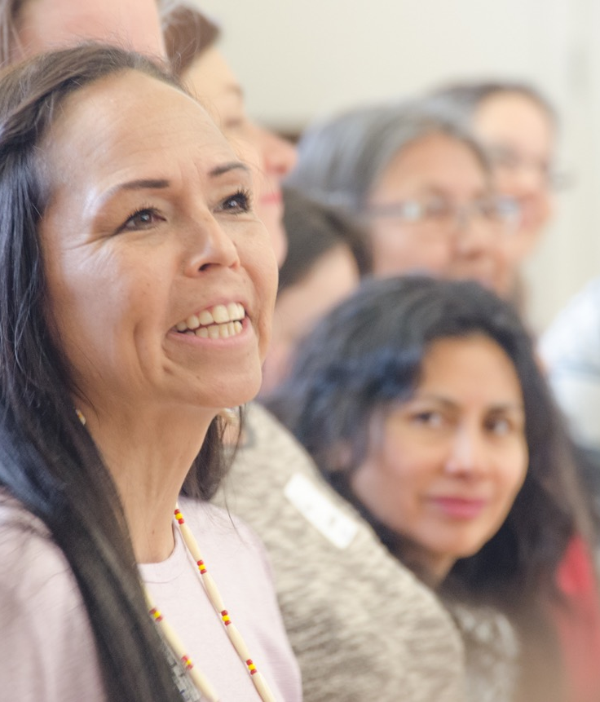

It started with tea …

Slide 3
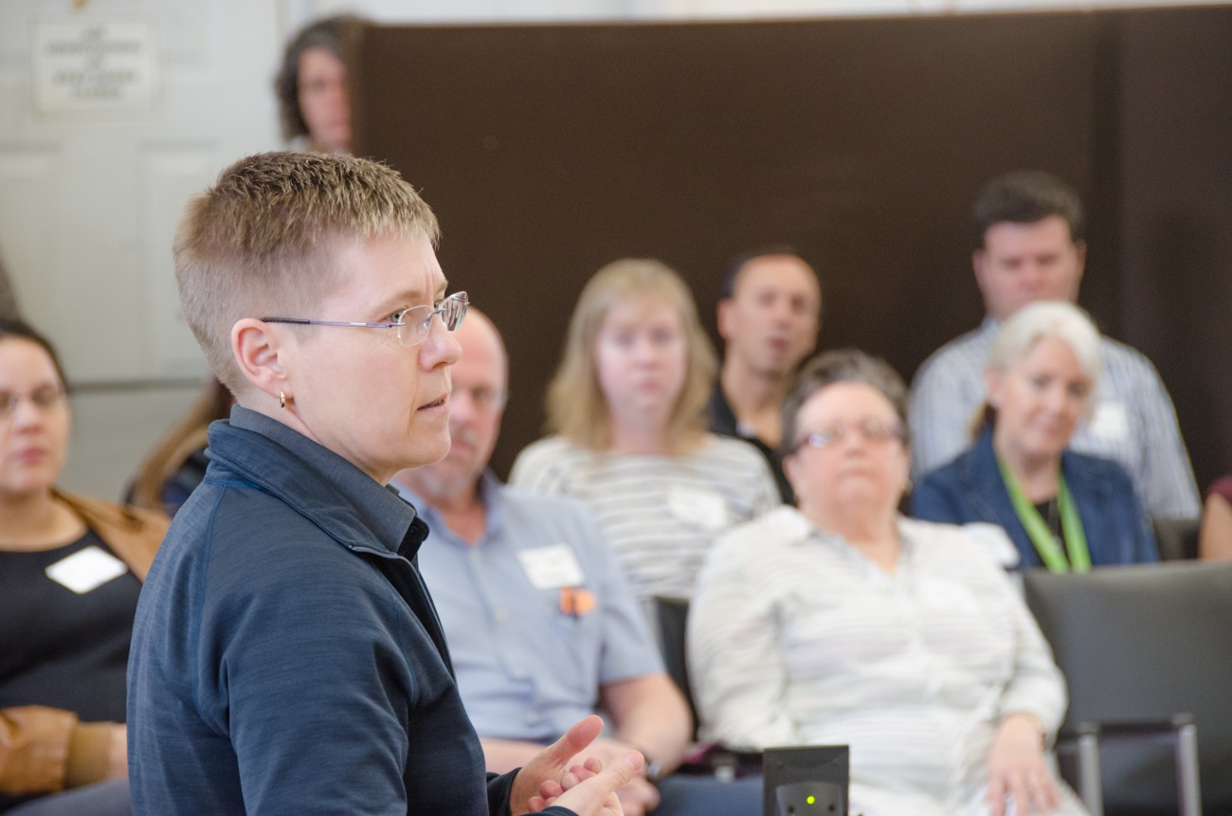
Focused on a mutual fear …

Slide 4
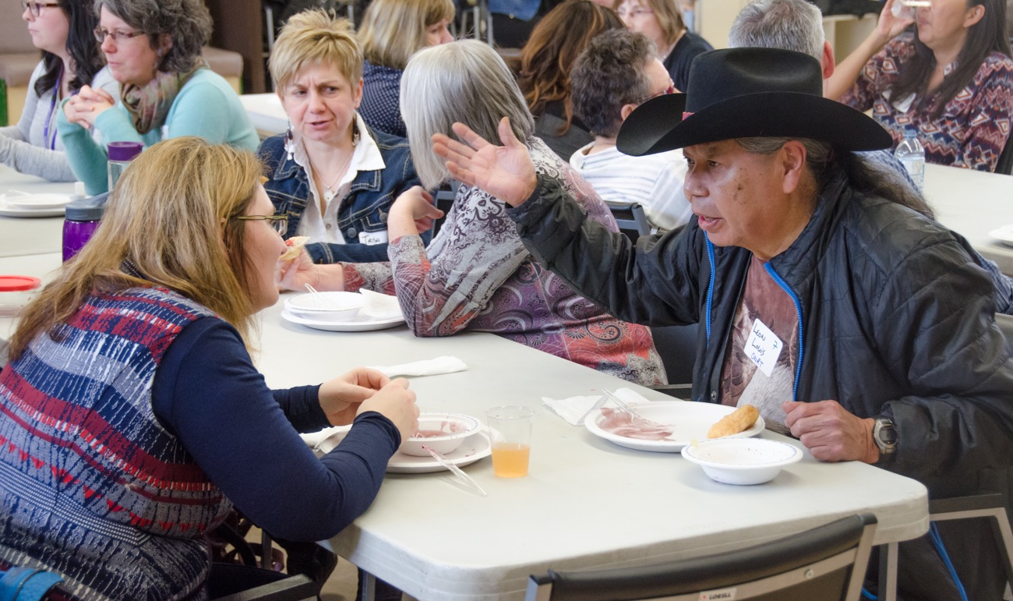
To find practical solutions …

Slide 5
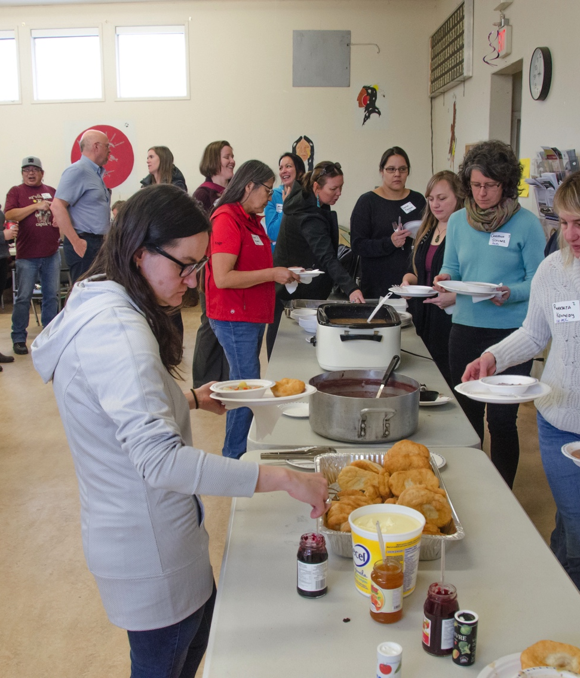
By building an environment of trust …
Always food
Variety of locations
Seeking to understand
Orienting new members at the right time
Space for story telling

Slide 6
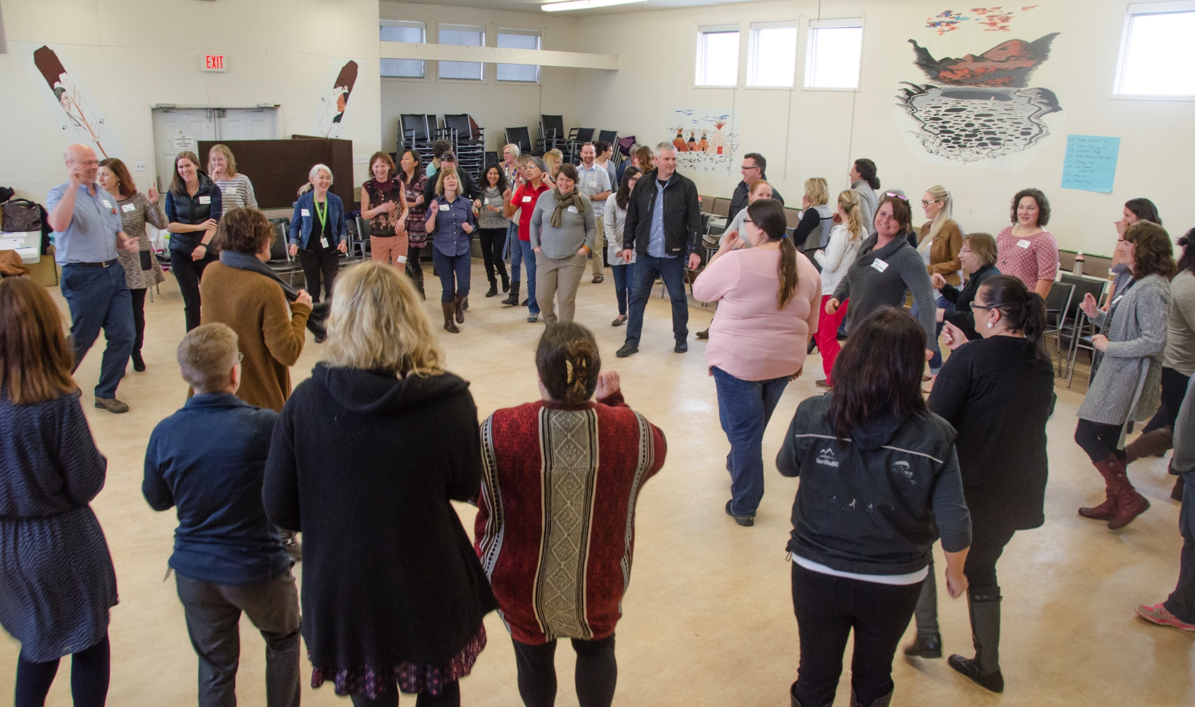
And the results can be magical …

Slide 7
Watch the 10-minute video
Youtube search: pathwaytopartnership 2017
More information: tracy.stclaire@sosdivision.ca

