Slide 1
Case for Hope
Multidisciplinary, Collaborative, Inter-professional Primary Care Model,
From a Rural Perspective

Slide 2
Disclosure
Dr Joshua Greggain BSc MD CCFP
Rural Family Physician, Hope , BC
Site Medical Director, Fraser Canyon Hospital
Medical Director, Hope Medical Centre and the Fraser Canyon Clinic
Lead Physician, Anderson Creek Outreach Clinic
I have no disclosures

Slide 3
Bias
I have no organizational or commercial bias
I do however, believe that Rural Family Medicine in a Collaborative, Multidisciplinary, Inter-Profesional Model
is the most gratifying medicine on the planet,
and everyone should come
to #ruralBC and try it

Slide 4
Hope and the Fraser Canyon

Slide 5
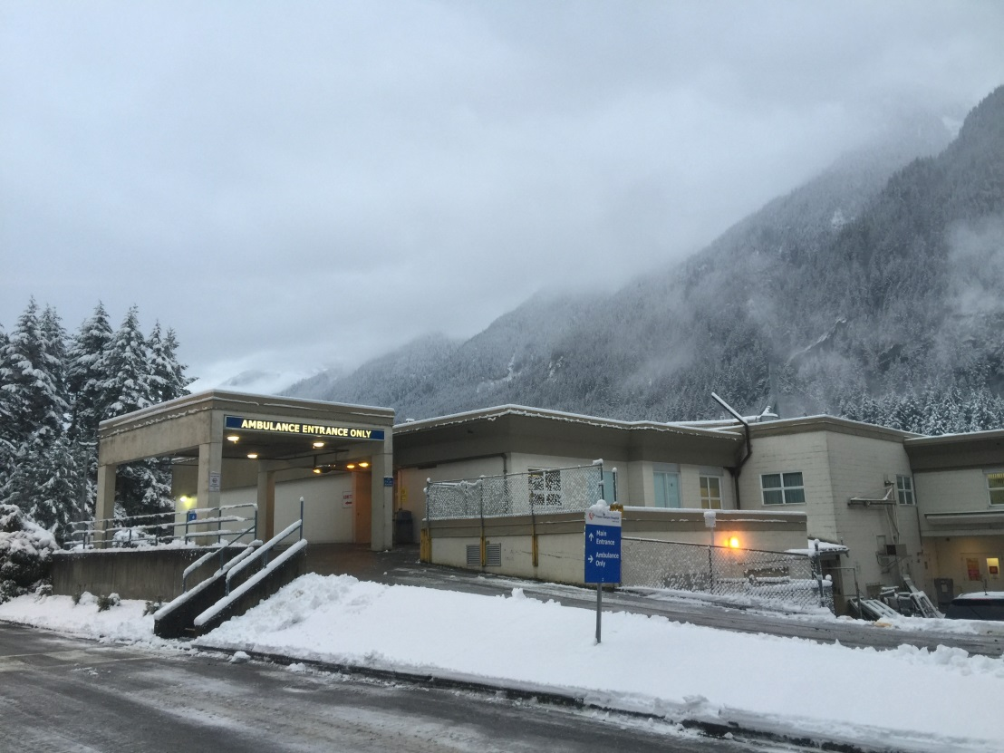
Multidisciplinary

Slide 6
Collaborative

Slide 7
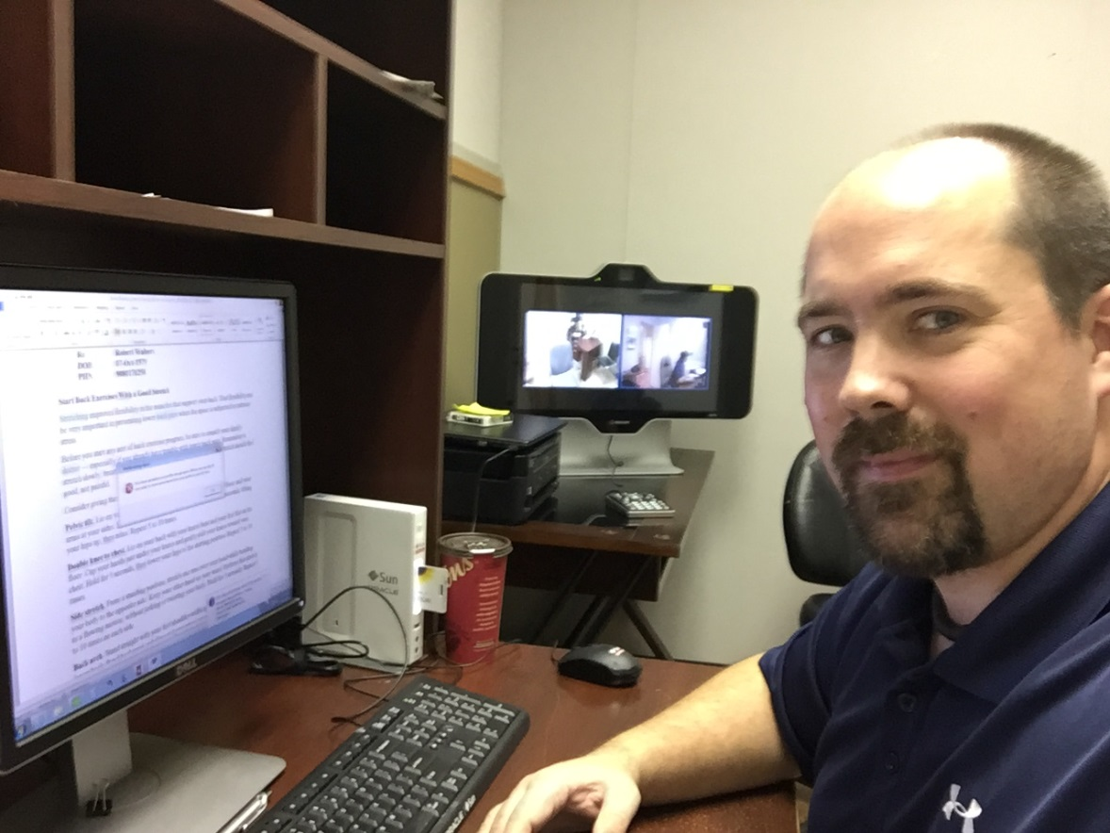
Telehealth

Slide 8
Inter-Professional

Slide 9
Thank you

