Slide 1
The PMH/PCN Journey
in KB’s
Boundary Proof of Concept
Dr. David Merry
Boundary GP
KB Division Board Chair

Slide 2
Presenter Disclosure
  Presenter:
    Dr. David Merry
  Relationships with Commercial Interests:
    None

Slide 3
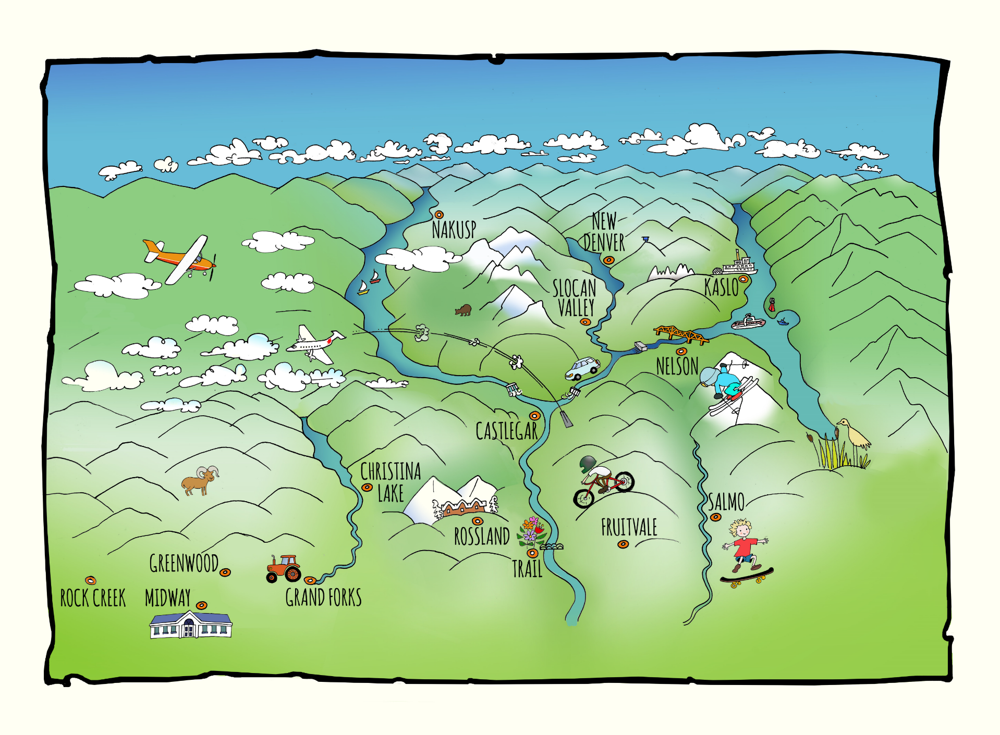
Notes:
Quick overview of KB – What we call the “Original” Rural and Remote Division
80,000K pop, Physician clinics and IH staff spread throughout 13 culturally distinct communities, five dominant regions, four GSAs
This presentation focuses on my home, the Boundary GSA of BC

Slide 4
KB’s PMH/PCH Journey
Spring 2015 MoH Policy Papers opportunity recognition* promotion
Fall 2015 CSC Leadership Commitment
Division AGM & Northern Health “road show”
Winter 2016 QI Discussion Paper
Spring 2016 Engagements
Fall 2016 Proof of Concept designation & subsequent funding
Notes:
I’m going to start with a quick overview of the journey for our entire region, before we spend most of my time showing you a handful of slides about our Proof of Concept work in the Boundary.
[Read Slide… but be quick about it…]

Slide 5
Outcomes of the Work:
Broad Physician interest across KB
Clinic re-organization conversations in three communities
Passionate, focused and cohesive CSC
Strong Community Leader interest
High awareness outside KB in all key leadership circles that we have capacity, AND competency
Proof of Concept funding by IHA
Notes:
So where has all this work gotten us?
[Read Slide...]
We’ll wrap up now with just a few themes about this funding
[COULD OMIT THIS SLIDE???]

Slide 6
Concept: High Skill Rural Generalism
In rural communities, where economies of scale for specialised services are absent, highly skilled and highly integrated generalist teams are the most effective approach to affect the core system challenges...
Notes:
OK… let’s talk about the Boundary
This slide speaks for itself: in rural communities, its all just “Primary Care”. The PMH/PCN designation is not particularly relevant to the way we do business now. If anything, we see only further integration between these two realms.

Slide 7
Process…
The CSC will facilitate a collaborative, consensus-based planning process with Boundary GPs & IH staff, CSC leaders, and (if desired) IHA senior representatives, to reach agreement by all parties re.:
Outcome Targets
Framework for QI & Team Development processes
Incremental Staffing
Scope of Existing Staff Alignment
Notes:
Second, our planning process. This is a pretty important slide.
We got the Health Authority to commit these funds with very little detail about what we are going to do with them. We didn’t invite Doctors to the table for a “proposal development” exercise, with an unknown likelihood of funding. Our $500K was committed before we began planning.
What the slide demonstrates is “the catch”… that we won’t spend a penny until a consensus decision, of all key stakeholders, including Doctors in the Boundary, is reached. AND… that this decision was respected by those not at the table.
This, for us, is what CSC and Division work is all about. Local people are respected and given real power in design decisions. But nobody gets to call the shots. Consensus has to be achieved.

Slide 8
Outcomes
Reduction of Age Standardized Total Cost of Care for Target Populations of Frail Seniors, MHSU & ACSC (Chronic Disease Mgt) of 5% over three years
Reduction in Boundary resident CTAS 4/5 by 50% over three years (yr 1 10%, yr 2 25%, yr 3 15%)
All Scheduled Visits removed from Emergency in one year, and total Scheduled Visits in facility reduced by 50% in three years.
Provide mild/moderate mental health supports to 160 patients in PMHs, enabling a decreased caseload at MHSU of 10%, as measured by active MHSU clients.
Reduced total hospital days for all cause hospitalizations, by 8%
Notes:
These are the Outcomes we are tackling.
There’s a few important elements here.
First these are specific, measurable, clinical and ambitious. Doctors aren’t putting in this much effort to only rearrange the deck chairs.
Second, they address all elements of the triple aim, but esp. system sustainability.
Third, these call out for a robust Quality Improvement system, high degrees of data sharing between all parties, and regular team conversations to discuss how to change practice to reach them. This QI process will be the cornerstone of Team Based Care. Not a “soft” exercise in working differently together because we “should”, but an ambitious ongoing conversation about changing our behaviors to improve patient outcomes.

Slide 9
Implementation
FTE | West Boundary | Grand Forks | Christina Lake | TTL
Primary Care Nurse | 0.4 | 1.0 | 0.6 | 2.0
Social Programs Officer | 0.6 | 1.0 | 0.4 | 2.0
Physician “entity” employs new staff
Data specs. for Outcomes
QI Structure & Plan
Funds for common EMR for practitioners
Integration of MHSU, Home Health, Public Health, etc…
Notes:
What’s next…
We’ve incorporated the “Boundary Health Care Cooperative” to enter into a contract with IHA to employ these staff.
We’ve posted the positions, and expect them all to be in place by September 1.
We are gathering baseline data and establishing the info. sharing agreements required to do our QI
We are doing as much background work as we can on other Enablers of PMH/PCN, in particular moving all our of EMRs to single database.
And most importantly, our Health Authority colleagues are making big changes to how they direct patients through our Emerg., and setting the stage for conversations about fuller integration of existing Home Health, Public Health, Chronic Diseas Mgt, and MHSU staff to integrate more closely with the Clinics.

Slide 10
Summary:
Embrace the opportunity for something bigger.
Apply rigorous change and engagement theory.
Think complex system:
  Nobody is in charge.
  Demand local governance.
  Assuage insecurity with story.
Utilize experienced Physician voice.
Focus on the BIG problems.
Lead with risks and pitfalls. So others don’t.
Sing the “single aim”, Per Capita Cost
Be political, strategic and maximize relationships.
Notes:
I’ll finish today with a summary of some of the themes I’ve shared today.
I won’t read them to you, but I will end with a sincere offer to share any of our work with you directly.
We are happy to talk about this with anyone, share our materials and presentations, etc…
Please contact us at any time, and we look forward to the discussion later.

