Slide 1
Physician Recruitment and Retention for the PMH: A Critical Enabler
Dr. Shelley Ross
Co-chair, GPSC (Doctors of BC)
Co-chair, GPSC Provincial Recruitment & Retention Steering Committee
Dr. Aaron Childs
Co-Chair, GPSC Provincial Recruitment & Retention Steering Committee (Divisions of Family Practice)
Notes:
Shelley – 30 seconds
I’d like to welcome all of you to our breakout session, Physician Recruitment and Retention for the Patient Medical Home: A Critical Enabler.
I’m Shelley Ross, GPSC Co-chair (for Doctors of BC), and Co-chair of the GPSC Provincial Recruitment and Retention Steering Committee, along with Dr. Aaron Childs, a Divisions of Family Practice representative, and Victoria-based family physician.
We’re joined today by Dr. Bruce Hobson, a member of the Provincial R & R Committee and the Practice Coverage Working Group.
[Ask other PRRSC members (& support/staff) in attendance to raise their hands].

Slide 2
Faculty/Presenter Disclosure & Conflict Management
Faculty/Presenters:
Dr. Shelley Ross
Dr. Aaron Childs
Dr. Bruce Hobson
Relationships with commercial interests:
Grants/Research Support: N/A
Speakers Bureau/Honoraria: N/A
Consulting Fees: Kylie Hutchinson
Other: N/A
No conflicts of interest or disclosures
Notes:
Shelley
We (myself, Dr. Childs and Dr. Hobson) have no conflicts of interest or disclosures.

Slide 3
Faculty/Presenter Disclosure & Conflict Management
Faculty/Presenters:
Kylie Hutchinson
Relationships with commercial interests:
Grants/Research Support: N/A
Speakers Bureau/Honoraria: N/A
Consulting Fees:
GPSC Provincial Recruitment and Retention Steering Committee (Paid by Community Practice Quality and Integration Evaluation Team)
Rural and Remote Division of Family Practice
Notes:
Shelley
Kylie Hutchinson, Evaluation Consultant to the Committee, is paid through CPQI Evaluation.
She also receives consulting fees from the Rural and Remote Division of Family Practice, as an Evaluation Consultant.

Slide 4
Learning Objectives
To define provincial-level recruitment, retention, and practice coverage work.
To identify supports for local recruitment, retention, and locum coverage activities.
To examine shared measures for recruitment, retention, and practice coverage.
To assess the feasibility of a centralized locum matching tool.
To explore PracticeinBC.ca.
Notes:
Shelley - 30 seconds
The majority of our time today will be spent in small group discussion.
We’d like to hear from you and we need your input to achieve our objectives, so we’re going to put you to work shortly.
First, let’s take a look at our learning objectives.
[read aloud].

Slide 5
Provincial Recruitment and Retention Steering Committee
Spring 2012
Divisions of Family Practice R & R Steering Committee
Spring 2015
Physician
R & R Stakeholder Summit
Spring 2017
GPSC Provincial
R & R Steering Committee
Fall 2015
Divisions of Family Practice
R & R Steering Committee
An Evolution
Notes:
Aaron – 2 minutes
Now, let’s take a look closer look at the Committee – who we are, how we’ve evolved, and what we do.
The Committee was originally formed as an inter-Divisional Committee after the Spring 2012 Roundtable, with a mandate to address the breadth and complexity of physician recruitment, retention, and locum coverage across BC.
Committee work gained recognition which led to its integral involvement, with GPSC support, in the physician R & R Stakeholder Summit in March 2015 - a first of its kind event that brought multiple stakeholders together to discuss coordinated, concerted efforts to address physician recruitment, retention, and practice coverage challenges in BC. The Summit recognized the multiple organizations that need to be involved in these processes.
Since that time, the Committee’s mandate evolved to focus on system improving initiatives by leveraging the collective knowledge and influence of participating partners and family doctor representatives. To best reflect the broader collaborative mandate, the Committee was renamed the GPSC Provincial R & R Steering Committee this Spring.

Slide 6
Mandate
To work collaboratively to understand the broad spectrum of issues around recruitment and retention of FPs in BC with a goal of aligning and optimizing efforts to retain family doctors and recruit new physicians to meet current and future primary care needs.
Notes:
Aaron - 30 seconds
Specifically, the committee’s mandate emphasizes keeping doctors in BC and recruiting new doctors to the province to meet current and future primary care needs. This work is an integral enabler of the PMH as we move towards a standard of team-based care, with family doctors being the backbone/at the hub.

Slide 7
Objectives and Responsibilities
Advise and inform the GPSC and other partners of activities and potential strategies in support of its mandate.
Inform system-wide and/or practice focussed approaches for current and future FP placement and practice/patient coverage needs, including providing input to the Ministry of Health’s Health Human Resources forecasting process.
Ensure that work around recruitment and retention is aligned with the goals and direction of the GPSC, in alignment with the PMH initiative.
Notes:
Aaron – 30 seconds
We’d like to point out 3 of our objectives that fit well with the today’s session and the Summit as a whole:

Slide 8
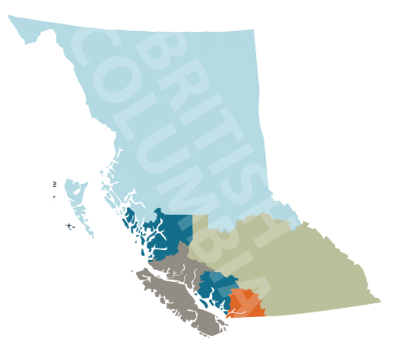
Members
Dr. Aaron Childs | Victoria DoFP (Co-Chair)
Dr. Shelley Ross | General Practice Services Committee (Co-Chair)
Doug Blackie | BC Ministry of Health
Dr. Alan Ruddiman | Joint Standing Committee on Rural Issues
Dr. Ray Markham | Rural Coordination Centre of BC
Dr. Bruce Hobson | Powell River DoFP
Dr. David Merry | Kootenay-Boundary DoFP
Dr. Ian Schokking | Prince George DoFP
Dr. Isabelle Hughan | North Shore DoFP
Dr. John Hamilton | Chilliwack DoFP/GPSC (Ministry of Health)
Leslie Keenan | Nanaimo DoFP
John Mabbott | Health Match BC
Reina Pharness | Northern Health
Family Medicine Resident/New to Practice GP | TBC
Notes:
Aaron: 10 seconds
Here’s a quick look at the Committee membership.
You can see from the representation, Divisions continue to be a driving force of the Committee and the future of primary care in BC.

Slide 9
Participating Partners
Al Richmond | Union of BC Municipalities
Corinne de Bruin | College of Physicians & Surgeons of BC
Dr. Jean Clarke | Society of General Practitioners of BC
Dr. Martin Dawes | UBC Faculty of Medicine
Dr. Sian Spacey/ Dr. Willa Henry | UBC Faculty of Medicine
Dr. Christie Newton | BC College of Family Physicians
Melanie Rivers | First Nations Health Authority
Notes:
Aaron - 5 seconds:
And these are our participating partners who play a key role in our collective work.

Slide 10
Accomplishments
UBC Faculty of Medicine
Provided input to the graduate exit survey to understand future practice intentions.
Created a family medicine (FM) resident survey to understand career intentions and support needed to transition to practice.
Delivered a customized family physician job finding workshop at Practice Survival Skills 2016 (UBC CPD).
Delivered a customized Transition into Practice (2017) session for FM residents to identify job finding strategies and supports.
Notes:
Shelley – 1 minute:
I’d like to spend a little bit of time highlighting a few of the Committee’s accomplishments.
One of the biggest accomplishments is the meaningful, impactful engagement with partners and other groups including UBC, The College of Physicians and Surgeons of BC, and CHSPR – in a way that hasn’t been done before. This type of engagement is key to achieving partner alignment and influencing effective, sustainable system change.
Here are some outcomes achieved by successfully working with UBC [Read slide].

Slide 11
Accomplishments
College of Physicians and Surgeons of BC (CPSBC)
Provided feedback on:
Proposed changes to CPSBC eligibility ruling process, in collaboration with Health Match BC.
CPSBC registration and licensure bylaws and processes - a first!
Notes:
Shelley – 1 minute:
We’ve also deepened our engagement with the College to the extent of receiving invitations to provide feedback on their bylaws and processes – this is a first!
In this case, we worked closely with Health Match BC to align our efforts and respond to the College in a coordinated fashion.
The opportunity to influence College processes is extremely important for all of us, especially the many GP candidates who are eager to efficiently obtain licensure to practice in BC.

Slide 12
Accomplishments
Health Match BC and Health Authorities
Participated in a first of its kind, award winning, collaborative marketing display at the Family Medicine Forum (2016).
Notes:
Shelley – 1 minute (for slides 12&13):
We further engaged with Divisions, Health Match BC as well as Health Authorities to participate in “Jobs for Doctors in BC” – an innovative collaborative booth at the Family Medicine Forum. Together, we presented a coordinated, united promotion of practice opportunities in all regions of the province to physicians across Canada and outside of the country.

Slide 13
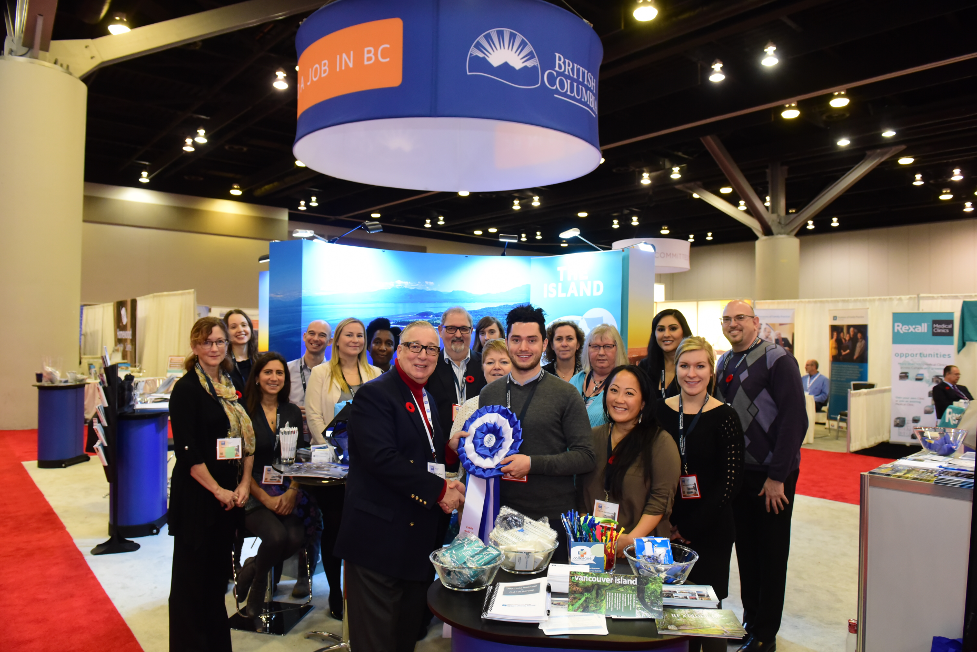
Jobs for Doctors in BC
Notes:
Shelley
The Jobs for Doctors in BC received the “Most Innovative Booth” award by the College of Family Physicians of Canada (conference hosts).
------------------------------------------------
Another one of our accomplishments is the creation of PracticeinBC.ca, which Aaron will introduce later today.

Slide 14
Current Work
Enhance Engagement of Medical Students & Family Medicine Residents
Support UBC residents to transition to practice
Enhance Recruitment and Retention of CMGs, IMGs, CSAs
Inform HHR forecasting through division-level and partner data
Improve Practice Coverage Strategies
Assess feasibility of a centralized locum matching tool
Improve Access to Recruitment & Retention Information, Resources, Tools
Assess support needs for local recruitment and retention activities
COLLECTIVE IMPACT
Notes:
Shelley - 3 minutes
We continue to build on the Committee’s accomplishments and learning, while moving forward with our work at hand.
Here is a simplified version of our high level work plan for this year. A detailed version is included in with your handouts.
The pie slices represents our four focus/priority areas, with one example of corresponding objectives and activities in the outer sections. We’ll be focussing on 3 of the sections today, during our table talks.
Our work is guided by a collective impact framework, which forms our foundation. Collective impact occurs when organizations from different sectors work together to solve a complex problem through the core conditions that are listed in the centre of your handout.
Since recruitment and retention is a critical enabler of the PMH, we reflect how our activities align with attributes of the patient medical home in the blue areas of your handout.
You can see that we certainly have a lot of work ahead, with an emphasis this year on alignment, efficiency, and addressing system barriers – together.

Slide 15
Table Talks
Supporting local Recruitment and Retention Activities.
Shared Measures for Recruitment, Retention, and Practice Coverage.
Assessing the Feasibility of a Locum Matching Tool.
Notes:
Aaron – 1 minute
We’d like your input on three topics today [see slide]
We’ll spend 20 minutes for each topic and will rotate through all 3.
After the last rotation, we’ll take a brief break and have a live demonstration of PracticeinBC.ca.
Then we’ll do a report out and wrap-up.
Please try and divide yourselves evenly to start.

Slide 16
http://www.practiceinbc.ca/
Notes:
Aaron – 3 minutes total for demo and google analytics
Focus on live demo – [CLICK HYPERLINK FROM SLIDE]
Suggested points:
PracticeinBC.ca is a one-stop resource for everything family doctors, residents and students within BC and around the world need to know about locating and practicing in BC.
As well, the site has a host of tools and information to support any recruitment and retention activities you, your members and partners may be undertaking.
Suggested pages:
Homepage with 2 main parts, Quick Links, and FAQs
This page http://www.practiceinbc.ca/practice-in-bc and maybe this page http://www.practiceinbc.ca/practice-in-bc/International-medical-graduates
Personal checklist
Resources and Tips
Job Opportunities

Slide 17
Total Unique Users
2,234
Notes:
Aaron – see slide

Slide 18
Users by Country and City
Notes:
Aaron – see slide

Slide 19
Notes:
Aaron – see slide
PracticeinBC.ca is the first and only site of its kind, bringing together information from a variety of sources into a single access point.
It has never been easier for people interested in being a BC family doctor - or recruiting one - to find the information they need.
I encourage you to spend some time on PracticeinBC.ca yourself and learn everything the site has to offer.
Please take advantage of the PracticeinBC.ca communications toolkit, put the logo on your website, and take rack cards to hand out at recruitment events.
Lastly, we’d be happy to provide a demonstration to your Division, organization, or group by request. Talk to Jennifer or sign up on the sheet.

Slide 20
Report Out
Summary and themes
How else can the PRRSC support you?
Next steps
Notes:
Shelley – Ask each group to report out [see slide]

Slide 21
Thank You!
RandRCommittee@DoctorsofBC.ca
Notes:
Shelley
Thank everyone for their participation
Encourage them to stay in touch and ensure them that the Committee will continue to engage with you and other partners

