Slide 1
Recruitment and Retention: A Conversation with the Next Generation of Family Doctors
Dr. Aaron Childs
Co-Chair, GPSC Provincial Recruitment & Retention Steering Committee (Divisions of Family Practice)
Dr. John Hamilton
GPSC (Ministry of Health)
Panelists
Alicia Pawluk, Chris Le, Danielle Downe, Derek Poteryko
Hyun-Kyoung Koo, Medhat Moussa, Raj Johal, Vincent Wong
Notes:
Aaron – 1 min
Welcome all to breakout session: “…A conversation with the Next Generation of Family Doctors.”
Introduce yourself, including background & role
Mention your Co-chair, Shelley Ross
Ask John Hamilton to introduce himself.
Acknowledge panelists (to introduce themselves later)
Ask who is in the audience (raise hands): Division, DoBC, GPSC, HA.
[Jennifer roaming]

Slide 2
Faculty/Presenter Disclosure
Faculty/Presenters:
Dr. Aaron Childs
Dr. John Hamilton
Drs. Alicia Pawluk, Chris Le, Danielle Downe, Derek Poteryko, Hyun-Kyoung Koo, Medhat Moussa, Raj Johal, Vincent Wong
Relationships with commercial interests:
Grants/Research Support: N/A
Speakers Bureau/Honoraria: N/A
Consulting Fees: N/A
Other: N/A
No conflicts of interest, disclosures, or potential bias
Notes:
Aaron – seconds
We (myself, John, panelists) have no conflicts of interest, disclosures, potential bias.

Slide 3
Learning Objectives
Explore residents & new grads’ career intentions.
Describe the values of residents and early career physicians.
Discover a new model of care designed to inspire engagement of early career family physicians into FSFP.
Define enablers to successful engagement, recruitment & retention of early career and new to BC family physicians.
Notes:
Aaron – 1 min
The majority of our time today will be spent hearing from our panelists.
We’d also like to take audience questions after the panelists.
First, let’s take a look at our learning objectives.
[see slide - summarize].

Slide 4
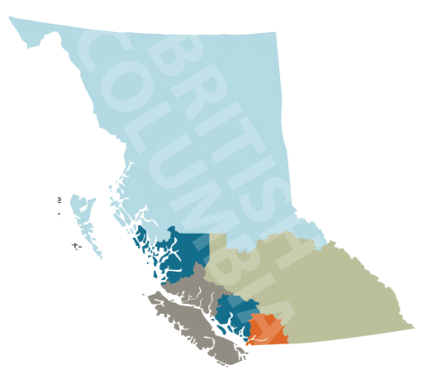
Provincial R & R Steering Committee
Members
Dr. Aaron Childs | Victoria DoFP (Co-Chair)
Dr. Shelley Ross | GPSC - Doctors of BC (Co-Chair)
Doug Blackie Al Richmond Corinne de Bruin | BC Ministry of Health Union of BC Municipalities College of Physicians and Surgeons of BC
Dr. Alan Ruddiman | Joint Standing Committee on Rural Issues
Dr. Ray Markham | Rural Coordination Centre of BC
Dr. Bruce Hobson | Powell River DoFP
Dr. David Merry | Kootenay-Boundary DoFP
Dr. Ian Schokking | Prince George DoFP
Dr. Isabelle Hughan | North Shore DoFP
Dr. John Hamilton | Chilliwack DoFP/GPSC (Ministry of Health)
Leslie Keenan | Nanaimo DoFP
Audra Fediurek | Health Match BC
Eva Vincent | Island Health
Family Medicine Resident Early Career GP | Alicia Pawluk Chris Le
Notes:
Aaron: 10 seconds
Before we start, here’s a quick look at the Committee membership.
You can see from the representation, Divisions continue to be a driving force of the Committee and the future of primary care in BC.

Slide 5
Participating Partners
Dr. Jean Clarke | Society of General Practitioners of BC
Dr. Christie Newton | UBC Faculty of Medicine, Dept. of Family Practice
Dr. Mark Mackenzie Dr. Sian Spacey | UBC Faculty of Medicine, Dept. of Family Practice UBC Faculty of Medicine
Dr. Christie Newton | BC College of Family Physicians
Kevin Howe | First Nations Health Authority
Notes:
Aaron - 5 seconds:
And these are our participating partners who play a key role in our collective work.

Slide 6
Strategic Priorities
Notes:
Aaron – 1 min
A closer look at the Committee – priorities
We’ve evolved to become a Committee of the GPSC with a focus on keeping doctors in BC and recruiting new doctors to the province to meet current and future primary care needs, through system improving initiatives & leveraging our collective knowledge & influence.
This work is an integral enabler of the PMH/PCN as we move towards a standard of team-based care, & aim to improve access, with family doctors being the backbone/at the hub.

Slide 7
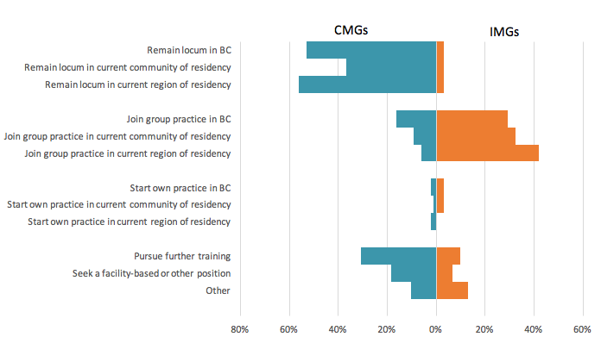
Evidence - Resident Survey
Most popular post-graduation goals (CMGs): locum, further training, facility-based position.
Notes:
Aaron – total 5 min for all evidence slides
Highlight findings from UBC FM residents’ survey (2016).
Developed by PRRSC (in consultation with UBC PGME)
Mention new survey will be conducted in May 2018.

Slide 8
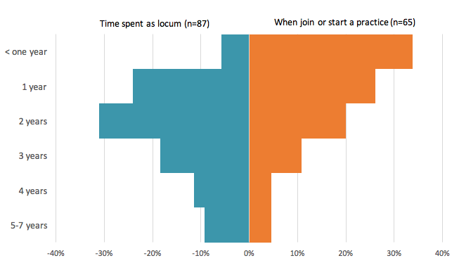
Evidence
The majority of respondents indicated they plan to locum for two years or less, and join or start a practice within two years of graduating
Notes:
Aaron – refer to summary statement

Slide 9
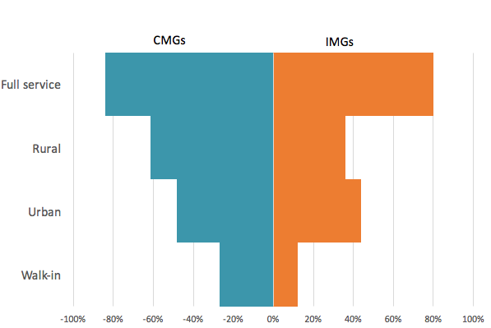
Evidence
The majority of residents envision themselves working in a full service practice.
Notes:
Aaron – refer to summary statement

Slide 10
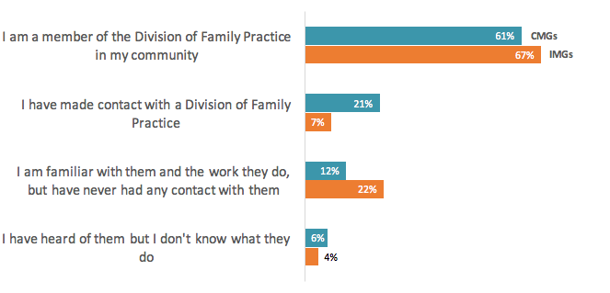
Evidence
Two-thirds of residents are already members of their division.
Notes:
Aaron – refer to summary statement

Slide 11
Most popular transition supports:
Evidence
Billing training
Locum orientation
Locum/practice opportunity information
Notes:
Aaron – refer to summary statement

Slide 12
Most important factors in choosing a permanent location: personal & professional lifestyle, spousal interest, and interesting medicine.
Evidence – Exit Survey
(n=128)
Notes:
Aaron
Findings from UBC PGME exit survey (2016)
Refer to summary statement.

Slide 13
New grads & young family physicians are seeking:
Evidence-Workforce Planning
Group practice
Team-based environment that supports work- life balance
Work in a varied or generalist practice
Different compensation options
Notes:
Aaron
Findings from MoH workforce planning survey with divisions
Refer to summary statement
**Hand over to John to continue topic of intergenerational differences/blue sky clinic with Dr Derek Poteryko.

Slide 14
Thank You!
RandRCommittee@DoctorsofBC.ca
Notes:
Aaron
Thank everyone for their participation
Ask them to visit the R & R booth for resource material, & a demo of practiceinbc.ca. [Note: Chris & I will cover, but there won’t be someone there 100% of the time].
Encourage audience to stay in touch and ensure them that the Committee will continue to engage with them and other partners.

