Slide 1
Physician Recruitment and Retention For PMH:A Critical Enabler GPSC Spring Summit June 19, 2017
Assessing the Feasibility of a Centralized Locum Matching Tool

Slide 2
Belief Statements
We believe:
All patients are entitled to continuous care, even in the absence of their personal family physician/primary care provider(s).
All patients should have timely access to their family physician/Patient Medical Home team.
A relationship between the patient, family physician or Patient Medical Home team is strengthened through coordinated practice coverage.
Physician wellness and professional competency can be achieved and maintained through integrated, coordinated practice coverage.

Slide 3
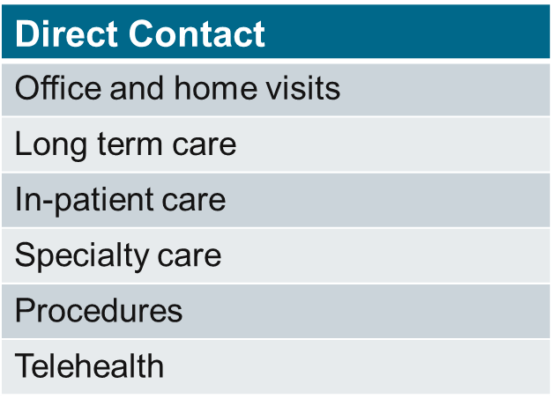
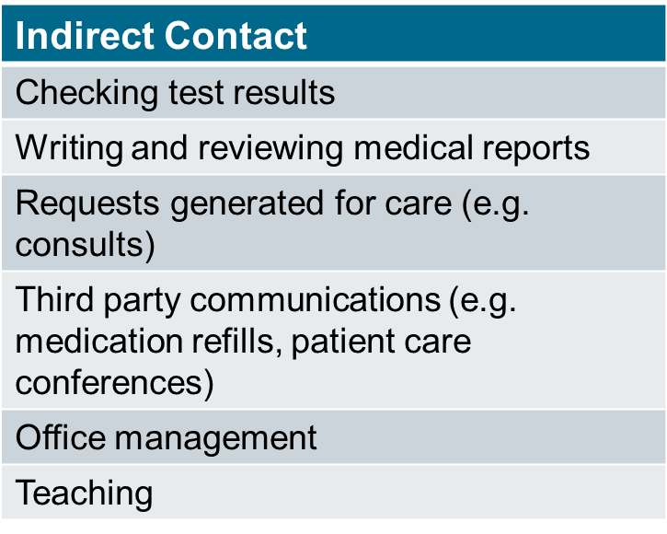
Defining Practice Coverage
Practice coverage refers to direct and indirect contact between a family physician/Patient Medical Home team and a patient. This includes:

Slide 4
Objectives of a Centralized Locum Matching Tool
Enable timely access to a family physician/PMH.
Support continuous patient care through enhanced practice coverage in BC’s urban and rural communities.
Enable the achievement and maintenance of physician wellness and professional competency through an improved overall practice coverage experience.
To facilitate family physician recruitment and retention.

Slide 5
Essential Elements of a Centralized Locum Matching Tool

