Slide 1
Population Based Funding
Mission, BC

Slide 2
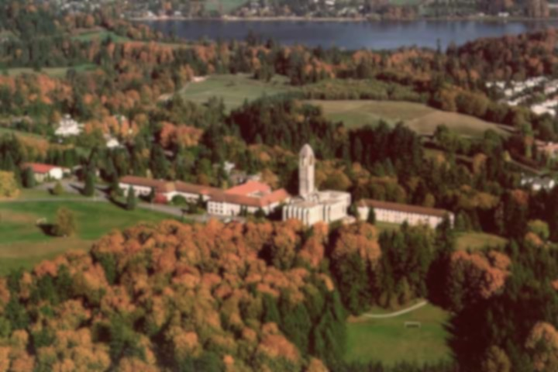
Presenter Disclosure
Presenters: Dr Peter Barnsdale, Irene Sheppard, Marie Ty
Relationship with commercial interests:
Grants/Research Support: none
Speakers Bureau/Honoraria: none
Consulting Fees: none
Other: none

Slide 3
Managing Potential Bias
Material presented is unrelated to financial relationship with commercial entity

Slide 4
What’s Your Ideal Work Day?

Slide 5
What’s My Ideal Work Day?

Slide 6
What’s My Ideal Work Day?
Starts with a coffee

Slide 7
What’s My Ideal Work Day?
Starts with a coffee
I control the work rather than visa versa

Slide 8
What’s My Ideal Work Day?
Starts with a coffee
I control the work rather than visa versa
Time to think

Slide 9
What’s My Ideal Work Day?
Starts with a coffee
I control the work rather than visa versa
Time to think
Opportunities for collegiality

Slide 10
What’s My Ideal Work Day?
Starts with a coffee
I control the work rather than visa versa
Time to think
Opportunities for collegiality
Both patient and I finish an interaction happy

Slide 11
What’s My Ideal Work Day?
Starts with a coffee
I control the work rather than visa versa
Time to think
Opportunities for collegiality
Both patient and I finish an interaction happy
My evenings are mine (most of the time)

Slide 12
What’s My Ideal Work Day?
Starts with a coffee
I control the work rather than visa versa
Time to think
Opportunities for collegiality
Both patient and I finish an interaction happy
My evenings are mine (most of the time)
The stuff I do is what I trained for

Slide 13
What’s My Ideal Work Day?
Starts with a coffee
I control the work rather than visa versa
Time to think
Opportunities for collegiality
Both patient and I finish an interaction happy
My evenings are mine (most of the time)
The stuff I do is what I trained for
My patient’s do better because I’m involved

Slide 14
What’s My Ideal Work Day?
Starts with a coffee
I control the work rather than visa versa
Time to think
Opportunities for collegiality
Both patient and I finish an interaction happy
My evenings are mine (most of the time)
The stuff I do is what I trained for
My patient’s do better because I’m involved
I don’t have to relate activity directly to income

Slide 15
Mission’s Story
43,000 population
20% unattached
Chronically Congested Hospital
25% of elderly registered with Community Services visited ER in 90 day period
19% of admissions Chronic disease related
30% readmission rate

Slide 16
Mission’s Story
GP for ME 2014
Repositioning Seniors Care 2015
Patient Medical Home 2016-17

Slide 17
Mission’s Story
Proposed plan to MoH in 2015
Reorganization of Community Services
Net new staff
Longer hours
Increased services – Physio, home care
Day care wait down down from 9 months to 0
Closer integration with willing Family Physicians
Acute admissions of community Care patients reduced
ER collaboration to recognize and focus on frequent flyers

Slide 18
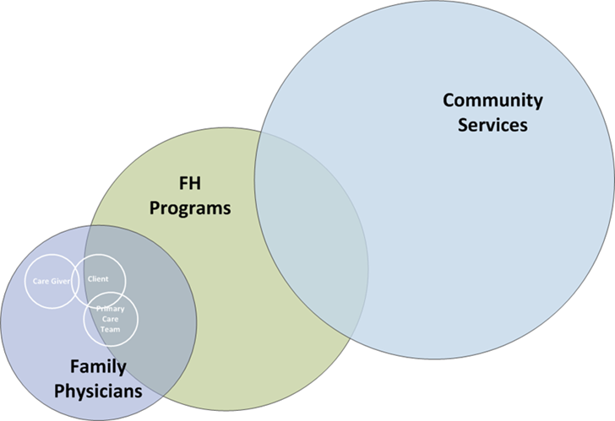
Current State
Notes:
We see many problems:
From a patient perspective:
Some lack a GP or have one outside the community
Distant family, reliance on Informal networks – neighbours, friends
Complex System, confusing to navigate
Inconsistent messages from different health providers
Transportation challenges for many seniors
Poor inter-professional communication: repeating their story, repeating tests, for seemingly uninformed professionals.
Overwhelmed, under supported Caregivers using ER as a place of last resort.
Physicians are commonly:
Isolated from the rest of the system
Not well Informed about services and options
Poorly incentivised to join team orientated work.
Capacity limited
Frequently not working to our maximum scope (doing work that a nurse or other professional could do)
Rate limited by bottle necks in care
Unavailable for out of hours, weekend and same day or even week appointments.
For the HA
19% of current admissions to MMH are for seniors with chronic conditions (Diabetes, COPD, CHF and dementia)
High Readmission rates (15%) which escalates to 30% by 30 days
Approximately 30% of ER visits by seniors are CTAS 4s and 5s.
App. 20% of the general population do not have a GP and more are likely functionally unattached (can’t get to see their GP)
Failure of Community Services to hit targets leading to waitlists.
Even the seniors being seen and supported by community services still utilize ER/Acute. Over a 90 day period 1 out of every 3 of them visited ER and 1 in 13 enrolled in the Home health long term program was admitted to acute care.
So if it’s all so bleak what hope is there. Plenty is the answer
As mentioned in Mission we already have a cohesive community that we can work with to improve services. We have many services already present even if struggles with coordination and provision exist and we have an active Division of Family Practice that has been working for 6 years in Mission and has demonstrated physician willingness to try new ways of doing business.

Slide 19
Future State
Mission Community of Care
Notes:
Building on this we are looking to the next step; a truly multidisciplinary approach to our frail elderly with anticipated trickle down benefits for our whole community.
Working together we plan to concurrently redesign our primary care physician team to link seamlessly with enhanced home care, seniors clinic, day care programs and respite services as well as geriatric psychiatry to provide increased capacity to shift services from an acute to community focus. The result being support for our frail seniors so they have the confidence to manage their health needs and conditions within their homes knowing they are well supported by a coherent group of health professionals and community service providers. Our care will envelop, not intrude, focussing on quality of life for the individual “I want to live until I die”.
As physicians we will increase our rosters by up to an estimated 30%. We will do this by utilising a more appropriate payment system with a predictable funding envelope as is currently being explored by the BC ministry of health to release our time from treadmill style patient care, making us more efficient and allowing us to hire allied health staff including Nurses and health counsellors and enhance the training and capacity of our MOAs to help with day to day management of our patients without eroding the doctor patient relationship. We will be very deliberate in our follow up of patients, managing them in their homes as much as possible. This will be achieved by having a closer relationship with home care staff, building accessible two-way communication mechanisms to allow troubleshooting and early assessment as well as coordinated pharmacy, mental health and acute nursing care provision. And by using home monitoring, from simple blood pressure recording to INR machines and other technologies, visits for chronic disease management will be reduced in frequency and enhanced in effectiveness. A group of physicians will move to collocate with home health, the geriatric team and public health where shared patient care and record keeping will become the new normal not only managing their own patients but providing assistance for those of colleagues who request it. We will also work together in establishing the development of a community net – empowering caregivers, shop keepers, library workers and even letter carriers with basic training in health surveillance and the tools to communicate concerns so crises can be investigated and averted before they develop.

Slide 20
Mission’s Story
Repurposed Building

Slide 21
Mission’s Story
Population Based Funding + Nurse support
Increased capacity
Flexibility to practice free of artificial limitations
Reduced physician frustration
Income stability
Team building and encourages shared care
Clear panel understanding
Better patient access
Proactive care
Decreased Acute care

Slide 22
Comparing Payment Modalities
Population Based Funding – payment for care of a patient over a period of time based on the patient’s expected morbidity burden
Fee-for-Service - payment based on the services provided
Alternative Payments - payment based on the contracted provision of services or hours worked

Slide 23
Population Based Funding
PBF is a compensation modality for physician-led primary care group practices that provide full scope family practice services.
PBF is a blended capitation-type model:
The greater part of PBF payments are patient-based – payments are for providing longitudinal primary care to registered patients (core services) and are based on patient morbidity burden and demographics; and,
Fee-for-service is paid for:
“non-core services” provided to registered patients; and,
all services provided to non-registered patients.
Each PBF practice has the flexibility to determine how and which team members provide services to the patient to ensure appropriate longitudinal care for the patient.
Notes:
*An extended set codes are used to indicate services outside the FFS schedule.

Slide 24
PBF ACG-Based Payment Rates
Johns Hopkins Adjusted Clinical Groupings (ACGs), as a measure of morbidity, form the payment rate categories (along with age range)
ACG software is used to place each patient into one of 82 ACG categories, based on diagnostic codes recorded in the MSP system in a 12-month period (and patient age and gender).
Payment rates differ significantly between ACGs (and age range), since different ACGs represent groups of patients with significantly different morbidity burden.
Population-Based funding rates were set using FFS payments to BC GPs as a basis:
ACG-based payment rates were set as the average, across patients in each ACG morbidity category, paid to Fee-for-Service GPs for providing core service care to those patients.

Slide 25
Mission’s Story
Where are we so far?
All planned staff hired by Fraser health
New Nurses in One clinic
Reduced wait time from 6 months to O for day care
Dedicated Home health case workers clinic based
Reduced ER visits by frail and elderly
Population Based Funding goes live August 1st
Community Health Centre renovations complete mid August
Active discussions for collapsing referral processes

Slide 26
Mission’s Story
Delays:
Wait and see approach from some physicians
Privacy legislation
Size of Renovation project
Parking

Slide 27
Thank You
Questions

