Slide 1
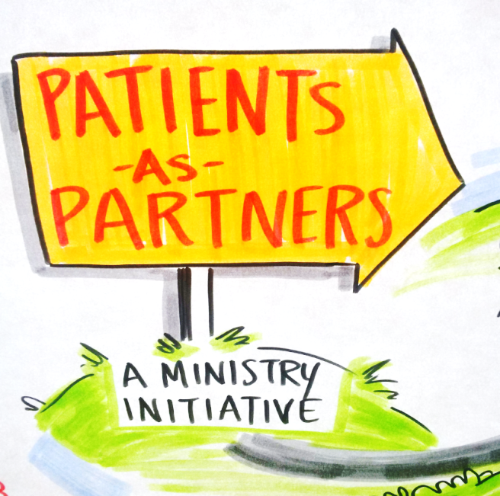
Patient Engagement
and the Primary Care Networks
Patients as Partners Initiative, Ministry of Health, Shannon Holms
Patient Voices Network, Quality Council, Ben Ridout

Slide 2
Disclosure
Staff members at the Ministry of Health & BC Patient Safety & Quality Council
No other associations to disclose

Slide 3
Management of Potential Bias
Material presented is unrelated to financial relationship with commercial entity

Slide 4
What is Patients as Partners?
It’s a philosophy, a Ministry initiative and an approach
Notes:
We bring the patient and family voice, choice and representation to the forefront as part of healthcare transformation

Slide 5
Vision
Ensure person and family centred care is at the foundation of health care.
Bringing a sustained focus on shifting B.C. health care to put patients and families at the centre, which drives policy, accountability, service design and delivery.
Notes:
For British Columbia, Patients and Family-Centred Health is the next evolution in transformational change with some new key features of a system fit for the future. These features include putting people more in control of their health and well-being by ensuring there are self-management and family caregiver supports available at the individual level; ensuring there are sufficient supports, activities, information and training available at the community level to reduce demand on formal services such as unplanned hospital admissions; and to ensure there is a provincial approach to policy and planning at the systems level resulting in improved primary and community care which incorporates team-based care and urgent care centres to improve healthcare throughout the province.

Slide 6
Mission and Strategic Goals
To promote patient involvement and decision-making in the healthcare system by providing patients and providers with relevant tools (competencies and capacity building)
and to foster their active involvement in the continuous improvement of quality of care and services.
1
IMPROVE THE HEALTH CARE EXPERIENCE FOR THE PATIENT AND PROVIDER AT THE INDIVIDUAL LEVEL
2
IMPROVE SERVICE DESIGN AND PROGRAM DELIVERY AT THE COMMUNITY LEVEL
3
IMPROVE SYSTEM LEVEL RE-DESIGN TO ACHIEVE PERSON AND FAMILY CENTRED CARE.
Notes:
For British Columbia, Patients and Family-Centred Health is the next evolution in transformational change with some new key features of a system fit for the future. These features include putting people more in control of their health and well-being by ensuring there are self-management and family caregiver supports available at the individual level; ensuring there are sufficient supports, activities, information and training available at the community level to reduce demand on formal services such as unplanned hospital admissions; and to ensure there is a provincial approach to policy and planning at the systems level resulting in improved primary and community care which incorporates team-based care and urgent care centres to improve healthcare throughout the province.

Slide 7
What do we do?
Notes:
Lead strategy, policy, educational webinars and sessions
Develop tools and resources
Create collaboration opportunities for health sector partners
Lead patient engagements for ministry priority work
Fund a variety of non-government organizations

Slide 8
Three Building Blocks
1
3
Self
Management
for chronic
diseases
Person and
Family
Centred
Care
2
Engagement

Slide 9
Why?
Better patient and provider experience
Better health outcomes
Financially sustainable
Supports the Ministry’s strategic priorities

Slide 10
Why?
https://www.youtube.com/watch?v=gbV_TkU0hoI

Slide 11
How?

Slide 12
How?
Leadership will champion engagements
Continue capacity building for engagement - training
Engagement is integrated into organizational structures, strategy and policy
A governance structure for engagement
Utilize best practices
Standardized approach to public engagement and the process to engagement
Tools and resources
Evaluate engagement

Slide 13
How?
New tools:
2018 Patient, Family, Caregiver and Public Engagement Framework
2018 Engagement Planning Guide (Draft)
Tip Sheets
Engagement Stories

Slide 14
Thank you https://www2.gov.bc.ca/gov/content/health/about-bc-s-health-care-system/partners/patients

Slide 15
BC Patient Safety & Quality Council
Vision:
High quality and sustainable health care for all
Mission:
Provide system-wide leadership through collaboration with patients, caregivers, the public, and those working within the health system in a relentless pursuit of quality

Slide 16
Patient Voices Network
Patient Voices Network is a community of patients, families and caregivers working together with health care partners to improve BC’s health care system

Slide 17
Patient Voices Network
Mission
Advance authentic patient engagement by building the capacity of our partners so person- and family-centred care becomes the foundation from which all health care decisions are made

Slide 18
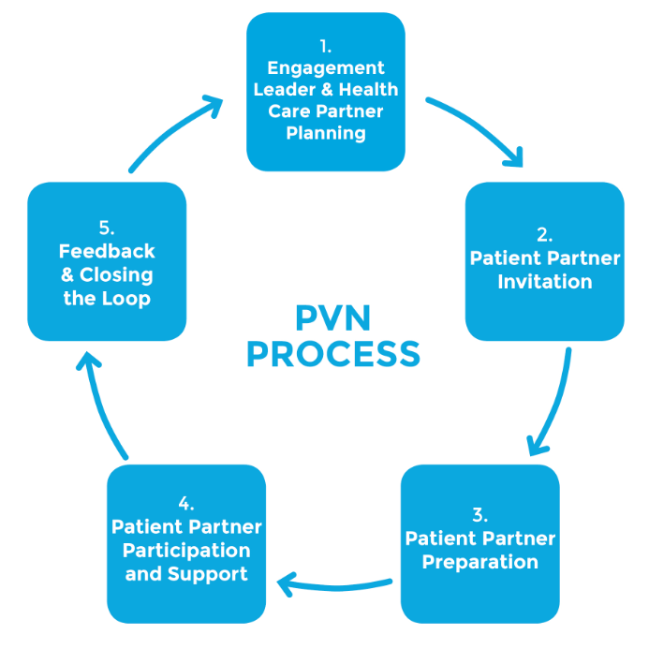

Slide 19
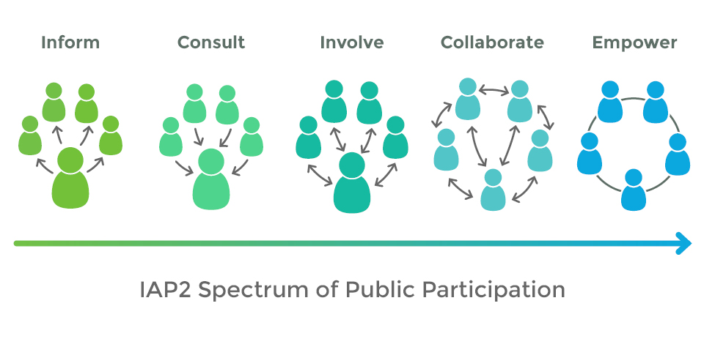

Slide 20
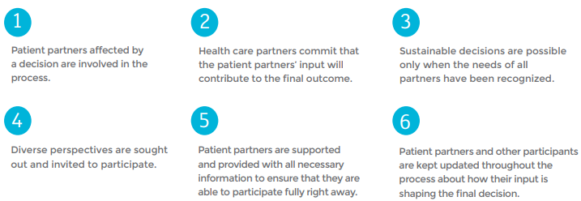
Authentic Engagement

Slide 21
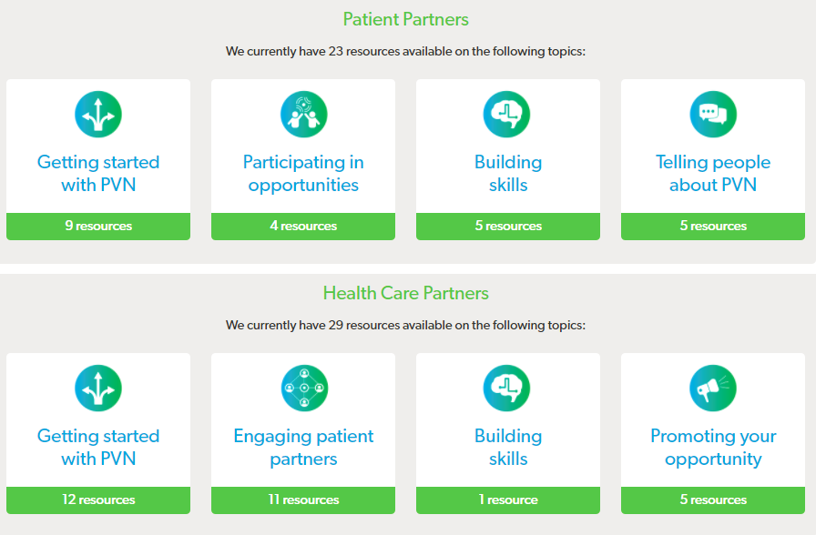
Resources and Info
Information & General Inquiries
www.patientvoicesbc.ca
pvn@bcpsqc.ca
1-877-282-1919

