Slide 1
GPSC Summit – Team Based Care Innovation
Notes:
Thank you for the introduction, and welcome everyone to our presentation titled a “Proactive Focus on the Primary Care Team Model”

Slide 2
Disclosure Slide
All presenters have no actual or potential conflict of interest in relation to this program/presentation

Slide 3
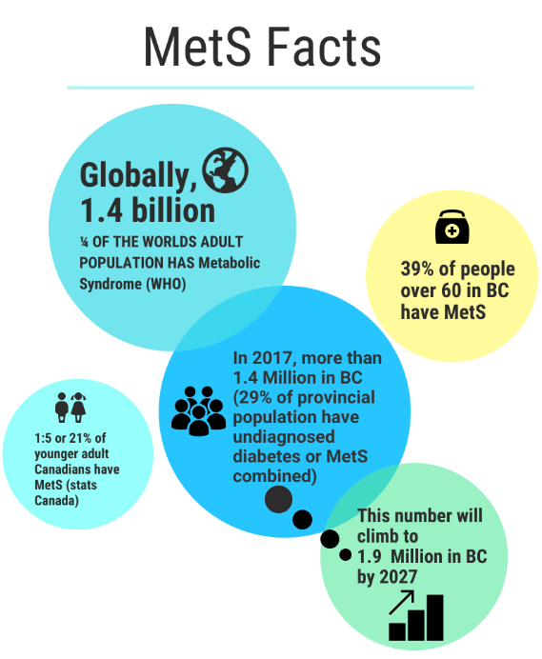
Notes:
Metabolic Syndrome affects billions of patients, globally ¼ of the world’s population- 1.4 billion has metabolic syndrome .
In BC, 20 % of younger adults and 39% of people over 60 have Metabolic Syndrome.
In 2017 1.4 Million in BC had Mets or DM, this number is expected to climb to 1.9 by 2027.
Unfortunately these are conservative estimates because of the low diagnosis rates (asymptomatic, low public awareness)

Slide 4
Can Metabolic Syndrome be reversed?

Slide 5
* Mets CAN be reversed using a combination of dietary modification and exercise (or lifestyle intervention) * 2012 meta-analysis reported that lifestyle intervention of diet and exercise are effective at reversing MetS and its complications
Notes:
despite the evidence showing that lifestyle interventions can substantially reduce the costs and complications of these medical conditions delivery of preventive care services in primary care remains very low
***A recent National survey less than 1/2 family docs discuss obesity and physical activity with their patients (due to lack of time and our current remuneration structure)
-while lifestyle interventions have been proven to be efficacious in the research setting, the resources and the personnel to implement these preventative care services in primary care are lacking = result in pharmaceutical rather than behavioural

Slide 6
Notes:
Complete reversal of Metabolic Syndrome by 19 %, and many of the components were reduced for an additional 42%

Slide 7
Notes:
developed by Metabolic Syndrome Canada (non profit organization)
Quebec, Ontario and Alberta (and now British Columbia)

Slide 9
CHANGE IS: Inter-professional approach to integrating lifestyle interventions into primary care clinics
Notes:
Canadian Health Advanced by Nutrition and Graded Exercise (CHANGE)
0, 3 and 12 m *initial fitness assessment = baseline aerobic, strength and flexibility scores
based on Borg scale (HR, BP, EFFORT and MAXimal O2 consumption
**same testing at 3 mo then 12 mo
0 - 3 mo INTENSIVE STAGE = assess pt’s motivation, obstacles , formulate patients goals, followed by weekly by kin
3 - 12 mo MAINTENANCE STAGE
throughout program communication with FD and kin ( up dates on goals,

Slide 10
Why is CHANGE so different?
5 Keys to Success
What makes the CHANGE Program more effective at reversing metabolic syndrome (MetS) than other diets or workout plans?
Your Family Doctor
A team approach
Personalized diet-exercise plan
Gradual intervention
Close follow-up over 12 months

Slide 11
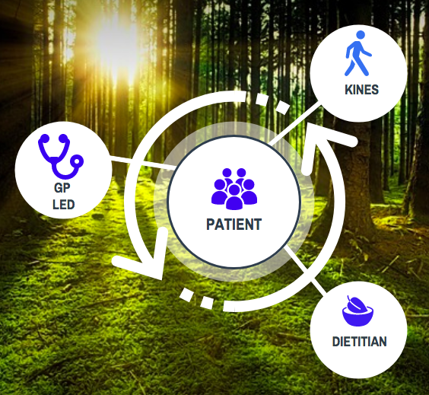
Notes:
Complete reversal of Metabolic Syndrome by 19 %, and many of the components were reduced for an additional 42%

Slide 12
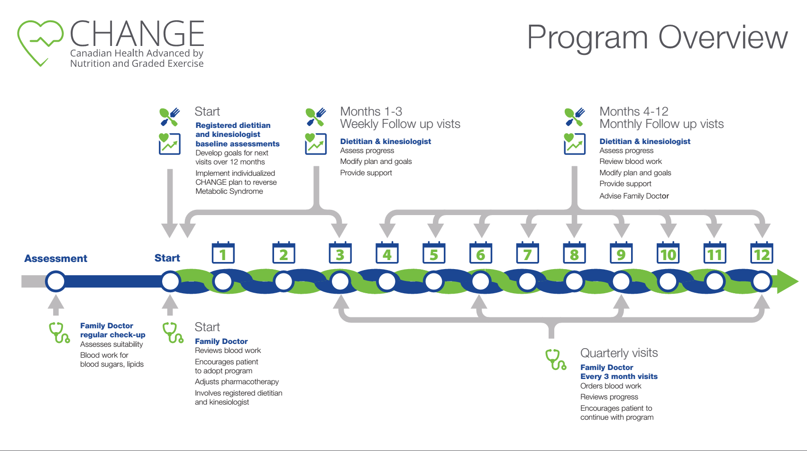
Notes:
Here is a diagram that shows visually the overall structure of the program,
As you can see there is an initial assessment, followed by intense weekly supports for the first three months, and then there followed by monthly supports for patients for a year.

Slide 13
CHANGE BC
Starting at Pacific Northwest Family Practice Division:
Pilot of 80 patients across 4 clinics
Started December 2017
Urban and Rural and Remote areas
UBC Kinesiology student placements
Other Local partnerships
Notes:
So here we have CHANGE BC!
GPs from Haida Gwaii, Houston, Smithers, and Terrace are leading this work with 80 initial patients to develop an innovative, community specific model to address Metabolic Syndrome in the most effective way possible.

Slide 14
CHANGE BC Family Physician Leaders:
Notes:
Here are the GPs driving this initiative:
Dr. Matthew Menard
Dr. Jocelyn Black
Dr. Brenda Huff
Dr. Wouter Morkel
Dr. Onuora Odoh
Dr. Greg Linton

Slide 15
Notes:
Here are our partners:
Pacific Northwest Division
Local Government
Metabolic Syndrome
UBC Kinsesiology
- Patients
- GPs

Slide 16
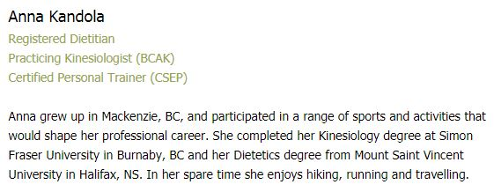
CHANGE BC Team members:

Slide 17
University of British Columbia Kinesiology

Slide 20
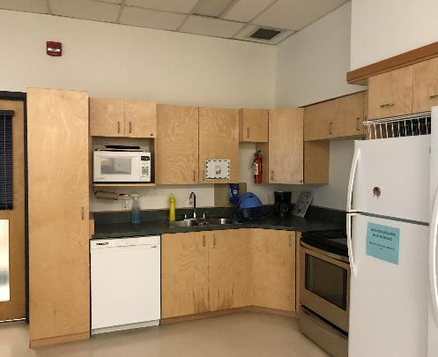
Houston Exercise room: for assessments (multipurpose room)
Can accommodate treadmill
Videoconferencing abilities

Slide 21
Nearby exercise facility
Walking distance from Health Centre
Equipment, pool, etc
Collaborative Partnership with District for Patient Memberships

Slide 22
Smithers
Partnership with local Gym, customized approach for each patient
Dr. Wouter Morkel

Slide 23
Valley Healthy Centre
Has purchased treadmill for patients
Blood work at hospital
Can accommodate small group sessions
MD exercising with patients

Slide 24
Core Family MD(s) and administration must be interested in diet and exercise for their patients
Some level of funding/in-kind to support the CHANGE Program
Access to a registered dietitian*
Access to a kinesiologist/exercise specialist*
Access to a gym for patients* (need to increase aerobic capacity and supervision weekly is ideal, other options can be sought)
Other staffing to support the program (coordination of visits, reporting, etc)

Slide 25
Disruptive Innovation in Primary Care:
Need to find resources/funds to recruit dietitians and exercise specialists
Diagnosis of MetS
Dietitians
PCN Model
Follow up visits can be incorporated into groups classes
Exercise Specialist
Alberta example: on site, equipment in clinic
Northwest Pacific BC example: linking with gyms in local community, Mayors, Council, subsidized rates
Weekly Supervised exercise: ideally to be done in groups

Slide 26
References:
1. The Obesity, Metabolic Syndrome, and Type 2 Diabetes Mellitus Pandemic: Part I. Increased Cardiovascular Disease Risk and the Importance of Atherogenic Dyslipidemia in Persons With the Metabolic Syndrome and Type 2 Diabetes Mellitus J Cardiometab Syndr. 2009 Spring; 4(2): 113-119
2. Riediger ND, Clara I. Prevalence of metabolic syndrome in the Canadian adult population. CMAJ. 2011;183(15):E1127-34.
3. Canada Health Measures Survey Government of Canada,
Statistics Canada http://www.statcan.gc.ca/pub/82-625-x/2012001/ article/11735-eng.htm
4. Bélanger A et al. Population projections for Canada, Provinces and Territories, 2005-2031. Catalogue 9520. Ottawa: Statistics Canada; 2005.
5. Chatterjee A et al. Cardiometabolic Risk Working Group (Canadian). Managing cardiometabolic risk in primary care: summary of the 2011 consensus statement. Can Fam Physician. 2012;58(4):389-93, e196-201.
6. Teoh H et al. Identification and management of patients at elevated cardiometabolic risk in canadian primary care: how well are we doing? Can J Cardiol. 2013;29(8):960-8.

Slide 27
FOR MORE INFORMATION CONTACT:
DR. BRENDA HUFF, CHANGE BC LEAD
DR. WOUTER MORKEL, CHANGE BC LEAD, SMITHERS
DR. ONUORA ODOH, CHANGE BC LEAD, HOUSTON
CENNS@DIVISIONSBC.CA 250-877-9354
COLLEEN ENNS, EXECUTIVE DIRECTOR
PACIFIC NORTHWEST DIVISION OF FAMILY PRACTICE

