Slide 1
One Patient,
One Record:
Big data from small places
Dr William L Clifford
CMIO, Northern Health Authority

Slide 2
Presenter Disclosure
Presenter: William Clifford
No current affiliation with any commercial organization.
CMIO, Northern Health
Medical Director, Health Data Coalition.
Honorary Board Member, Applied Informatics for Health Society.
Co-chair, Health Information Standards Standing Committee
Member, provincial IMIT Standing Committee
Board member, PGDoFP
Site Lead Informatics, Prince George Family Practice Residency Program

Slide 3
“Faithful record of what clinicians have heard, seen, thought and done”
Rector, Nolan & Kay, 1991
Foundations for an electronic medical record
Including what they plan to do
Notes:
The fundamental basis of the record

Slide 4
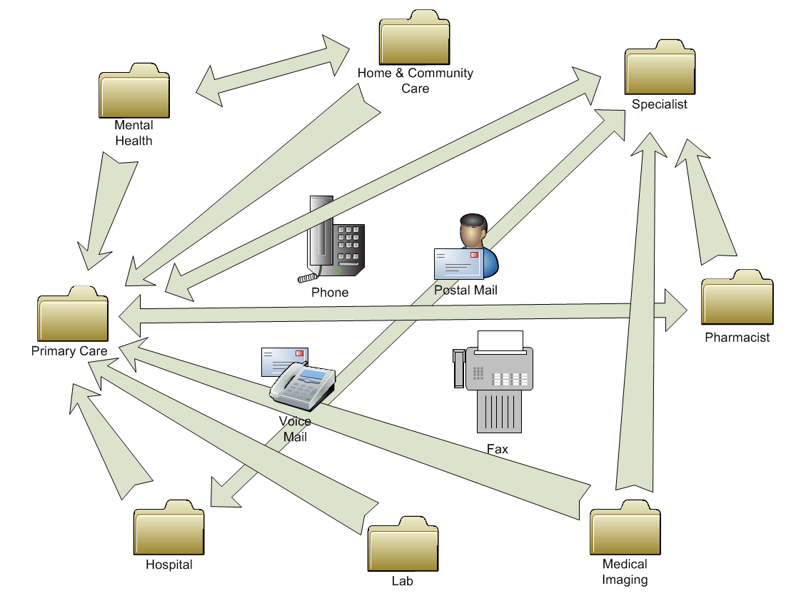
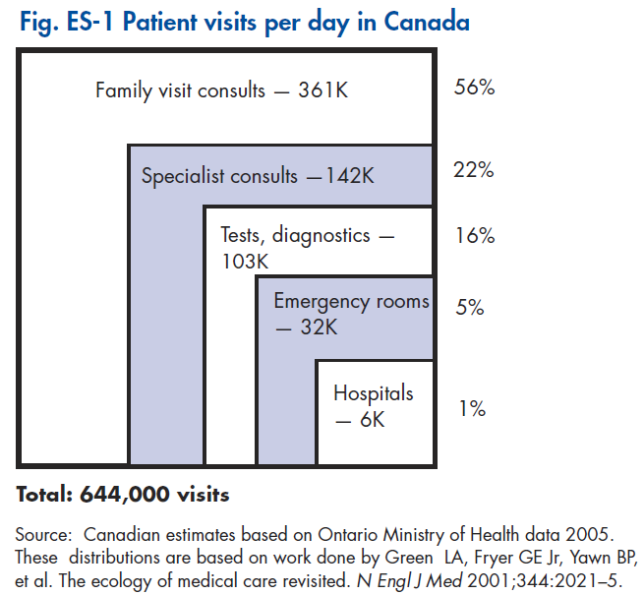

Slide 5
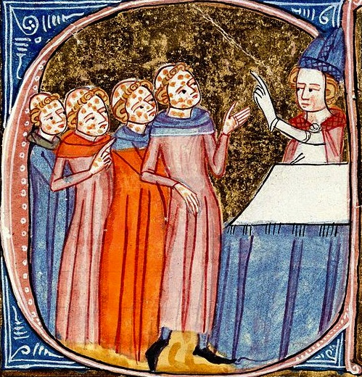
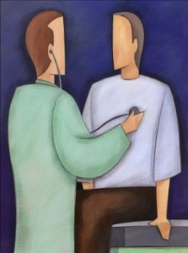


Slide 6
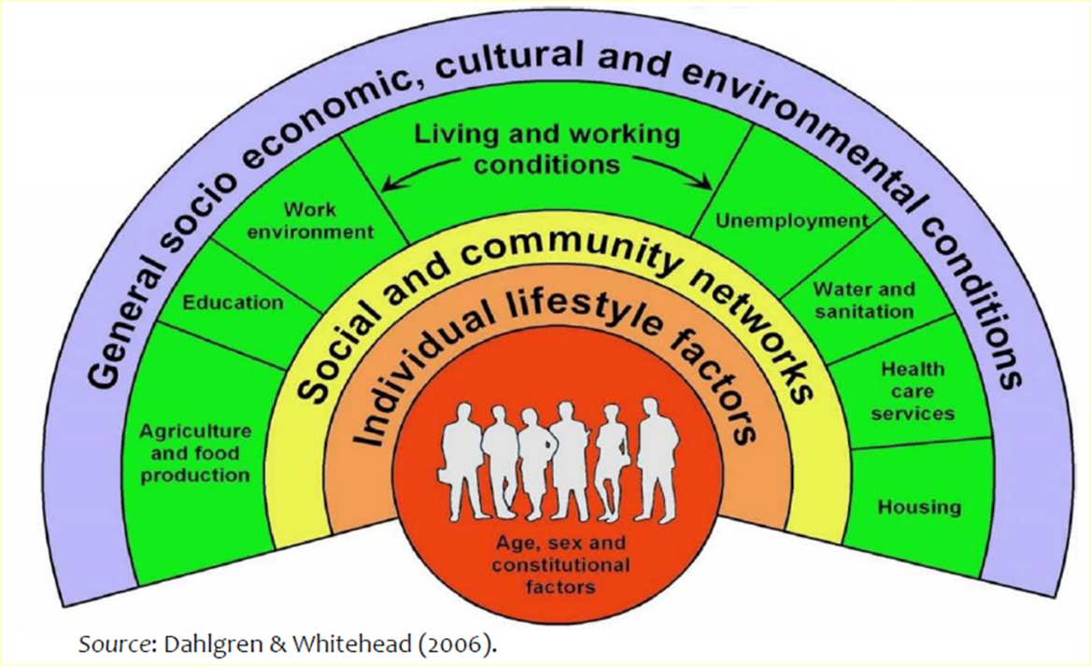

Slide 7
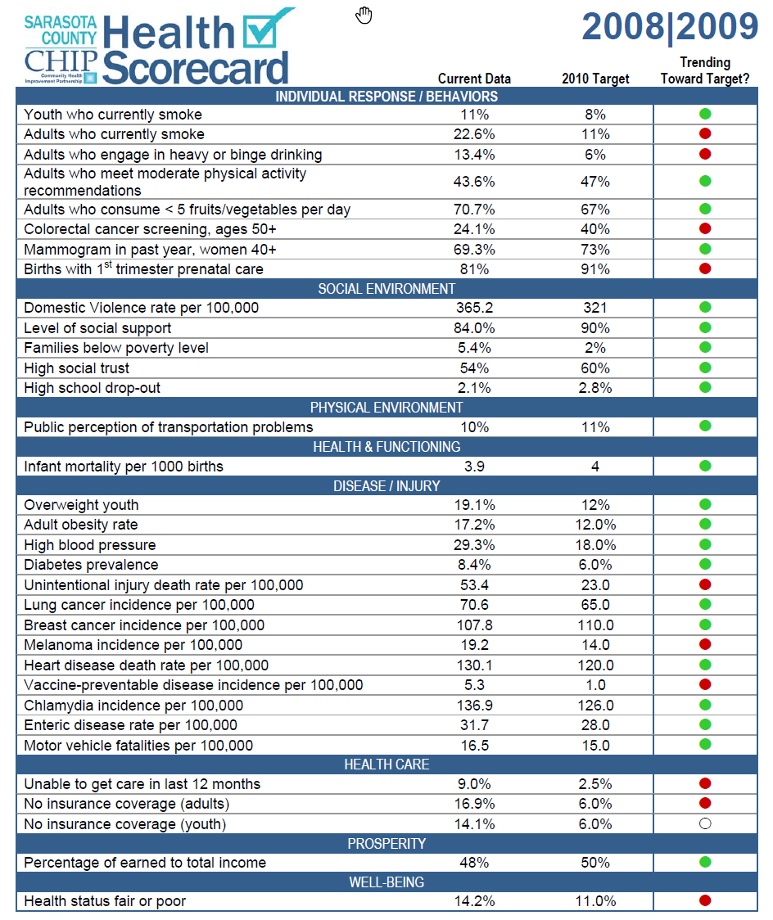

Slide 8
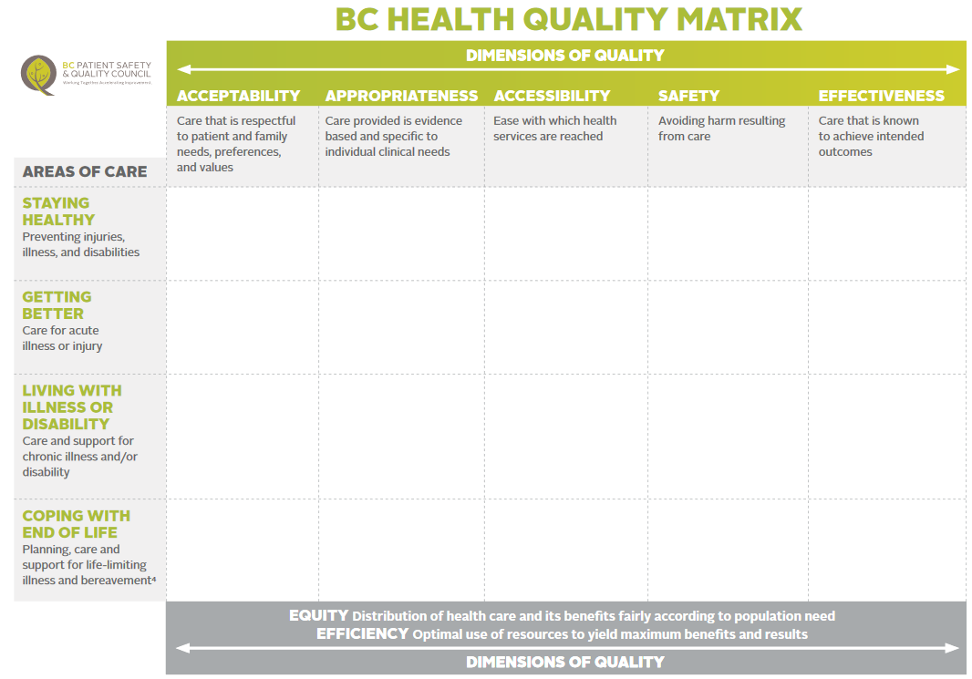


Slide 9
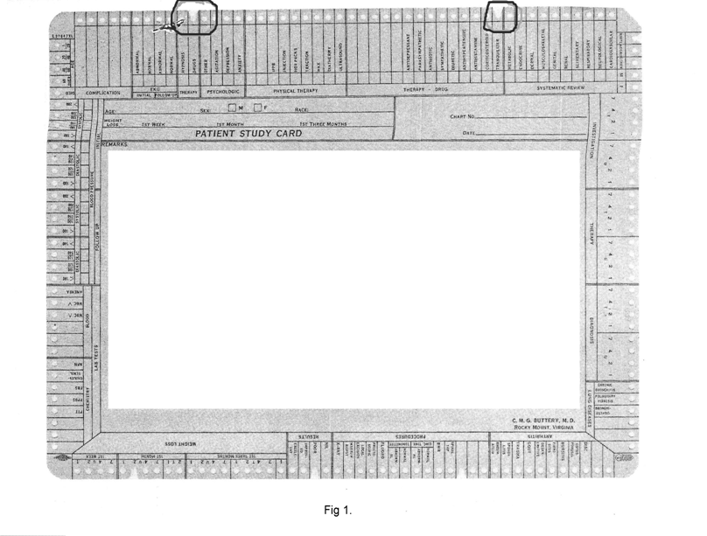

Slide 10
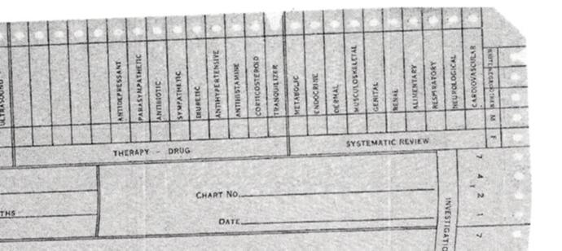

Slide 11
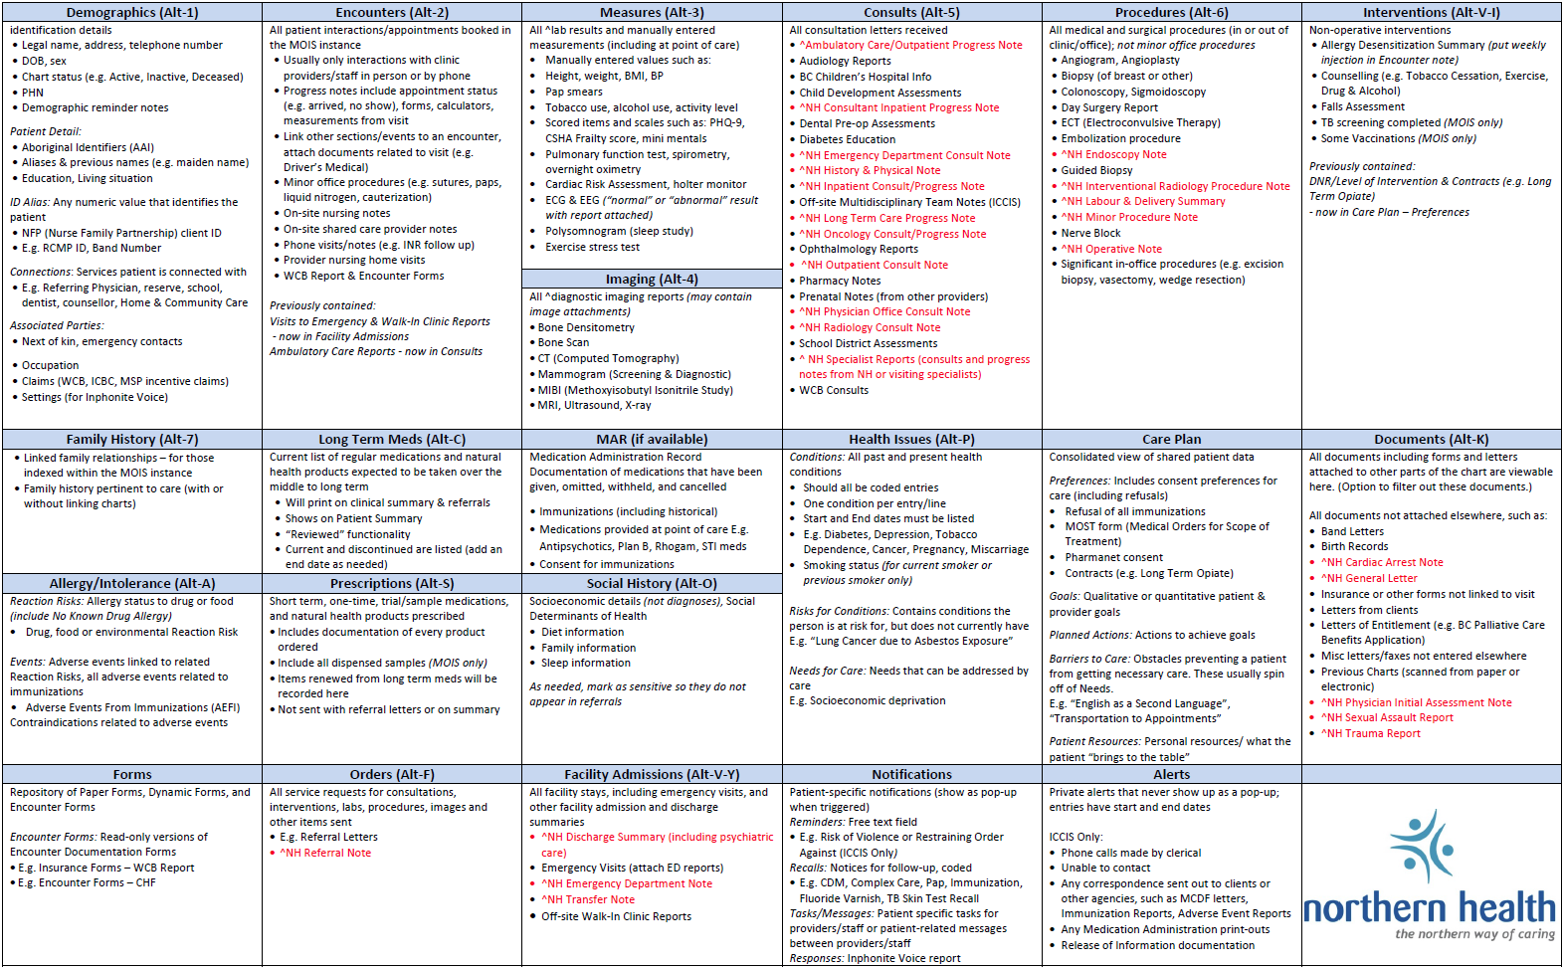

Slide 13
Interoperability – IEEE Definition
“the ability of two or more systems or components to exchange information and to use the information that has been exchanged.”

Slide 14
Northern Core Clinical Data Set
Preferred language (ISO)
Preferred gender
Race & ethnicity (CDC)
Education level (ISCED)
Occupation (ISCO-88)
Living arrangements
Socio-economic (BC DoFP poverty toolkit)
Procedures (SNOMED CT)
Long-term medications (DIN&ATC)
Immunizations (DPD/ATC & PH)
Health concerns
  Problem list – 5,000 SNOMED CT reference set mapped to ICD9-10
  Risk for condition & risk factor (SNOMED CT)
  Unmet needs (Camberwell)
Adverse reactions
  Risk – agent (Multum) and reaction (SNOMED CT)
  Events

Slide 15
Northern Core Clinical Data Set Continued
Laboratory results (LOINC)
Common clinical measures (LOINC where possible – PHQ9, GAD7, Palliative Performance Scale, Pain10 etc. )
Medical Imaging (SNOMED CT)
Function (ICF)
Medical Devices (Health Canada)
Data quality support and review (“the placemat”)
Care plan (CONTsys, Old@Home, HL7)
  Preferences (including consent, advance directives and therapeutic precautions
  Goals & targets
  Planned Actions
  Resources
  Barriers
  Team (connections)
  Associated parties (Power of Attorney, substitute decision maker, spouse etc.)

Slide 16

Some Elements of the Universal Schema
Demographics
  Occupation
  Ethnicity
Observations
  Measurable including laboratory results
  Non-measurable (e.g. cyanosis)
  By history (e.g. insomnia)
  Imaging reports
Procedures/interventions
Health Issues
Medication list
Prescriptions & other instructions/orders (e.g. exacerbation plan)
Family history
Encounters
Care plan elements
Billing (fees suggest services provided)

Slide 17
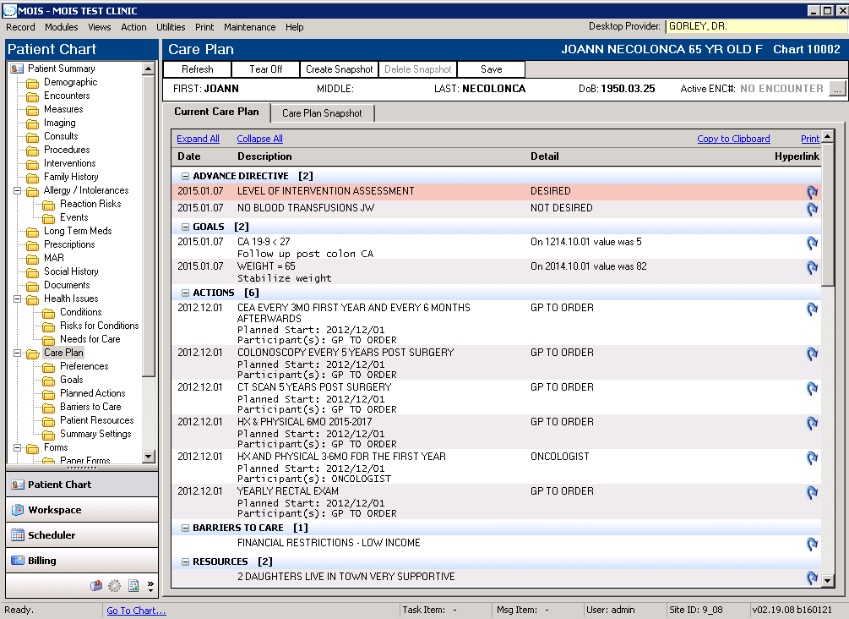


Slide 18
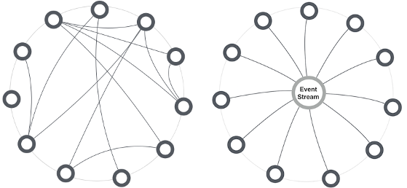


Choreography versus Orchestration
(Jazz versus Symphony)

Slide 19
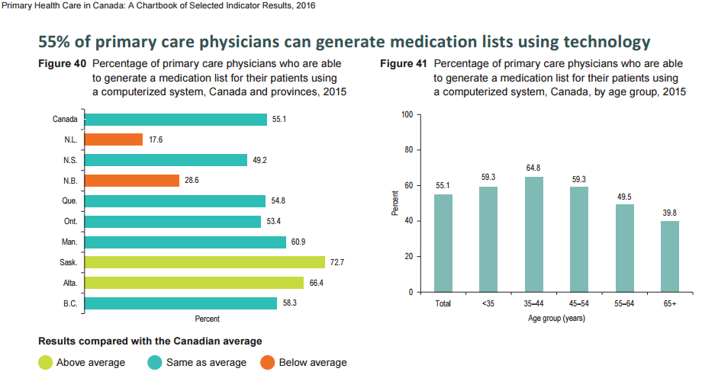
Core Data Set and Data Quality

Slide 20
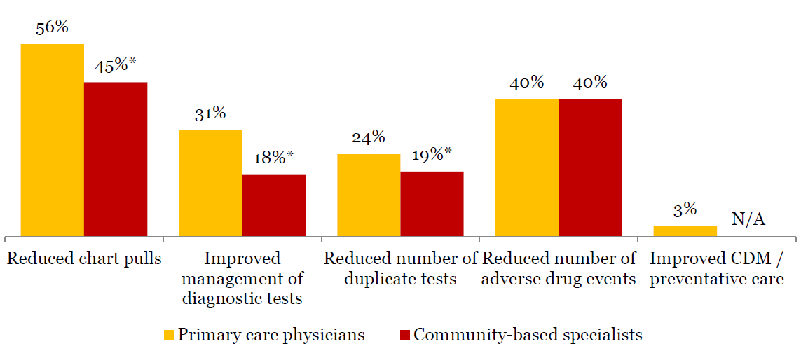
The emerging benefits of electronic medical records in community based-based care, PwC, 2013

Slide 21

Use of information in Primary Care (Commonwealth Fund Report)
Proportion of primary care doctors who

Slide 22
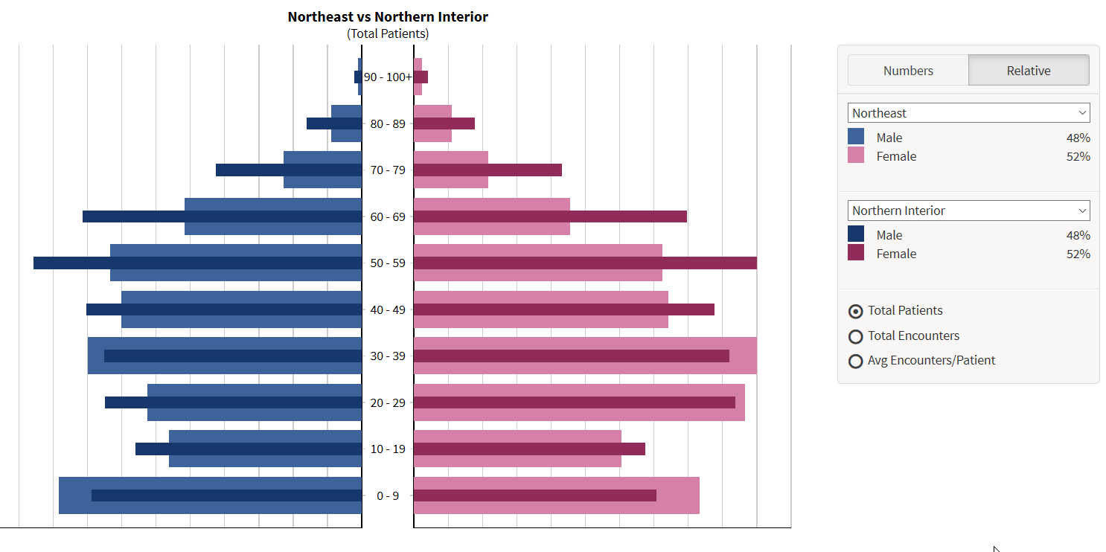
What is my attachment? What is attachment in my community?

Slide 23

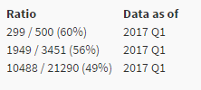
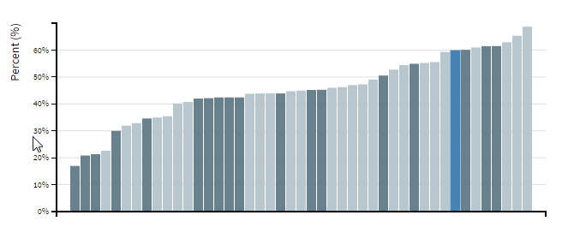
Where am I with respect to my peers?

Slide 24


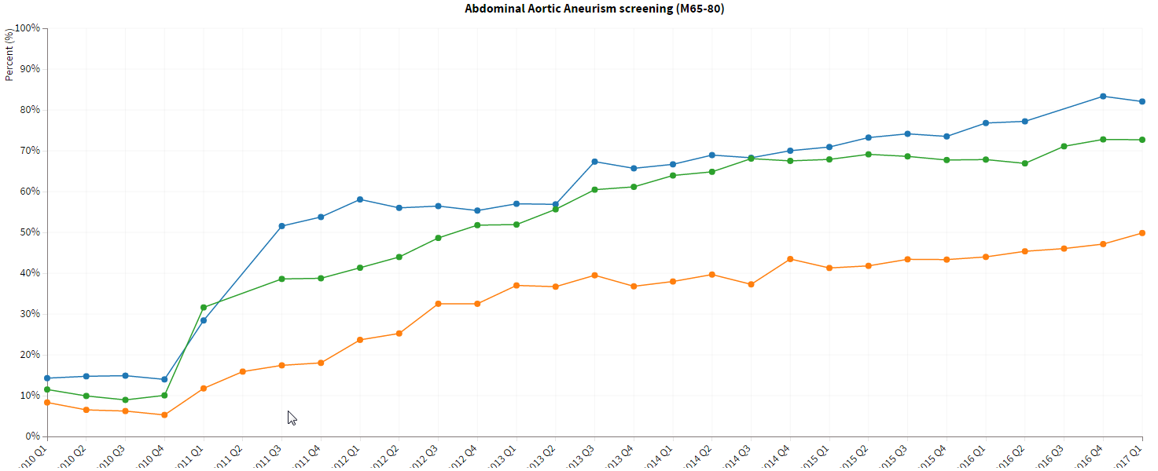
How Did We Get to Here?

Slide 25
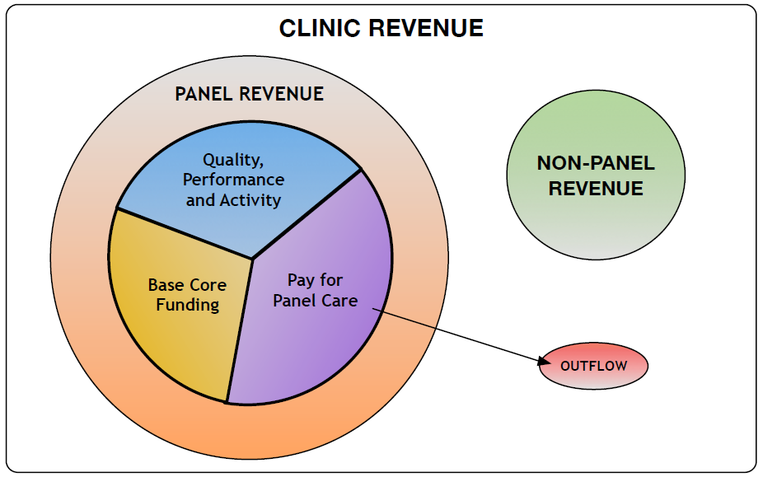

Northern Blended Funding Model
Uses EMR data to determine complexity (health concerns, socioeconomic status and physical / mental functioning measurements)

Slide 26
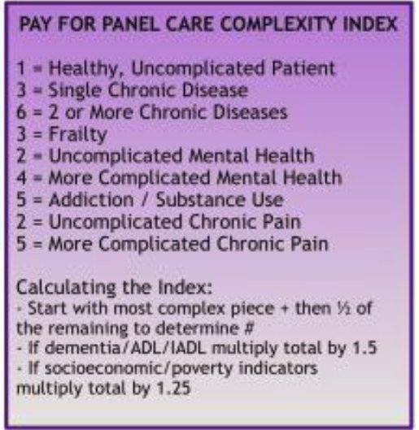
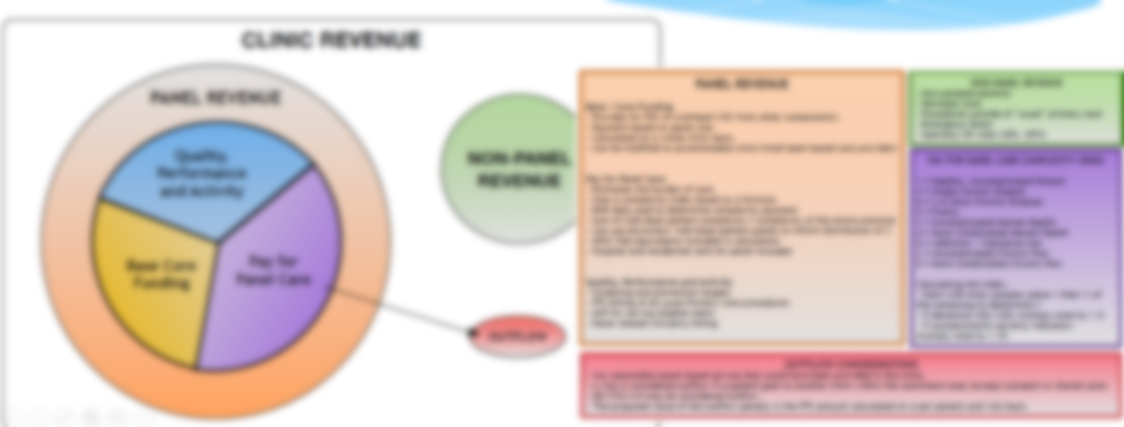

Slide 27
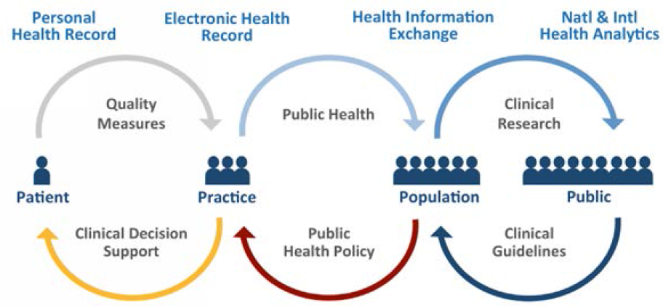
Learning Health System - ONC

