Slide 1
Nurses in primary care
Rosemary Graham, FNP, MN, BScN
GPSC Summit April 17, 2018

Slide 2
Disclosures
Grant/Research Support: NO
Speaker’s Bureau: NO
Consultant: CRNBC NP accreditation assessment & OSCE examiner
Major Shareholder: NO
Other: I work for Island Health Authority

Slide 3
Florence Nightingale
“Money would be better spent in maintaining health in communities rather than building hospitals to cure.”
Notes:
Nursing has its roots in primary health care. Florence Nightingale, widely recognized as the 19th century founder of modern nursing, said: “Money would be better spent in maintaining health in communities rather than building hospitals to cure.” By the early 20th century, registered nurses were serving as autonomous primary care providers, particularly in urban centers and rural communities where the needs were greatest. In 1919, a nurse-run community health center regarded the hospital as a “repair shop, necessary only where preventive medicine has failed.”

Slide 4
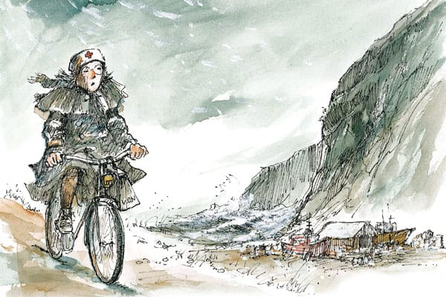
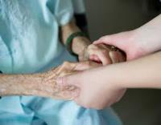
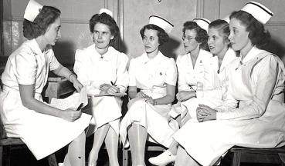
What is a nurse?
Notes:
Nursing has its roots in primary health care. Florence Nightingale, widely recognized as the 19th century founder of modern nursing, said: “Money would be better spent in maintaining health in communities rather than building hospitals to cure.” By the early 20th century, registered nurses were serving as autonomous primary care providers, particularly in urban centers and rural communities where the needs were greatest. In 1919, a nurse-run community health center regarded the hospital as a “repair shop, necessary only where preventive medicine has failed.”

Slide 5
What is a nurse?
A person trained to provide specialized care and assistance through relationship, education and therapeutic intervention.
Supports individuals to the extent that it increases their capacity for health and feeling of wellness.
Can work independently or collaboratively.

Slide 6
Nurses in BC
Oversight and professional regulation by CRNBC, CLPNBC
LPNs, RNs, RPNs and NPs are all regulated health professionals.
Each category of nursing builds on foundational nursing knowledge and skills
Nursing activities depend on location, scope, training &/or privileging and competence.
Work independently or collaboratively on teams

Slide 7
Nurses in BC
Health care for the promotion, maintenance and restoration of health.
Prevention, treatment and palliation of illness and injury, primarily by :
− Assessing health status.
− Planning, implementing and evaluating interventions.
− Coordinating health services.
MAID
Restricted activities
Health Professions Act, 2016
Notes:
There are three main components of the legislative framework that regulates the profession of nursing. These include the Health Professions Act, the Regulations and the Bylaws.
Health Professions Act – the Act is umbrella legislation that provides a common regulatory framework for health professions in British Columbia.
Regulations (BC Reg 129/2016 – June 6, 2016) – Regulations are created by government for each individual health profession governed under the Act. Each regulation defines reserved titles, contains a statement about the scope of practice and outlines a set of restricted activities describing what members of that profession are authorized to do.
Bylaws – each regulatory college has its own bylaws. The bylaws set out the details of the operation of the organization, including: the duties and responsibilities of a governing board, committees and the registrar; qualifications for registration and licensing; the regulation of professional conduct and ethics; and fee schedules.
Professional Regulation

Slide 8
Liability
Licensed professional nurses carry professional liability protection (PLP) for negligence in the provision of nursing services for at least $1 million per claim.
Nurse practitioners are required to have coverage of at least $5 million per claim.
The Canadian Nurses Protective Society (CNPS) provides professional liability protection up to a $10 million limit per year per RN or NP.
CMPA advice to NPs.
CMPA/CNPS joint statement.
Notes:
https://www.cmpa-acpm.ca/en/advice-publications/browse-articles/2014/physicians-and-nurse-practitioners-working-collaboratively-as-independent-health-professionals
https://www.cnps.ca/upload-files/pdf_english/CMPA_CNPS_Joint_Statement_2017_EN.pdf

Slide 9
Liability
“The courts have stated that physicians working in the context of collaborative practice are not required to check the work of other independent healthcare professionals, such as nurse practitioners, who are providing care within their scope of practice and, generally speaking, each healthcare professional is responsible for the care provided.” CMPA 2014
Notes:
Restricted Activities
Restricted activities (formerly called reserved acts) are a narrowly defined list of invasive, higher risk activities that must not be performed by any person in the course of providing health services, except
members of a regulated profession that has been granted specific authority to do so in their regulations, based on their education and competence, and
unregulated persons who have been delegated the authority to perform the restricted activity, or who have been authorized to perform the restricted activity, by a member of a regulated profession that has been granted the restricted activity.
Individual professions will be granted a list of specific restricted activities from a ‘master list’ as appropriate to their education and competencies, which may be performed while providing the services described in their respective scope of practice statements. The same restricted activities may be granted to more than one profession. Not all professions will be granted restricted activities. Unregulated persons or classes of persons may be exempted from the prohibition. The 'master list' and any exemptions will also be established in regulations.
This approach abandons the historical notion of professional exclusivity in which legislation prohibits any person other than a member of the profession from performing certain services or procedures, except where another profession is also specifically authorized in legislation to perform them. Under the new model, many aspects of the scope of practice of each regulated profession may overlap, or be shared, with those of other regulated professions, and may also be performed by unregulated persons (to the extent that either no restricted activities are involved in the service, or the unregulated person is delegated or authorized to perform a restricted activity under supervision).
This approach supports enhanced interprofessional and multidisciplinary practice and increased consumer choice, while maintaining patient safety and public protection.
https://www2.gov.bc.ca/gov/content/health/practitioner-professional-resources/professional-regulation/scope-of-practice-reform

Slide 10
LPN
LPNs have two year diploma education in nursing that covers foundational nursing knowledge.
LPNs care for patients at all life stages and provide care to patients with a focus on stable or predictable states of health.
With additional education and experience some LPNs may be able to care for patients who have more complex care needs.
Notes:
Opportunities for significant LPN involvement in this changing health care environment include:
Chronic disease management (e.g., in physicians offices, home care, senior support programs, outpatient programs for diabetes, chronic obstructive pulmonary disease (COPD), asthma, renal disease, etc.) Ambulatory care centres for non-urgent and emergent care
Preventive care, immunization, school health programs (e.g., nutrition, smoking reduction, etc.) Technical skills and expertise (e.g., casting, dialysis, electrocardiograms [ECGs], venous puncture, etc.) Birth to death - wellness and support.

Slide 11
LPN
Case finding , handover, outreach
Develop health plan with pt & team
Health assessment, screening , promotion
Vital signs
Medication updates
Procedures within scope – labs, dressings, some immunizations & injections etc
Evaluate pt response/effectiveness of interventions
Update plans
Notes:
Opportunities for significant LPN involvement in this changing health care environment include:
Chronic disease management (e.g., in physicians offices, home care, senior support programs, outpatient programs for diabetes, chronic obstructive pulmonary disease (COPD), asthma, renal disease, etc.) Ambulatory care centres for non-urgent and emergent care
Preventive care, immunization, school health programs (e.g., nutrition, smoking reduction, etc.) Technical skills and expertise (e.g., casting, dialysis, electrocardiograms [ECGs], venous puncture, etc.) Birth to death - wellness and support.
Talk about Yukon

Slide 12
RN
Can work in varied settings and with any type of patient, and can care for clients with complex needs in unpredictable situations.
RNs can perform assessments, provide a nursing diagnosis, conduct physical examinations, screening, healthy lifestyle support, education and chronic disease management with a goal of improving health outcomes and facilitating access to services.
RNs work with patients individually or with their teams to develop plans of care

Slide 13
RN
Case finding and case management & coordination
Triage
RN only visits
Initiate labs for screening or monitoring of disease
Treatment, dressings and procedures
Medication dispensing or Rx within scope
Standing orders
Health monitoring, education & coaching
RN co- visits
Medication review
Health maintenance review
Telehealth
Notes:
OHC experience

Slide 14
NP
NPs have graduate or post graduate nursing education. (Masters or doctorate) with autonomous scope
Clinical focus
Assess, treat and educate patients & plan ongoing care and surveillance.
ORDER a wide range of diagnostic tests (e.g. X-rays, lab tests, ultrasounds, MRIs).
DIAGNOSE and treat a disease, illness or condition.
REFER to specialists.
PRESCRIBE Schedule I, IA and II drugs.
Leadership
Research

Slide 15
NP
MRP & collaborative partner in care
Med reconciliation & Rx initiation or renewal
Health and illness screening, assessment & monitoring and treatment within scope
Ordering investigation -labs, x-ray, U/S, CT, MRI biopsy
In-office surgical or other interventional procedures
Referral to medical specialists
Admit and discharge with privileging
Team leadership, education
Research
Notes:
Evergreen and OHC
Admit and discharge with privileging

Slide 16
Fit
Population, patient needs
Location – office or remote
Scope – LPN, RN, NP
Competence – novice to expert
Experience – remote, community, hospital
Personal qualities – adaptability, willingness to learn etc.
Team fit – mentorship, leadership, collaborative

Slide 17
Right fit for patient and team
Notes:
Consultation and inclusion - build your team around patient
Discuss experience Dawson, Vancouver Island Health

Slide 18
References
BC Laws, Health Protection Act, Nurses and Nurse Practitioner Regulation, 2016. http://www.bclaws.ca/civix/document/id/lc/statreg/284_2008
Byers, D , 2018, Nursing Policy Secretariat, Priority Recommendations. https://www.health.gov.bc.ca/library/publications/year/2018/nursing-policy-consulation-report-Jan24-2018.pdf
CLPNBC Scope of practice for LPNs in BC, 2018 revisionshttps://www.clpnbc.org/Documents/Practice-Support-Documents/Scope-of-Practice-ONLINE.aspx
CRNBC, Overview of the Health Professions Act, RNs and Nurse Practitioners. https://www.crnbc.ca/crnbc/Documents/324.pdf
CMPA, 2014, Physicians and nurse practitioners: Working collaboratively as independent health professionals https://www.cmpa-acpm.ca/en/advice-publications/browse-articles/2014/physicians-and-nurse-practitioners-working-collaboratively-as-independent-health-professionals
Executive Summary, Conference Recommendations, Macy Foundation, June15-18, 2016 Atlanta Georgiahttp://macyfoundation.org/docs/macy_pubs/201609_Nursing_Conference_Exectuive_Summary_Final.pdf
Proden Bhalla, N, Scott, L. 2016. Primary Care Transformation in BC, A New Model to Integrate Nurse Practitionershttps://bcnpa.org/wp-content/uploads/BCNPA_PHC_Model_FINAL-November-2-2016.pdf

