Slide 1
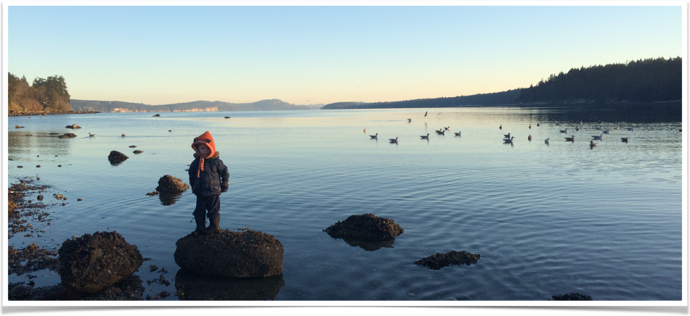
Ferry Dependent
Self Reliant
A Rural, Island Community Takes Charge of its Own Health Care
Tracey Thorne BSc, MD, CCFP
Nancy Rowan BScN, MHSA
GPSC Spring Summit
Vancouver, BC
April 17, 2018

Slide 2

Disclosures
No financial relationship with industry
Telus donated in kind services to the building of the Gabriola Medical Clinic and produced a video that will be shown as part of this presentation

Slide 3
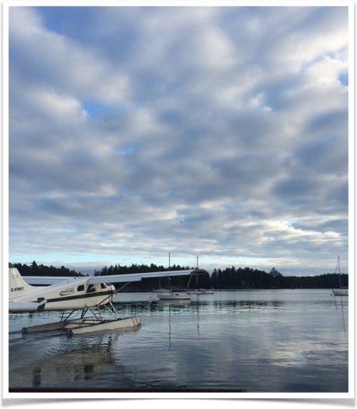
Gabriola Island
Population - 4033
Geography - 14 x 4 km island in the Salish Sea
Access - BC Ferries, private boat, sea plane
Economy - Arts, Tourism, Home based business, Agriculture
Governance - Islands Trust, Regional District of Nanaimo
Median Age - 61.3, 50% population >65
Seniors Living Alone - 26.6%
Low Income - 25%
Children Living in Poverty - 39%

Slide 4
Conditions Leading to Change
Lack of urgent/emergency care
High suicide rate and prevalence of mental illness
Access to primary care hampered by lack of doctors, nurses and allied health professionals
Inadequate facilities
Ferry dependent, no night time service
Urban centric health care delivery despite barriers to access
Lack of system concern for island/rural culture
Strong sense of community, and a motivated population
A whole community of “patients” prepared to voice their unmet needs and create and support a health system to serve their needs

Slide 5
Gabriola Community Health Centre

Slide 6
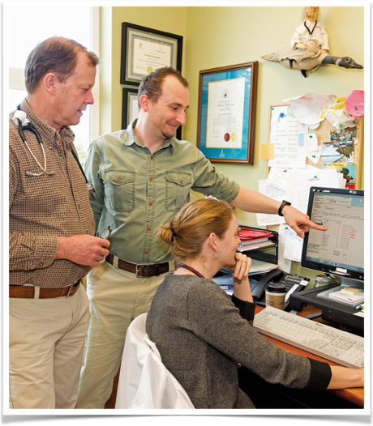
Clinical Change Realized
Recruitment and retention of 3 full-time GPs providing primary care and urgent after hours on-call care
Demonstrations projects prove value and lead to permanent positions for a mental health nurse and social worker
Expansion of home care, seniors outreach, public health, specialist services
Creation of primary care home model
Acquisition of Telehealth services

Slide 7
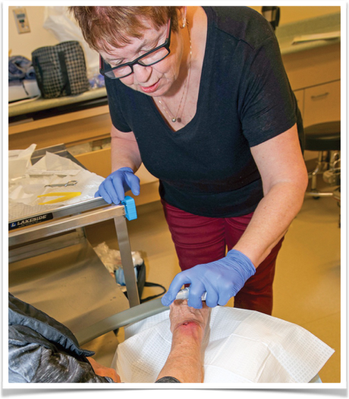
Primary Care Home Accomplishments
Primary Care Home serves 3270 patients
1300 patient seen for urgent care annually
24.5% treated are not patients of the clinic
90% are seen and discharged without transport
Mental Health Nurse has approximately 500 appointments annually (intake, case management, follow-up)
Visiting psychiatrist ~ monthly appointments
Social Worker encounters – approx. 500 annually
40% reduction in RCMP callouts for mental health crises
Home care nurse approx. 800 appointments/annum
Telehealth approx. 120 appointments annually
Public Health immunization clinics monthly

Slide 8
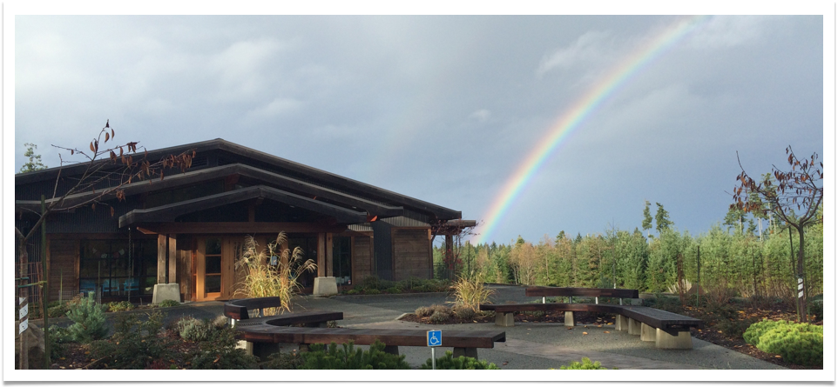
Value of Co-location in Primary Care
Monthly interdisciplinary rounds
Daily contact
Opportunity to see patients together
Regularly move patient from one profession to another based on need
Immediate problem solving in palliative care, wound care or mental health crisis
Great team atmosphere and building of relationships
Shared successes and shared burdens

Slide 9

Our Team

Slide 10
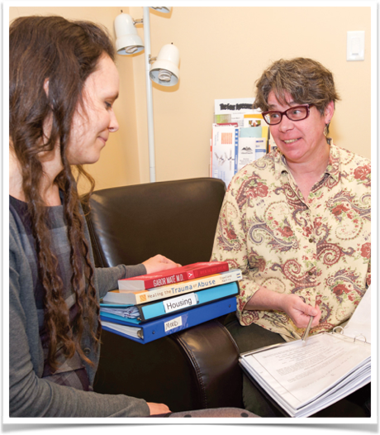
Community Experience
Sustainable access to primary care, after hours care, mental health services, home care nursing, social work, visiting specialists
Marginalized patients have been identified and programs created to target mentally ill, frail elderly, socially isolated
Barrier free wellness programs from cradle to grave through collaboration with community groups
System navigation now supported by online and in person resources

Slide 11
Tools of Engagement
Partnerships with local not-for-profits and health authority
Comprehensive needs assessments with broad community and via action teams
Citizen/patient participation on action teams along side physicians and system managers
Demonstration projects based on assessed community need
Collective action – community priority setting with engaged community groups and citizens
Evaluation process involving all stakeholders

Slide 12
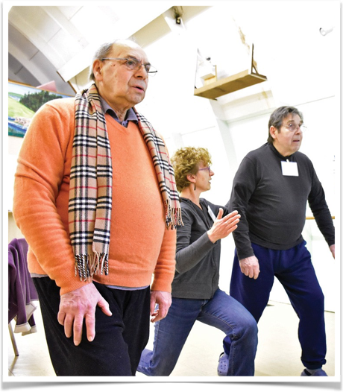
Community Programs
FETCH Website
Peer led exercise program
Volunteer training in CMHA programs
Community programs and workshops in ASSIST, Safe Talk, Recovery Yoga, Trauma Based Care, Chronic Disease Management
Art therapy based programs for people facing challenging diagnosis, intentional aging and adults with special needs
Weekly day program for vulnerable seniors
Seniors lunch
Support groups for Caregivers, AA, NA, grief
Meals for Wheels, Drivers to Doctors
Rug-Huggers and Mother Goose for families
Community Paramedic Program

Slide 13

Mission Statement
Enhancing Resources for Community Health and Well Being
To create opportunities among the Gabriola Health and Wellness Collaborative members for mutual support, shared advocacy and improved use of funding resources in order to improve health outcomes for all Gabriolans

Slide 14
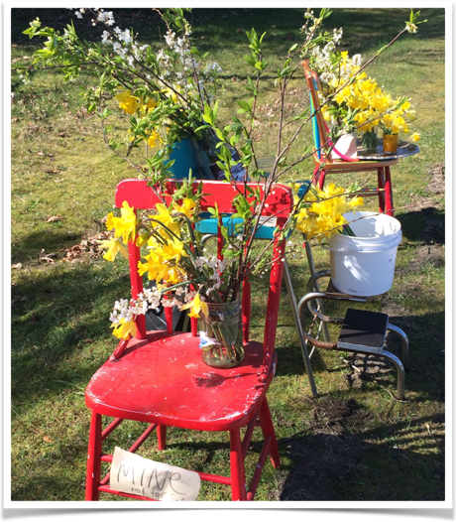
Current Collaborative Objectives
Encourage an integrated approach to health and wellbeing
Increase awareness of and access to social and health care services
Increase the coordination of social
and health care services
Support the ongoing education of health
service providers
Expand societal connections for
vulnerable and/or isolated people
Address major health challenges on Gabriola e.g. mental health and substance use
Guided by the social determinants of health

Slide 15
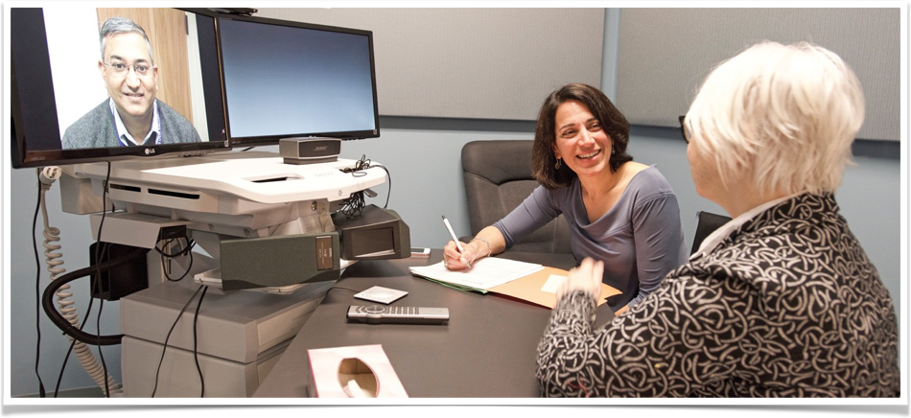
Factors Enabling Success
Citizen engagement and volunteerism
Community owned facility
Primary care reform focusing on the Primary Care Home model
Allied health providers based in the community
Success of Rural and Remote Division of Family Practice
Health Authority restructuring into geographic regions allowing for a rural lens
Successful development of heath system, community and not-for-profit partnerships

Slide 16
Unique Contribution of Rural and Remote Division
GP for Me Funding
  Community Social Worker position
  Development of the Health and Wellness Collaborative
Improved Communication with the Health Authority
  Contributed to enhancement of professional relationships and ongoing, open dialogue with health authority leadership
  Led to improved Home Care and Mental Health services
  Recognition that “rural is different”
Support for physicians to engage with community initiatives
  Participation in community organized events for Mental Illness and Mental Health Week, Seniors Day Program, Palliative Care working group and the Gabriola Health and Wellness Collaborative
Support for new technologies
  Funded tele-health video conferencing equipment
Administrative and project management support
  Maximizes physician impact in system change by supporting planning, coordination and representation
Innovation Spread
  Shares learnings of the strength of physician, HA and community partnerships to other Divisions and rural communities

Slide 17
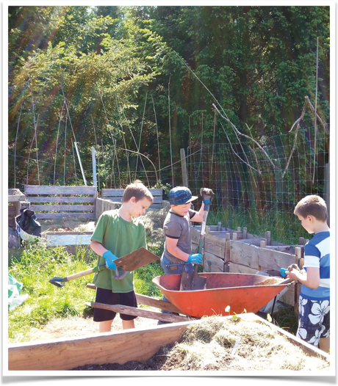
Where do we go from here?
Building sustainable rural capacity
Ongoing collaborative partnerships with multiple levels of government and across departments/ministries/budgets
Interdisciplinary team expansion to include nurse in practice, community support workers, physical therapy, increased public health services e.g., prenatal
Continued Community Engagement focusing on addressing the social determinants of health - Collaborative goals for 2018 are related to children and families and palliative care

Slide 18
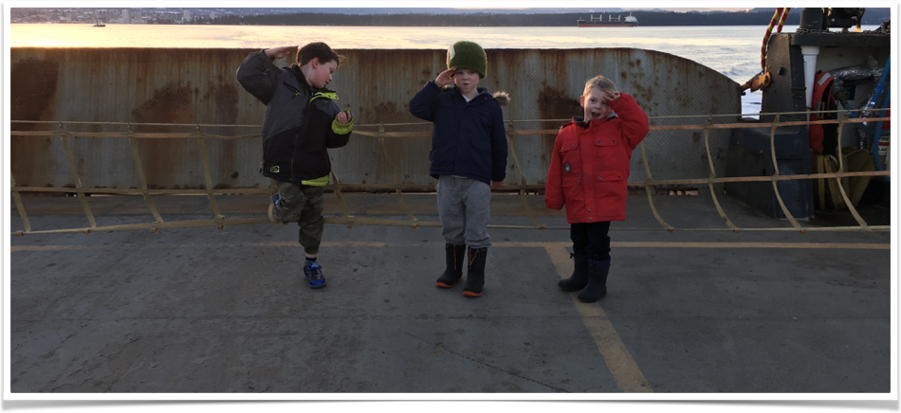
Questions?
Thank you!
Contact:
Tracey Thorne - drtthorne@icloud.com
Nancy Rowan - nrowan@divisionbc.ca

