Slide 1
Engaging Specialists, Patients and Families in Primary Care Transformation
April 16th, 2018

Slide 2

WELCOME
Katie Hill Director
Shared Care Committee

Slide 3
Disclosure
Katie Hill

Slide 4
SCC Mandate
Engage GP's, Specialists, GP's with Focused Practice and other health professionals to develop collaborative models of care, and improve the experience of patients and families as they move between health care providers and care settings

Slide 5
Road to System Transformation
Focus on Primary Care Transformation
Patient Medical Homes – Primary Care Networks
Missing Element – Community Specialist Practice
Lessons Learned Elsewhere
  Starting Integrated is Better
  Patient Medical Homes Operate in the Larger Medical Neighbourhood
Coordination of Care – Communications Among Providers, Patients and Family Caregivers

Slide 6
Creating Successful Change
“With all that has been discovered in the past decade, we now know that medical homes must achieve three key goals to be successful:
They must perform population health management
They must implement a variety of health IT tools to do that and coordinate care effectively, and
They must develop relationships and workflows with the other providers in their medical neighborhoods”
Hodach, Grundy, Jain & Weiner
Provider-led Population Health Management

Slide 7
SCC Initiative
Support engagement of specialist physicians, other health professionals, patients and families as primary care work gets underway
Focus on Older Adults (Chronic Conditions and/or Frail)
  Improve communication and care coordination
  Improve transition between providers and services
  Support a shared care approach over the continuum

Slide 8
Where Do Seniors Receive Care
~ 850,000 seniors in BC
~12% of seniors see GP only in PMH
~88% of seniors are managed by GPs, SPs and families
~15% of seniors on Home & Community Care caseload

Slide 9

Role of Family Caregivers
Janet McLean
Family Caregivers of British Columbia

Slide 10
Disclosure
Janet McLean
Education & Engagement Lead Family Caregivers of BC
Notes:
We are non profit charity, and our Provincial Caregiver Program is funded by the Ministry of Health, Patients as Partners

Slide 11
Patient and Family Centered Care
“Puts patients at the forefront of their health and care, ensures that they retain control over their own choices, helps them make informed decisions and supports a partnership between individuals, families and health care services providers. Patient-centered care incorporates the following key components:
  Self-management
  Shared and informed decision making
  An enhanced experience of health care
  Improved information and understanding
  The advancement of prevention and health promotion activities.”
The British Columbia Patient-Centered Care Framework, 2015
Notes:
This a door opener

Slide 12
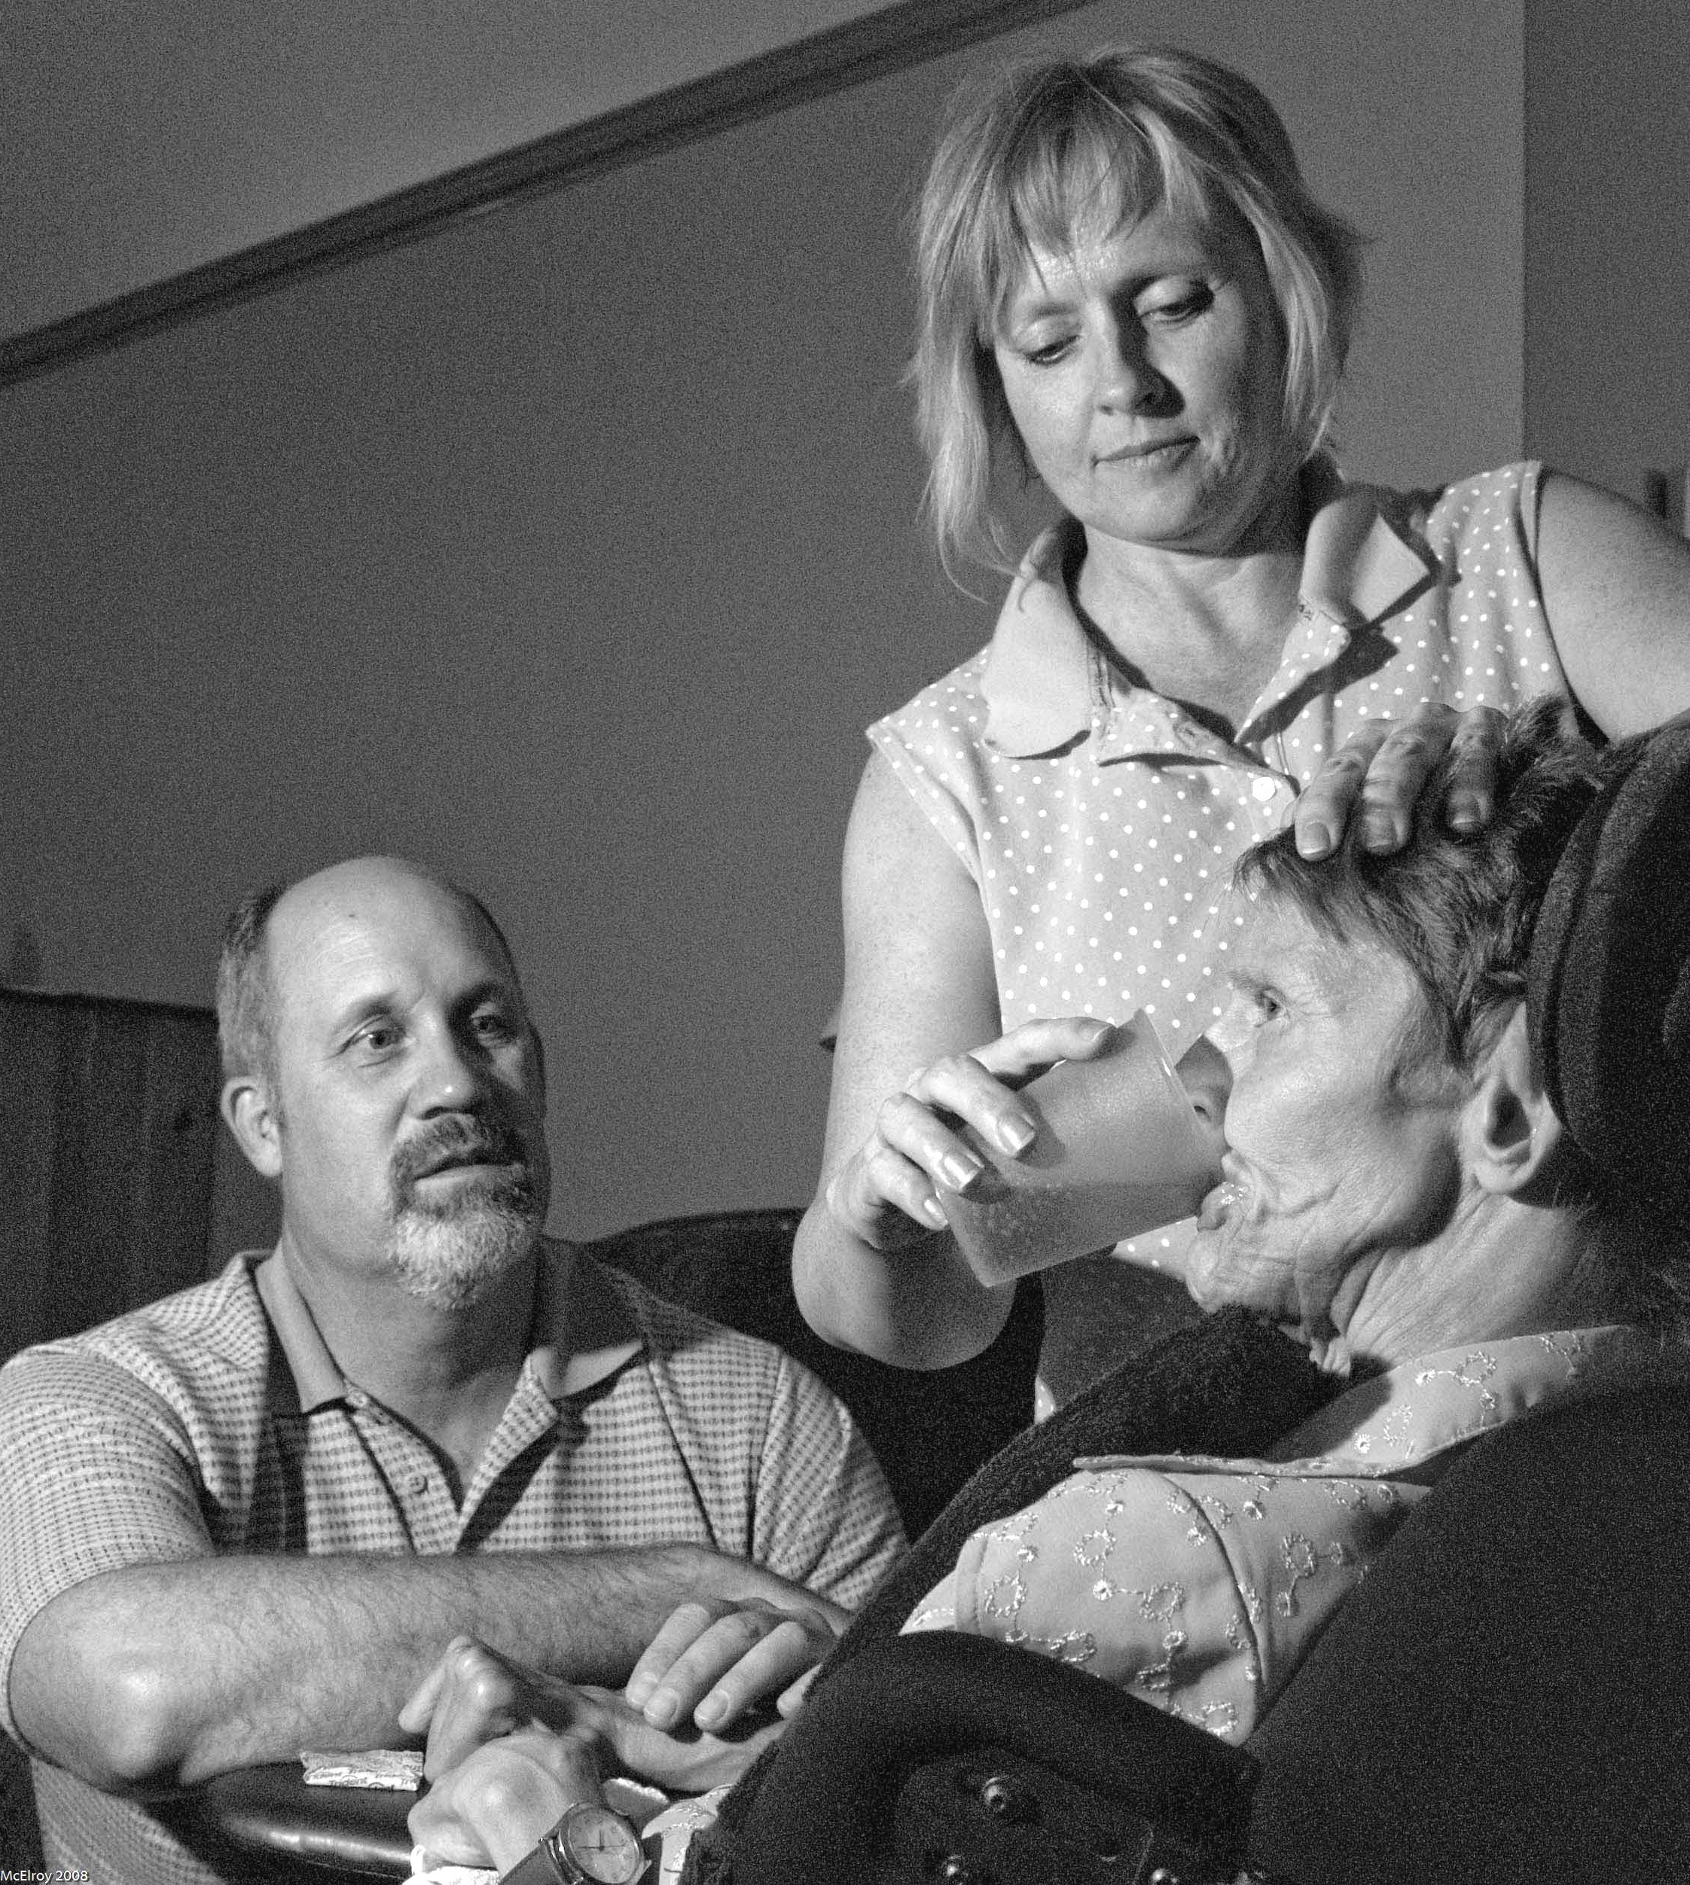
If “home is best”,
who’s at home?

Slide 13

80%
80%
Notes:
Over 80 % of the care is by family and friend caregivers.

Slide 14
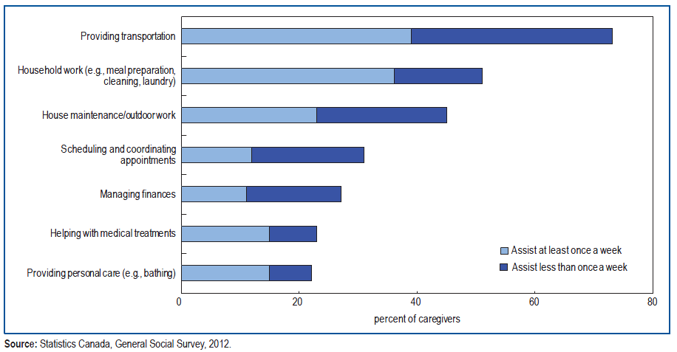
Caregiving Tasks
www.familycaregiversbc.ca

Slide 15
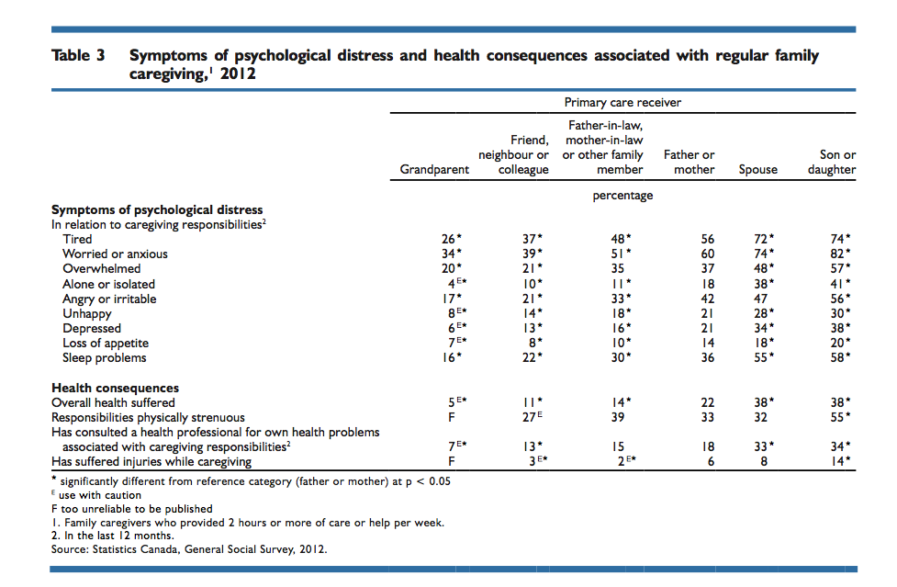
Caregiving is a health issue
Turcotte, M. 2013. “Family caregiving: What are the consequences?” Insights on Canadian Society. Catalogue no. 75‐006‐X, September.
Notes:
There are consequences to the health system when – and if – caregiver health suffers. Prevention is key, the evidence is clear.

Slide 16
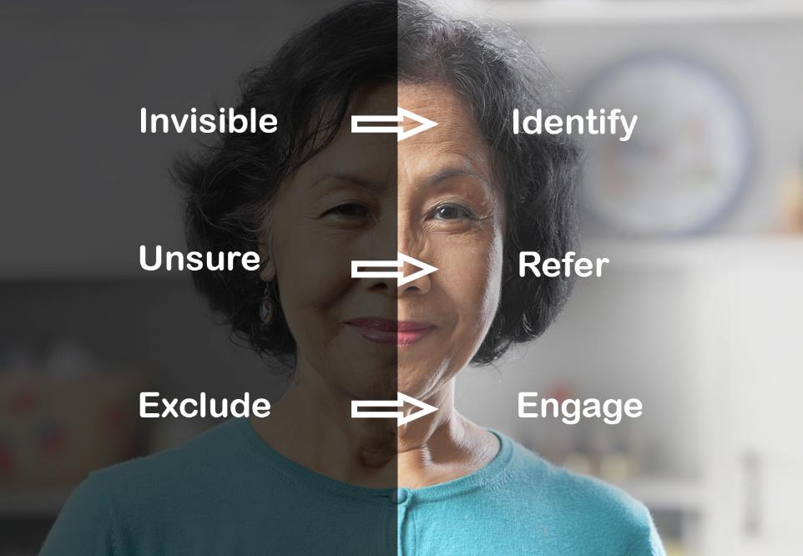
Family Caregivers – A Shift is Required

Slide 17
IDENTIFY Family Caregivers
Use the right language to identify caregivers
  “Are you looking after someone who couldn’t manage without your help?”
Embed identification of caregivers into care processes

Slide 18
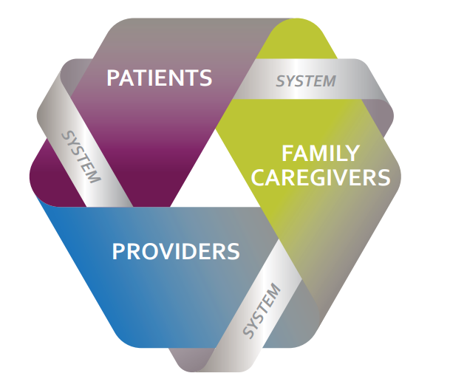
The Care Team Triad
Let’s open the door wider:
who’s on your
care team?
Old ways
won’t open
new doors.
Image: The Change Foundation
Notes:
Including caregivers at the point of care, at the community or clinic level, and at the policy level. They are critical partners in care.

Slide 19
Coordinating Care Along the Continuum
Dr. Jiwei Li

Slide 20
Disclosure
Dr. Jiwei Li
Family Physician
Member Shared Care Committee

Slide 23
Barriers and Bright Lights
Naming the issues and highlighting the hope
Margaret English
Lead, Shared Care Committee

Slide 24
Considering the Continuum of Care
Staying healthy, & health promotion (NGO & SP supportive involvement with PMH)
Beginning to deal with illness (SP “consultative” & care coordination with PMH), family caregiving starts now
Complexity increasing-patient at home (SP episodic or longitudinal care, Family Caregivers)
High acuity & end of life (PMH, Specialist, PCN & Family Caregivers)

Slide 25

At Your Table (15min)
Discuss the key gaps in care or barriers you see in care coordination and communication between GPs, Specialist Physicians, other health professionals and family caregivers for older adults with complex conditions
Write these on the boulders provided - be descriptive
(one gap/barrier per bolder)
FEED ME

Slide 26

At Your Table (15min)
Discuss the innovations and promising practices you see improving care coordination and communication between GPs, Specialist Physicians, other health professionals and family caregivers for older adults with complex conditions.
Write these on the fish provided – be descriptive
(one thing per fish)
Swimming upstream!

Slide 27

Take your boulder and fish and place them in the stream

Slide 28
Barriers and Bright Lights Summary
Each table report out key challenges and opportunities

Slide 29
What Now
Think about how these issues can be addressed in your community
Contact us if you’re interested in being involved in the initiative

Slide 30
Thank You!
Katie Hill, Director Shared Care Committee khill@doctorsofbc.ca
Dr. Jiwei Li, Family Physician, Shared Care Committee jiwei.li@vch.ca
Janet McLean, Family Caregivers janetmclean@familycaregiversbc.ca
Margaret English, Lead, Shared Care Committee menglish@doctorsofbc.ca

