Slide 1
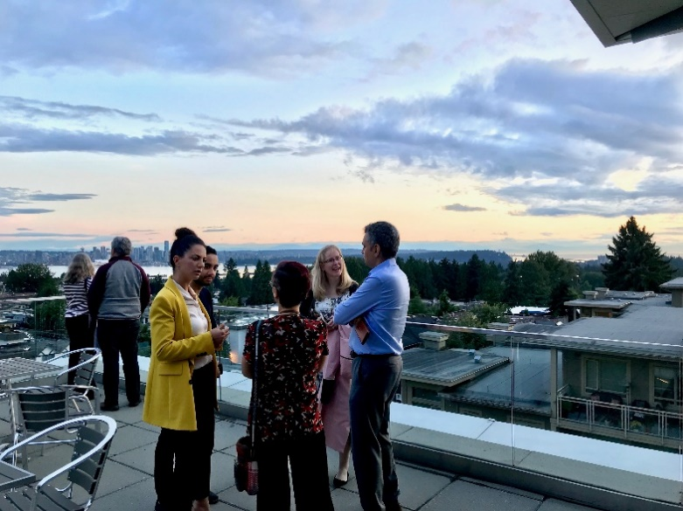


MDs4Wellness North Shore
North Shore Division
Committee Mandate:
In collaboration with LGH Physician Engagement Society (PES), advocate for and promote physician wellness by facilitating networking opportunities among Family Practitioners and between FPs and specialists on the North Shore.
2018: Four events, 232 physicians and specialists engaged
2019: Focus on mindfulness and meditation
Event examples: Workshops with Dr. Dike Drummond, mindful breathing and meditation practice at the Centre for Mindfulness Canada, workshops with Dr. Mark Sherman, and more.

Slide 2


Opioid Crisis and Chronic Pain Management Project
North Shore Division
Key Impacts
Pilot project for chronic pain patients in the form of a Gentle Movement program followed by sustainable classes run at local rec centres.
Patient navigator tool to be used for ED pain crisis visits and with other members of their healthcare team.
Suboxone mentorship program for new prescribers.
Chronic Pain Community Resource Fair and speaker to foster the development of a local network patients and care providers
June 2018
Funding received
Spring 2019
Pilot programs in progress. 2 physician education sessions complete.
Fall 2019
OAT Mentorship program kicks off with extended funding and final report is submitted.

Slide 3
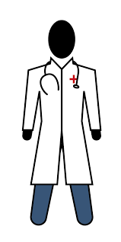



Assisted/Independent Living Pilot Project: “Health Hub”
Delta Division
Pilot expanded to second seniors residence
97% family physician engagement
83% of residents feel more confident taking care of their own health
96% increased their knowledge of healthy aging
93% are more aware of supports and services available to them
Mobile Falls Clinic resulted in Reduced Risk of Falls
Expedited referrals to Fraser Health Home Health Services
Streamlined connections to specialised services for pre-frail and frail seniors

Slide 4

Physician Recruitment
Delta Division
Five new physicians chose to practice in South Delta!

Slide 5



First Nations Health Care Access: Bringing Doctors into Safe Spaces
Campbell River and District Division
Kwakiutl District Council Health (KDC) has partnered with the Strathcona Site of the UBC Family Medicine Residency Program to create clinic space for second-year Residents to deliver primary care services through KDC’s On-Reserve Health Care Centres.
Residents train in trauma informed practice, traditional medicines, history of the territory, and more.
By March 2020, with the continued support from the division, KDC & UBC are hoping to have Resident Clinics open in all four of our Health Centre locations:
K’omoks, Quinsam, Cape Mudge, and WeiWaiKum Reserves.
12 sessions | 6 months
“We appreciate having the opportunity to get to you guys to talk to you before you go out into the medical world. We have been very poorly treated by doctors for many, many years.
It’s nice to see you coming to talk to us now.”
–an elder during the annual Elders Circle for the residents

Slide 6
Campbell River and District Division
PMH DEVELOPMENT
Division, Medical Clinics & Community Health Services (CHS)
Three Advisory Meetings involving:
GPs, R2, MOAs, RN/LPNs, RPT, Pharm, Social Workers, Mental Health Clinical Coordinator, PSP
Goal: Focussed development of integrated team-based care with four FP Clinics & CHS Services
PLANNING
Fall 2018
CONSULTATION
PLANNING
UBC: Team-Based Care Planning and Team Mapping Workshop
COLLABORATION
PARTNERSHIP
Dec 2018
Team Mapping Workshop Report – Morgan Price, et al.
Four Clinic and CHS Debrief and FU workshop
Collaboration on development of a
Health Care Professional Office Communication Tool
Spring 2019

Slide 7
Campbell River and District Division
Case manager initiative launch event
Pilot Initiative: Integrate Case Managers into three family practices along with a new communication tool for referrals to Community Health Services (CHS).
On September 4, 2019, the Division held a meeting at one of the participating clinics to launch the initiative and discuss how the clinics and Case Managers can work together to deliver patient care.
Response was very positive!

Slide 8
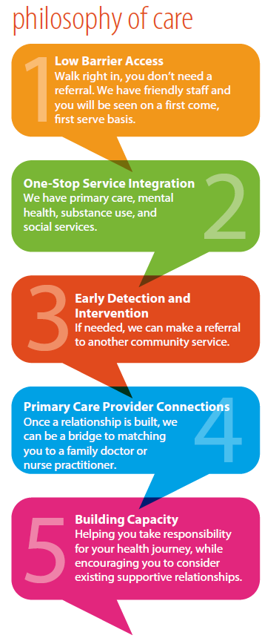
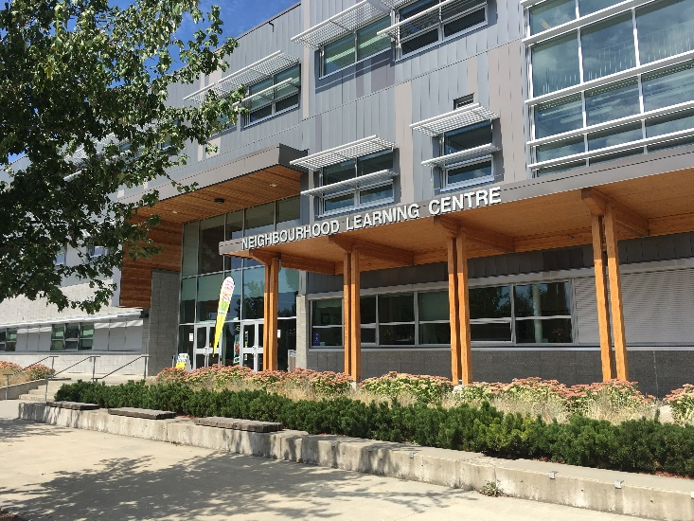
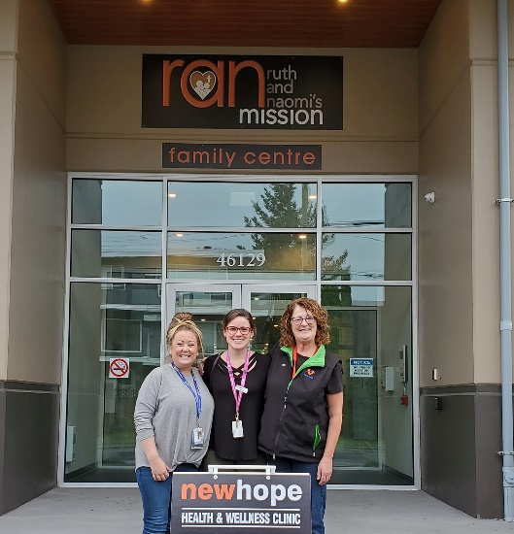
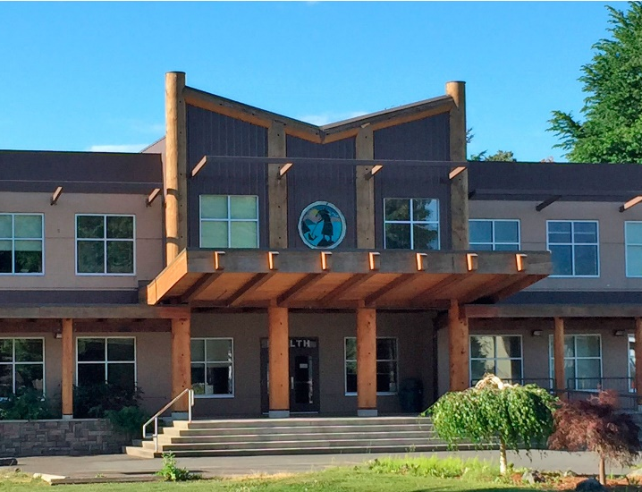













Outreach Clinics
Chilliwack Division
Partnerships enable us to support outreach clinics that serve vulnerable populations (youth and young adults, street entrenched, and LGBTQIA).
Team-based care enables us to provide the right care, by the right person, in the right place. We have an awesome team of family physicians, nurse practitioners, nurses, counsellors, pharmacists, a psychiatrist, and medical office assistants!
When we leverage our collective resources, patients and providers are better supported to receive and provide care in the community.

Slide 9
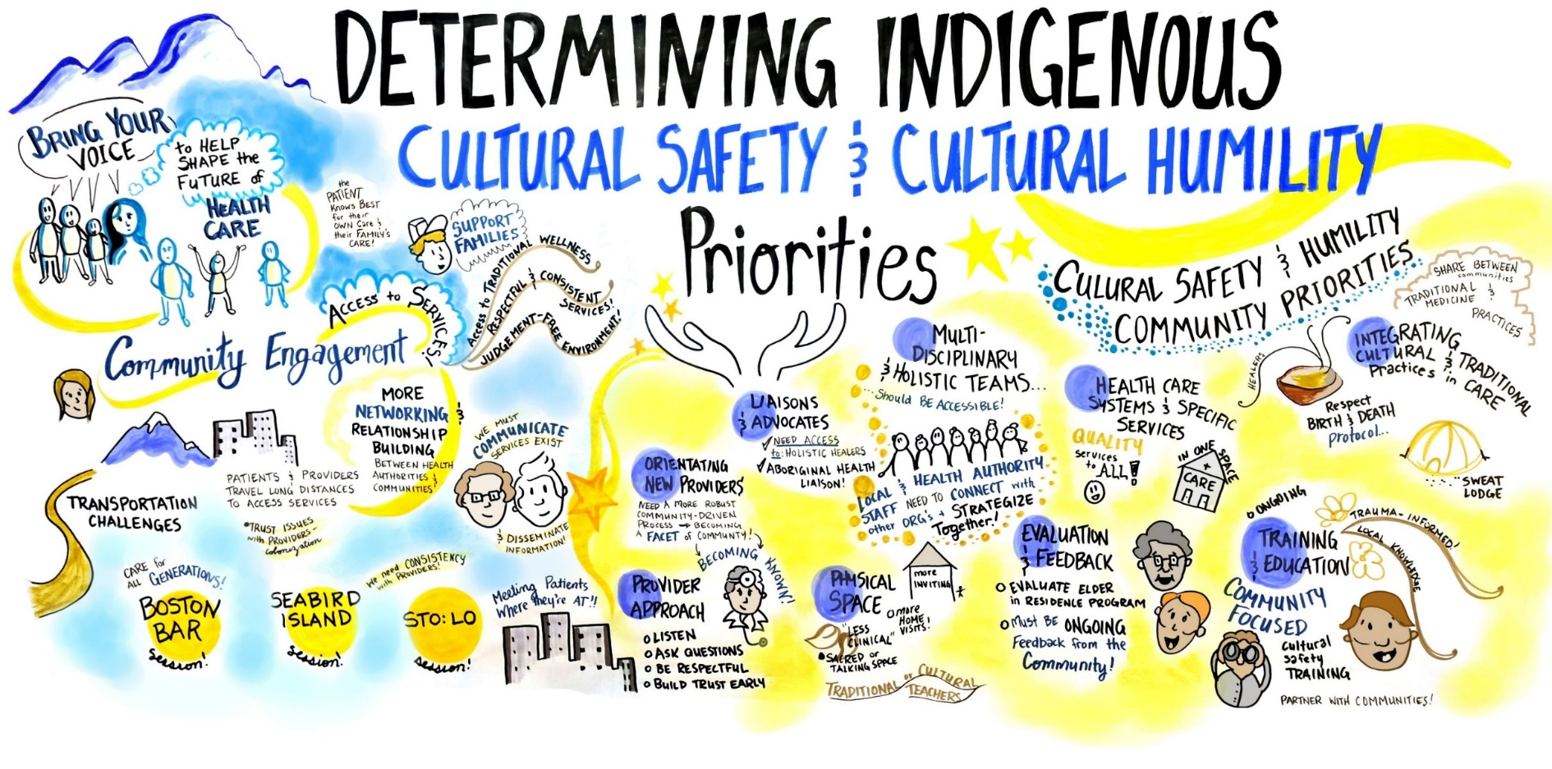





Partnering with our 22 Indigenous Communities
Chilliwack Division

Slide 10
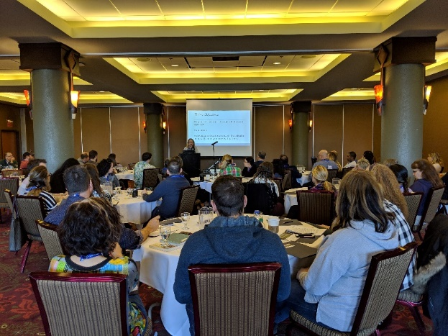
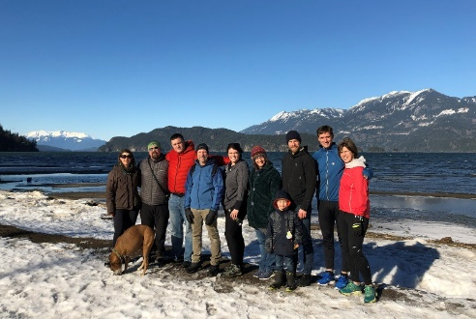

Chilliwack Division
Focusing on Provider Wellness
57 GPs, NPs, Specialists and their families joined together for a weekend of learning and relationship-building, with a focus on resiliency and professional and personal wellness.
Providers engaged in a CME accredited workshop, Thrive! Resilience and Stress Mastery for Physicians
100% of providers felt they were provided with education and resources to foster their personal & professional resiliency
100% of providers agreed they were given the opportunity to build relationships with their colleagues
“I feel lucky to be part of the division and work with so many people invested in my success.”
“Thank you for validating that the time I spend on personal growth is part of resilience.”

Slide 11
Victoria/South Island Patient Summaries Project
Victoria Division
Partners
Victoria
Division
South Island
Division
Island
Health
Family physicians leverage automated notification of hospital admission to create summaries of patient information to support longitudinal treatment and discharge planning.
Potential adverse events are avoided
Patients feel more confident that continuity of care is maintained
Hospital clinicians avoid having to duplicate diagnostic tests
  Cognitive and functional baseline information helps distinguish between existing health conditions and new symptoms

Slide 12
Patient Medical Home Steering Committee
Victoria Division
12 family doctors
2 division staff
The result of eight months of engagement with 100+ physicians was the creation of NINE
key elements that must be present in order to develop PCN in Urban Greater Victoria
1
    Reduce the cost to physicians associated with operating a PMH
5
    Administration burden reduction
6
    Team-based care
2
    After-hours care
7
    Unattached patient clinic
3
    Reimbursement for current unpaid work related to team based care
8
    Learn from others and work together
9
    Create a new non-profit organization to oversee the creation and development of PCN in Victoria
4
    Co-locating GPs

Slide 13
Victoria-South Island Residential Care Initiative (Vic-SI RCI)
Victoria Division
Partners
Victoria
Division
South Island
Division
Island
Health
2013
Partnership with Island Health to develop the TORCH practice model
2015
Partnership with South Island Division of Family Practice to implement the regional Vic-SI RCI.
2019
Vic-SI RCI is active at all 38 local residential care sites, with 85 RCI physicians acting as MRP for 90% of all 3,416 local residents.
100% of residents are covered by the RCI after-hours call group.

Slide 14

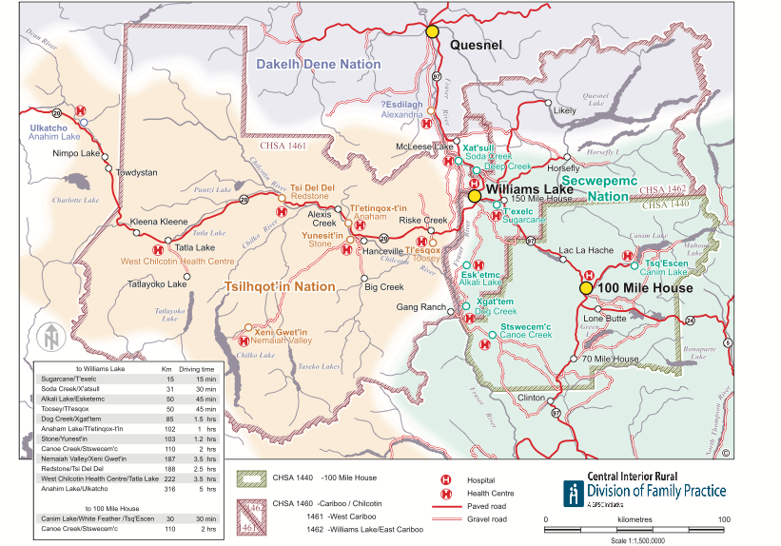

Strengthening Relationships with Indigenous Communities
Central Interior Rural Division
Created a map of the CIRD with a focus on local Indigenous communities and health services
Cultural Safety training for GPs
Piloted 3 physician visits to Indigenous communities
Developing a toolkit for FP clinics including health resources in FN communities

Slide 15
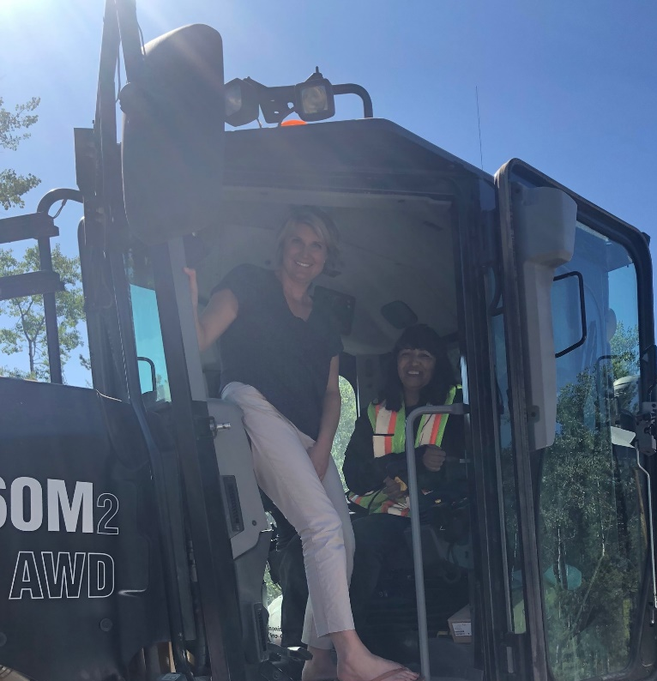
Physicians Visit Local Indigenous Communities
Central Interior Rural Division
Division staff coordinated site visits to one community in each of our three Indigenous nation territories
GPs toured health centres, did a home visit with a patient, met community elders and experienced cultural events
  “I now have a better understanding how far some of my patient's travel and the road conditions they deal with. I also will take extra time making sure my client understands me by explaining more and taking extra time.” - CIRD GP

Slide 16
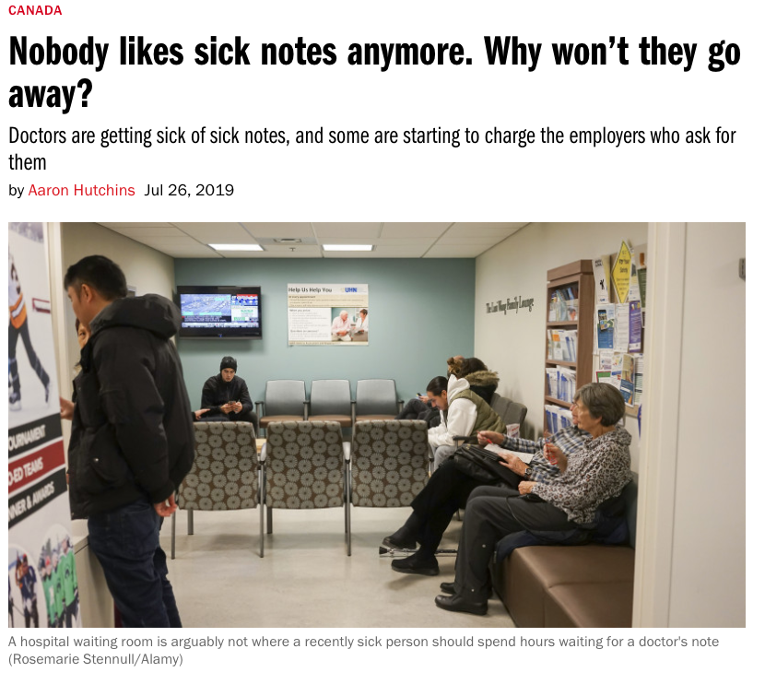
Reducing Sick Note Requests
Central Interior Rural Division
CIRD physicians implemented a new division-wide policy to charge employers instead of patients for medically unnecessary sick note visits
A campaign to educate patients and employers was launched with local media
Issue of sick notes featured in Maclean’s magazine article

Slide 17



SHARE Mental Health Program
Fraser Northwest Division
Co-designed with feedback from Doctors
Improved Communication
A commitment to
patients & doctors
Data collected & shared every 30 days
Access & Improved Healthcare
81
patients seen in two months
84% increase month-over-month
Location convenient for client
Available 7 Days a week
Within 48 hours, SHARE will attempt to contact the patient and inform the GPs office on status

Slide 18

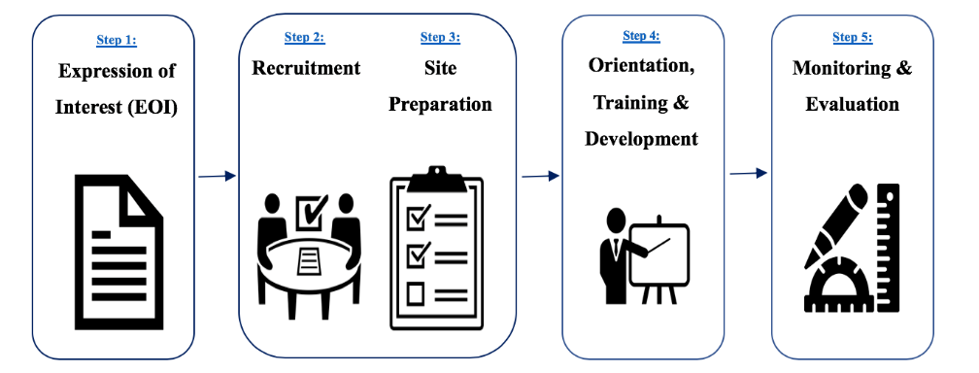

Registered Nurse in Practice
Fraser Northwest Division
Inter-Organizational Collaboration
Process Driven
Phase 1
Phase 2
3 RNs Onboarded
4 EOI’s Received
Onboarding Manual
Improving Systems
Positive Feedback
Reducing Lag-Time

Slide 19
East Kootenay PCN – SCSP Engagement and Planning
East Kootenay Division
Partners
East Kootenay Division
Interior Health
Patient Voices Network
Ktunaxa Nation
A decisive effort was made to engage in all 8 municipal and 4 band communities, multiple times, with various participants.
We recognize that PCN and SCSP are integrated components of the same system and require us to work closely together.
We have become better partners, with a stronger understanding of our organizational challenges to and opportunities for change.

Slide 20
Ktunaxa Nation Partnership
East Kootenay Division
Partners
East Kootenay Division
Ktunaxa Nation
Objective: To sustain and spread the Primary Care Social Worker program
6 social workers supporting patients across 8 municipalities and 4 band communities.
The social workers accept referrals from family physicians, as well as Nation-based RNs and NPs.
Families, patients, and providers are feeling better supported,
and have better access to supportive services.

Slide 21










Nurse in Practice: Promoting Therapeutic Relationships
Central Okanagan Division
The nurse has regular home visits with Joe, who has progressive dementia.
The nurse supports Lucy
(Joe’s wife) and assesses her for caregiver burnout.
She has the time to have coffee with them to assess Joe’s dementia and find out how they are coping. Joe showed the nurse how ‘Hey Google’ worked for playing music and they sang a few songs together.
Because of the trusting relationship between the nurse and Lucy, she agreed to try the medication.
The nurse followed up by phone to assess the effect and to explain why it was needed to increase the dose for even better effect.
Joe needed medication and Lucy was resistant.

Slide 22



Nurse in Practice: Health Promotion
Central Okanagan Division
Our Nurse in Practice meets with our Chronic Disease Management patients to create and follow up on their action plans.
Randy has been a Type 2 diabetic for 20 years.
Through dietary counselling with our nurse, he has lost 28 pounds and he has reduced his insulin by 95%.
His A1C is NORMAL after one year!

Slide 23
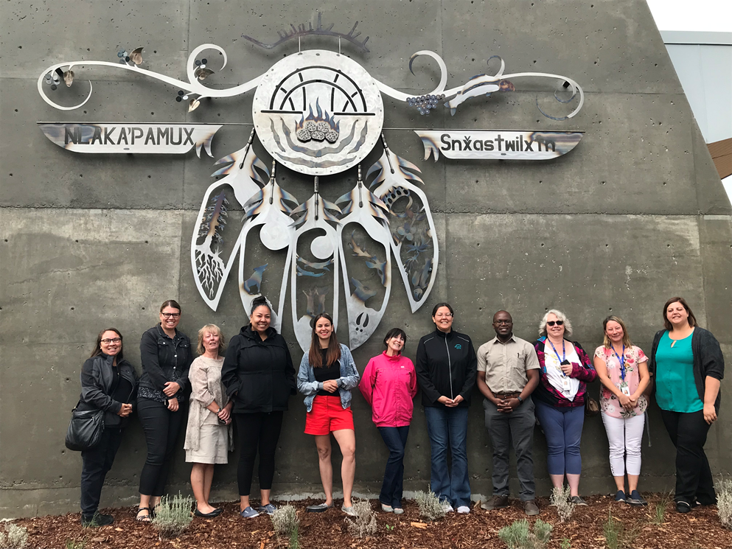
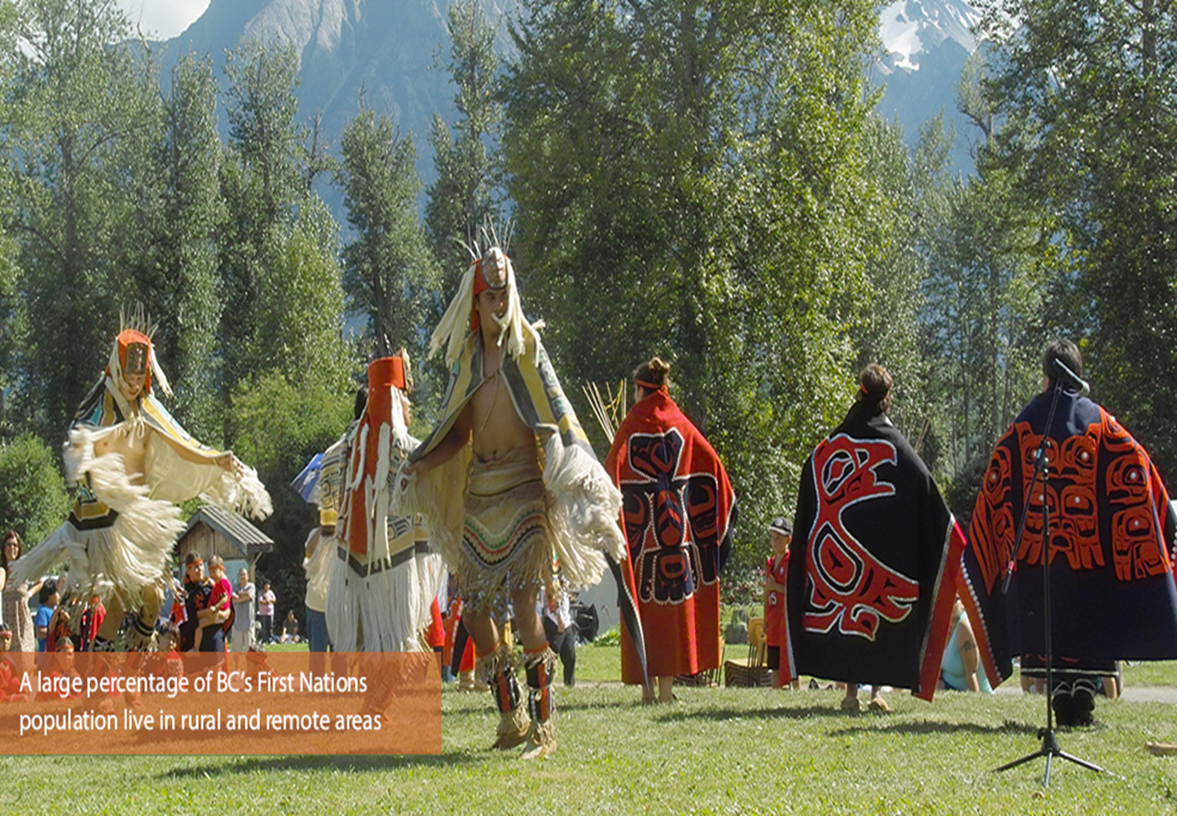

Building Meaningful Partnerships with First Nations
Rural and Remote Division – Western Interior Chapter
Allowing First Nation partners to take the lead and demonstrate how relationships are built.
Nlaka’pamux, Northern St’at’imc, Secwepmec & Syilx Nations
Western Interior Chapter spans 23 First Nation Communities with a majority First Nation population.
There is opportunity for better alignment of Nation-based team based services and primary care.
Key Impact: Elevating the contribution of First Nation partners allows for comprehensive and creative planning.
Notes:
What: The Western Interior Chapter and Merritt Chapter boundaries rest within the traditional territories of four Nations: the Nlaka’pamux, Northern St’at’imc, Syilx and Secwepmec. This area has 24 of the 54 First Nations communities in the Interior Region, and First Nations represent a majority population in many of the communities served by Rural and Remote Division of Family Practice physicians. Therefore, understanding the health needs of First Nations and developing meaningful partnerships with communities and health providers has been an area of focus in 2019.
To develop these relationships, the Rural and Remote Division of Family Practice Interior Region has taken an approach of doing things differently, allowing First Nations partners to take the lead and demonstrate how relationships are built, such as participating in sharing circles focusing first on developing trust, and going out to First Nations health centers, recognizing the importance of seeing community strengths and challenges first hand. Before delving into health service planning and gap identification, the Nations have shared that we must first better understand each other as partners.
Who: First Nations, R&R and IH
Where: Western Interior Chapter
Key learning or impact: K On June 17-19th, the Nlaka’pamux Nation hosted a three-day tour of their 12 communities for
Interior Health administrators and the Rural and Remote Division of Family Practice. Some of the emerging themes were:
The difficulty in recruiting and retaining nursing staff and primary care providers due to multiple factors such as housing shortages, complexity of care, etc.
The untapped opportunity for virtual care as a viable solution to access gaps
The need for additional diabetes support (foot care, certified diabetes educators, etc.)
The need to develop discharge planning protocols that consider the unique socio-economic challenges faced by many First Nations community members
The opportunity to better integrate primary care providers with Nation shared service providers, utilizing a multidisciplinary team-based model (example: Nation mental wellness clinicians, dieticians, nurses)
A possible role for a health advocate position for more vulnerable Nation members, such as those with MHSU challenges. This position has been tried in Merritt and has been a welcomed by local physicians
Need for increased outreach from allied health
Need to improve cultural safety
Learnings for us as a Division are as follows:
New Territory = Cultural Humility – It’s okay to not have the answers!
FNHA is an important facilitator but is not the voice of local First Nations
Communities/Nations/FNHA are service providers with key services to be considered in multidisciplinary team building
Important role of the Community Engagement Coordinators and Health Directors
Human resource capacity challenges = “what does meaningful partnership look like to you?”
Understanding the Urban Population Needs – Ask the Nations!
First Nations have their own avenues to advocate for change
Acknowledge the uniqueness of each community in planning
Take a spirit of learning! - “We are committed to be true collaborative partners. We commit to show up to the table with good intentions, and learn from each other.”
Consider the round table/sharing circle format for meetings

Slide 24
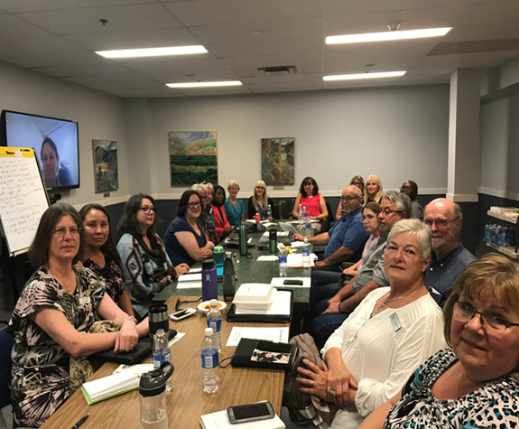

Rural and Remote Division
Hosting Local Community Health Planning Tables
R&R
Divisions
Health Authorities
Peer Voices
Partners
Mayors
FNs
Across 12 Chapters and 5 Health Authorities
Communities will support what they helped create and inspire sustainable community health services that work for the community.

Slide 25

Collaborative Redesign Approach
Rural and Remote Division
Mount Waddington Collaborative Working Group undertook a comprehensive review of the health care services, “Mount Waddington Rural Patient Journey Re-Design.”
Key Learnings:
Broad stakeholder collaboration provides opportunity for greater innovation & sustainable solutions.
A healthy collaborative provides a strong foundation for ongoing planning & problem solving.
Photo Credit: Darrell MacIntosh, Port Alice

Slide 26


EMPOWER THE NEXT GENERATION!
Powell River Division
Summer Internship Program
Key learnings:
  Increase operational capacity of our division
  Provide an opportunity for a university student to gain insights into primary care transformation

Slide 27

CO-LOCATE, then COLLABORATE!
Powell River Division
Integration of NP into a GP office
Key learnings:
  First co-location, then collaboration!
  Flexibility is paramount when addressing system issues such as overhead and cross-coverage!

Slide 28

Powell River Division
Integration of health authority Skype for Business in a GP office
Key learnings:
  Failure damages physician engagement
  Significant technical issues: PPN and connectivity
Virtual care flop!

Slide 29
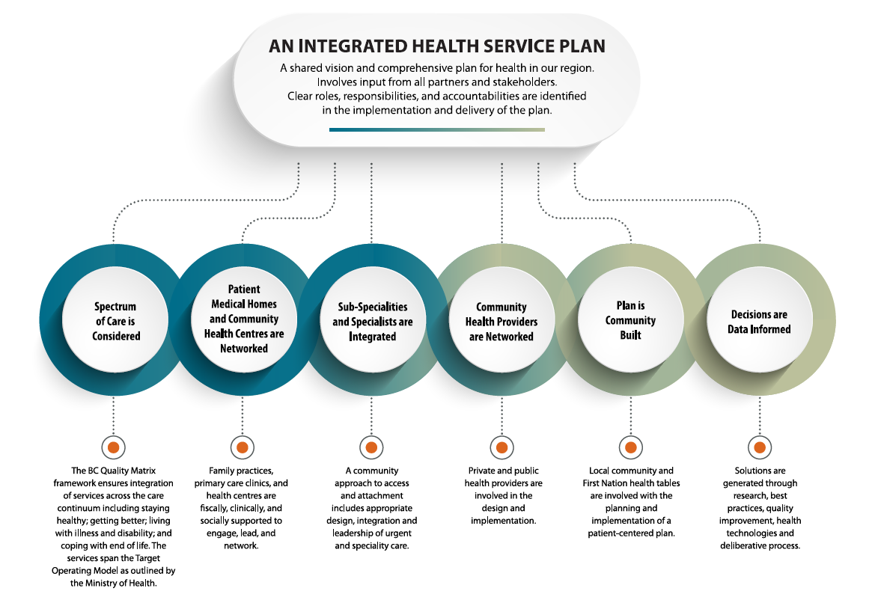
Health Service Planning
Thompson Region Division

Slide 30
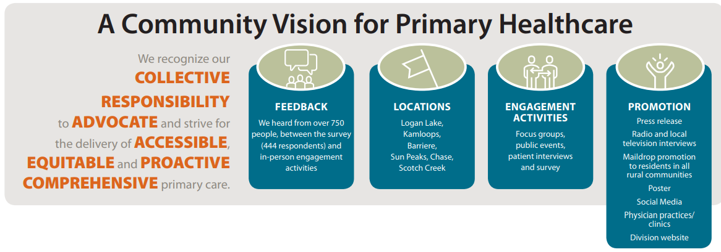
Primary health care inspired by YOU
Thompson Region Division
A community vision for primary health care

Slide 31

Better Together: Division of Family Practice and Facility Engagement Collaboration
Thompson Region Division
The Thompson Region Division of Family Practice and the Royal Inland Hospital Medical Staff Association joined forces to bridge the gap between community and facility providers.
A further partnership has developed as a result, the Thompson Medical Alliance, which includes Physician Quality Improvement, the Practice Support Program, Interior Health Quality Improvement, IH Research Department, as well as the division and RIHPA. The group is synchronizing resources for physician and medical partners.

Slide 32
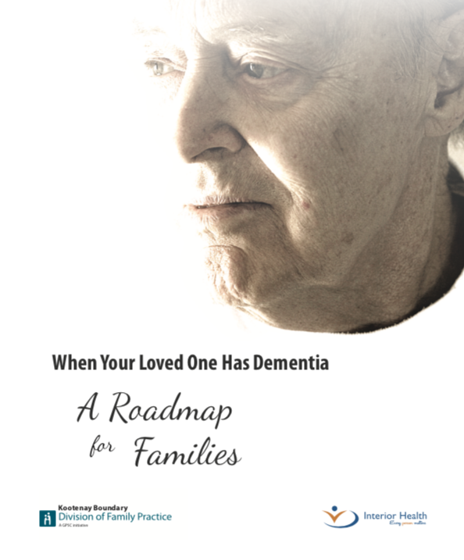
For Patients: Dementia Roadmap Booklet
Kootenay Boundary Division
Booklet designed to provide information and support for families facing a dementia diagnosis.
Published in 2017, the booklet has been adopted by multiple divisions and in Alberta.
Translated into Chinese. 2,000++ copies distributed.
“This is an excellent resource for families who’s loved ones are experiencing dementia.”

Slide 33

For Practitioner: ACEs Toolkit
Kootenay Boundary Division
Supporting Practitioners to incorporate Adverse Childhood Experience screening in their practices.
Published in 2019, combined with in-clinic supports and education.
“Screening for ACEs acknowledges that past experiences shape current behaviour and can help people develop coping skills and resilience. It can support practitioners in determining effective interventions and/or treatment.”

Slide 34
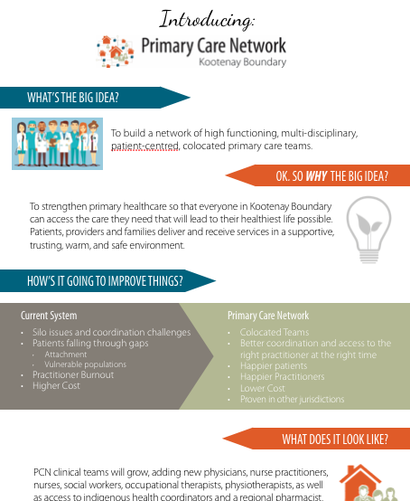
For Everyone: Primary Care Networks
Kootenay Boundary Division
Wave 1 of the Kootenay Boundary PCN
32.5 FTE practitioners, co-located in 14 KB clinics:
  physicians
  nurse practitioners
  nurses
  social workers
  occupational therapists
  physiotherapists
  indigenous health coordinators
  regional pharmacist

Slide 35
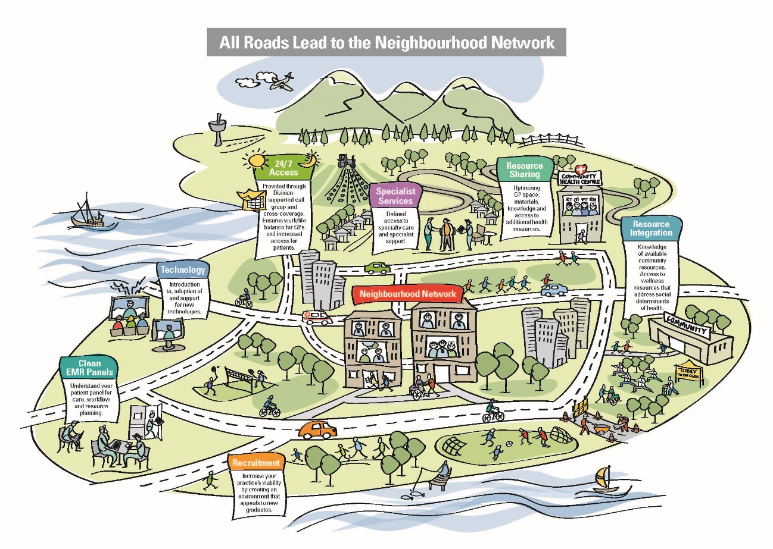
Neighbourhood Network Initiative
Richmond Division
Neighbourhood Networks bring together GPs into four geographically-based groups who work together to solve issues, provide practice coverage, and receive support from additional healthcare providers.
Richmond GPs
RDFP
VCH Richmond
UBC Clinical Pharmacy
City of Richmond
Richmond Mental Health Services
Consultant geriatricians
Never underestimate the ability of a group of GPs to design, deliver, and sustain local solutions that strengthen primary care at the community level!

Slide 36
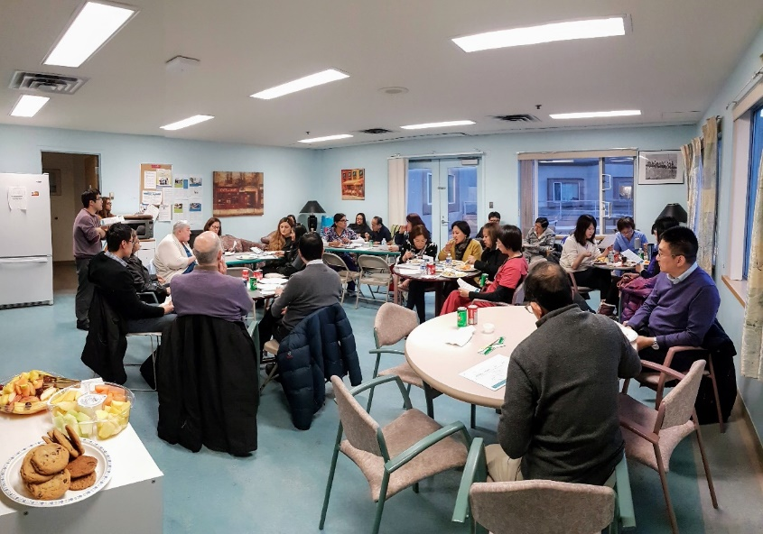
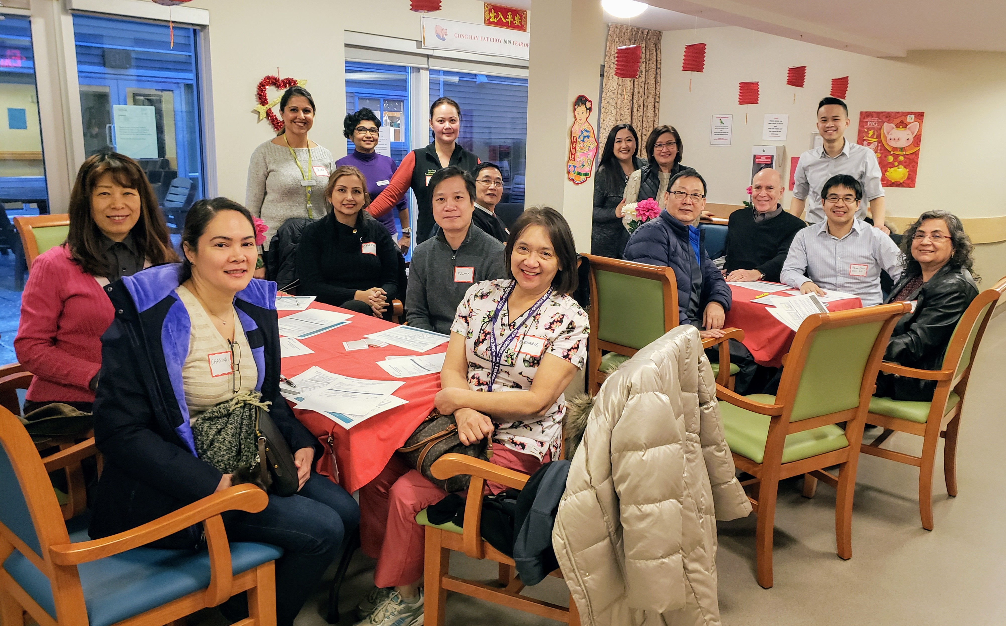
Richmond RCI program
Richmond Division
85%
of all residential care patients are now attached to a physician participating in RCI
4
new GPs recruited to residential care
10%
decrease in the average number of ordered drugs per patient
19%
increase in the average number of proactive visits per patient
Well functioning call group with high levels of facility staff satisfaction
Effective and collaborative governance through relationships with VCH, all residential care homes through multi-party Steering Committee, Quality Improvement

Slide 37




Ridge Meadows Division
Pathways: Public central online resource
Connecting Citizens to Local, Regional &
Provincial Health Care Resources Online!
A Collaboration Between…
FindaResourceRidgeMeadows.ca

Slide 38







White Rock - South Surrey Division
Solution designed by
GPs & Specialists
Pursuing adoption with a health authority clinic
Electronic referral & patient notification system developed by Pathways
Improving the
Referral Process in WRSS
67% of patients opting for electronic notification
Provincial expansion is underway
Receipt of referral acknowledged
63% < 24 hours
94% within a week
Average no show rate is 2.5%

Slide 39
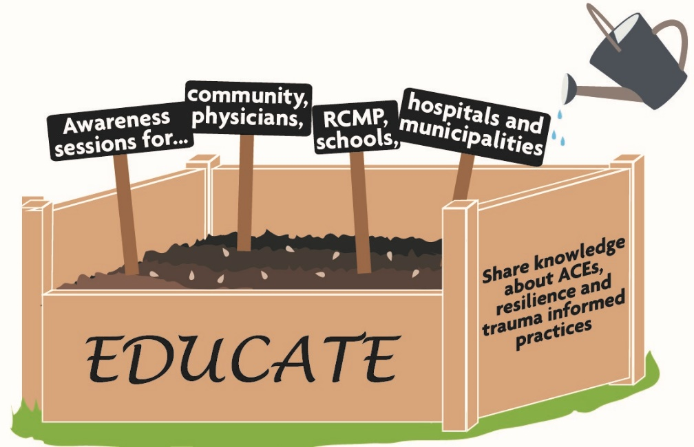
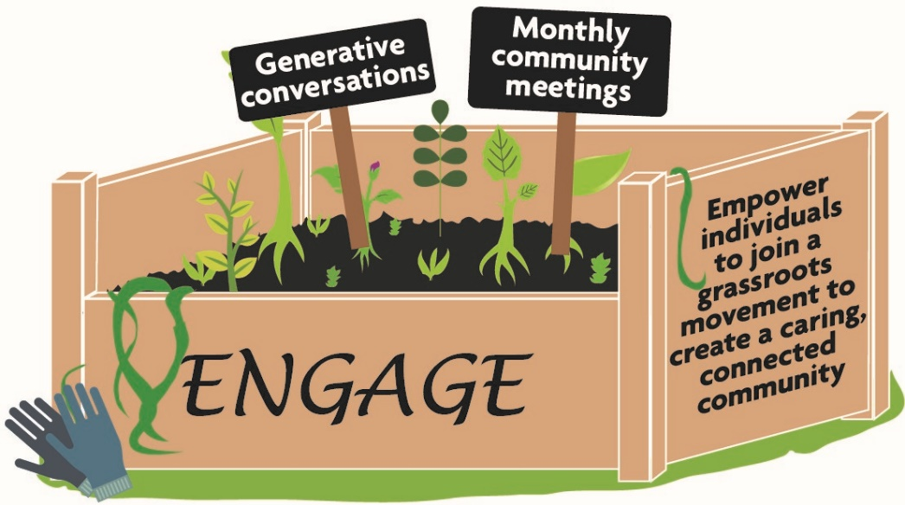

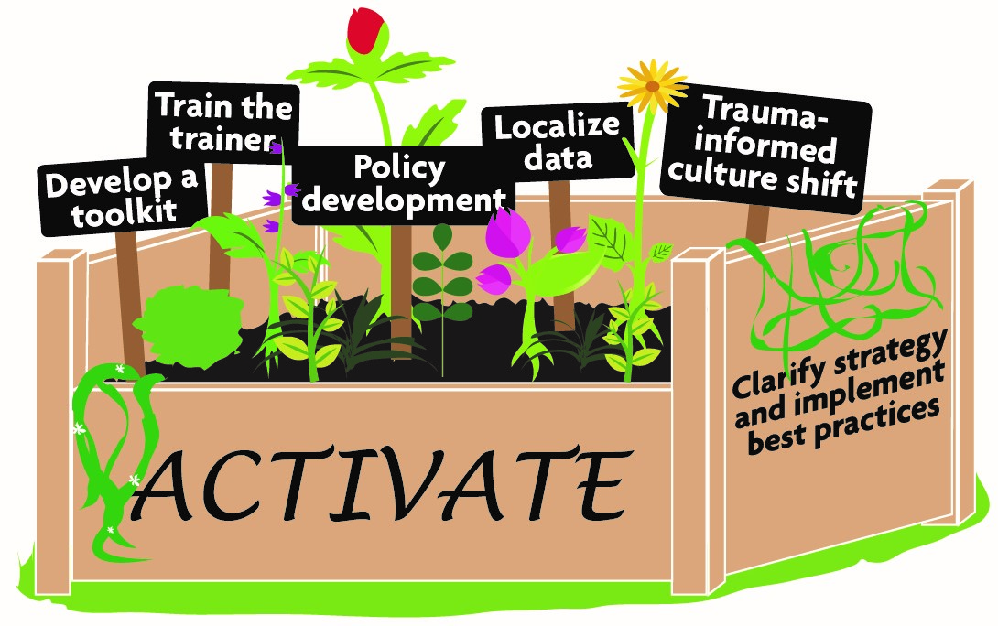
White Rock - South Surrey Division
Cultivating a Self-Healing Community in WRSS

