Slide 1
A Coming Together of Health Systems:
First Nations Traditional Practitioners in Health Care Settings
Presented by:
Kendall Ho, Gerry Oleman, Elizabeth Stacy, Kaitlin Atkinson
UBC Faculty of Medicine, Digital Emergency Medicine
Digital Emergency Medicine

Slide 2
Disclosure
Faculty of Medicine, Digital Emergency Medicine (DigEM),
University of British Columbia (UBC)
Funded by: BC Ministry of Health, Patients as Partners
No conflict of interest or commercial affiliation
that can be potential sources of bias.
Digital Emergency Medicine
Notes:
Each presenter outline verbally their disclosure information to the audience with a slide at the beginning of their presentation. If a disclosure slide has not been included in a presentation, it will be inserted by the program organizer.

Slide 3
What would you do…
(self-reflection)
If an Indigenous patient came into your office and requested Traditional Medicine?
How would you respond?
Digital Emergency Medicine

Slide 4
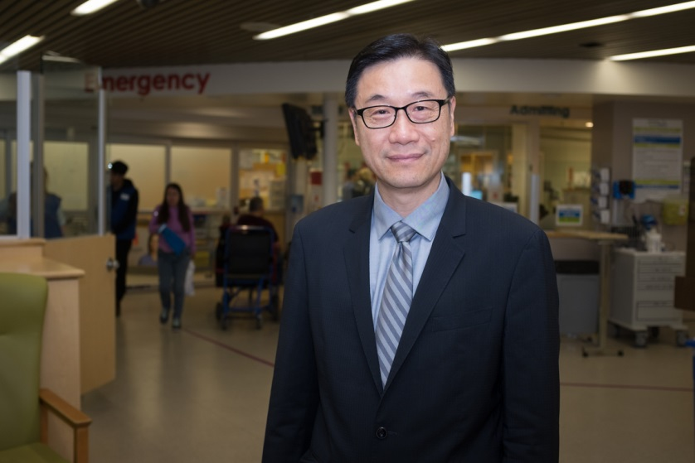
Background
“In 2011, I was providing medical care for a patient who had been in a car accident, when they requested traditional medicine.” Dr. Kendall Ho
Digital Emergency Medicine

Slide 5
Background
Strong support from Ministry of Health, Vancouver Coastal Health, and Indigenous communities for culturally appropriate and safe health care
Gap has been identified by health care professionals:
  How to access Traditional Practitioners?
  What procedures/ protocols do I follow?
  What responsibilities do I have as care providers?
Digital Emergency Medicine

Slide 6
Video & Discussion Guide
Objectives:
Create a video featuring First Nations and Aboriginal Traditional Healers
Introduce cultural healing practices
Improve access to Traditional Healers
Digital Emergency Medicine

Slide 7

Video
Digital Emergency Medicine

Slide 8
Discussion Question
What do you think we could do, organizationally, to support the inclusion of Traditional Practitioners as part of the health care system?
Digital Emergency Medicine

Slide 9
Call to Action
Digital Emergency Medicine

Slide 10
Discussion Question
What do you think you could do, as an individual health care provider, to encourage or implement this process?
Digital Emergency Medicine

Slide 11
Patients as Partners
BC Definition: Patients, families and caregivers are partners in health care when they are supported and encouraged to…
  Participate in their own health care
  Participate in decision making about that care
  Participate at the level they choose
  Participate in quality improvement and health care redesign in ongoing and sustainable ways
Nothing about me, without me…
Digital Emergency Medicine

Slide 12

Patients as Partners:
Collective Impact of Ministry Funded Partners
InterCultural Online Health Network (iCON)
Delaney & Associates
Family Caregivers Network
Centre for Collaboration, Motivation, & Innovation
Pain BC
UVic Chronic Disease Self-Management Program
Digital Emergency Medicine

Slide 13
What is iCON?
Engaging communities across BC to improve patient care
Serving Chinese, South Asian and Indigenous communities in BC, Canada (multigenerational and multilingual)
Multichannel engagement (live in-person events, webcasts, online and print resources)
Unique technological opportunities (linguistically and culturally tailored website, digital health literacy)
Digital Emergency Medicine

Slide 14
Get Involved, Use the Tools!
Download from iCON: www.iconproject.org
  Video: http://bit.ly/TraditionalPractitioners
  Discussion Guide: http://bit.ly/1NdX66A
We welcome opportunities to host workshops, etc.
Feedback and reflections?
  https://survey.ubc.ca/s/iconaboriginalfeedback/
Digital Emergency Medicine

Slide 15
Developed in Partnership
Produced by
  iCON Program, Digital Emergency Medicine, UBC
  Vancouver Coastal Health’s Aboriginal Health Strategic Initiative
Funded by
  Funded by BC Ministry of Health, Patients as Partners
Special thanks to
  The Musqueam Indian Band
  Providence Health Care
  First Nations Health Authority
  Dr. Lee Brown
Digital Emergency Medicine

Slide 16
Special Thanks
Te Ta-in (Shane Pointe)
Musqueam Indian Band
Dr. Patricia Daly
Chief Medical Health Officer/ Vice President, Public Health, VCH
Gerry Oleman
Traditional Practitioner, St’at’imc Nation
Dr. Georgia Kyba
Naturopathic Physician, Advisor to FNHA, Selkirk First Nation
Carol Kellman
Aboriginal Nurse Practice Leader, Providence Health Care, Cree Nation
Susan Powell (Inyan Skawin)
Holistic Health Educator
Digital Emergency Medicine

Slide 17
Reflections and
Commitment to Change
Write down 1-2 action(s) that you will take in the next 3 months as a commitment to change your practice.
Digital Emergency Medicine

