Slide 1
Board Composition and Succession Planning

Slide 2
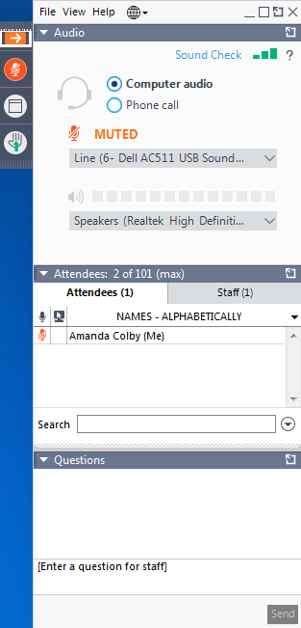
Technology Overview
You are currently muted. To ask a question, or make a comment, please raise your hand.
When your hand is raised,
the button will look like this:
If you’re experiencing technical difficulties you can send a message to the organizers through the questions window.
Note: questions are sent to the organizers only. Other webinar attendees won’t see them unless the organizer shares both the question and response with all attendees.

Slide 3
Agenda
Learn from two Divisions on how they made changes to their board composition, and their onboarding process of new board members
Powell River Division of Family Practice
Dr Bruce Hobson, Physician Lead
Guy Chartier, Executive Director
South Okanagan Similkameen Division of Family Practice
Dr Tim Phillips, Physician Lead
Tracy St. Claire, Executive Director

Slide 4
Powell River Division of Family Practice Board Composition & Succession Planning
August 16th, 2018

Slide 5
Our Journey
2012
NPs and Specialists
2015
Non-member appointment
2016
BC Societies Act
2017
Community member elected
Equality
Sustainability
Conformity
Proficiency

Slide 6
Our Journey
2012
NPs and Specialists
2015
Non-member appointment
2016
BC Societies Act
2017
Community member elected
Equality
Sustainability
Conformity
Proficiency
Notes:
BH

Slide 7
2012: NPs and Specialists as voting members
Notes:
BH
2011, NPs and Specialists became non-voting members of our Division
2012, in recognition of their role in supporting family physicians, NPs and Specialists became voting members so that all members were treated equally

Slide 8
Our Journey
2012
NPs and Specialists
2015
Non-member appointment
2016
BC Societies Act
2017
Community member elected
Equality
Sustainability
Conformity
Proficiency
Notes:
GC
2015, we changed our bylaws to allow the Board to appoint non-members to our Board

Slide 9
2015: Non-members appointed to the board
Notes:
GC
The main reason for that change was around sustainability as we had one board meeting with only 3 directors and 1 Executive Director, which was a risky position to be from a sustainability and succession planning perspective. While we change our bylaws to allow such appointment, such practice did not materialized until 2017

Slide 10
Our Journey
2012
NPs and Specialists
2015
Non-member appointment
2016
BC Societies Act
2017
Community member elected
Equality
Sustainability
Conformity
Proficiency
Notes:
BH
2016 was the year that the BC government announced changes to the Societies Act with a two-year compliance period

Slide 11
2016: New Societies Act (Section 41)
Notes:
BH
The main change for Divisions was compliance with Section 41, which says that the majority of directors cannot be under a contract for service with the organization. For us, this was a time to rethink our governance composition.

Slide 12
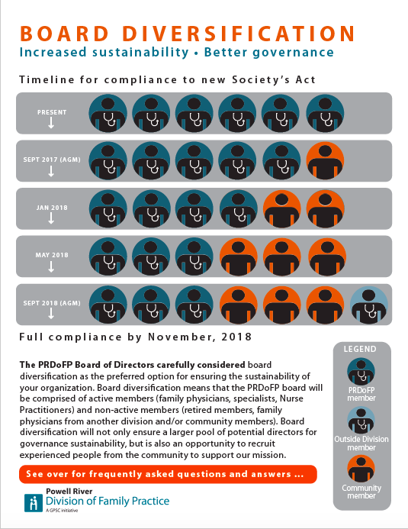
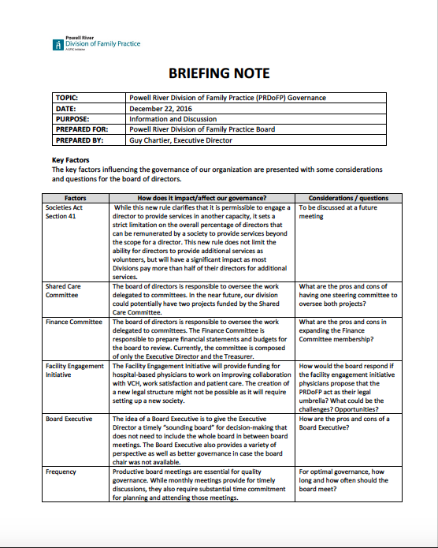
2016: New Societies Act (Section 41)
Notes:
BH
After going through a rigorous process, our Board landed on board diversification as the preferred method not only for complying but also for thriving!

Slide 13
2016: Board Diversification - Planning
Notes:
BH
Recognizing that implementing a diversified board was tricky and needed to be staged, we developed a plan to replace physician board members incrementally. This was key to maintaining a functional board while onboarding new members.

Slide 14
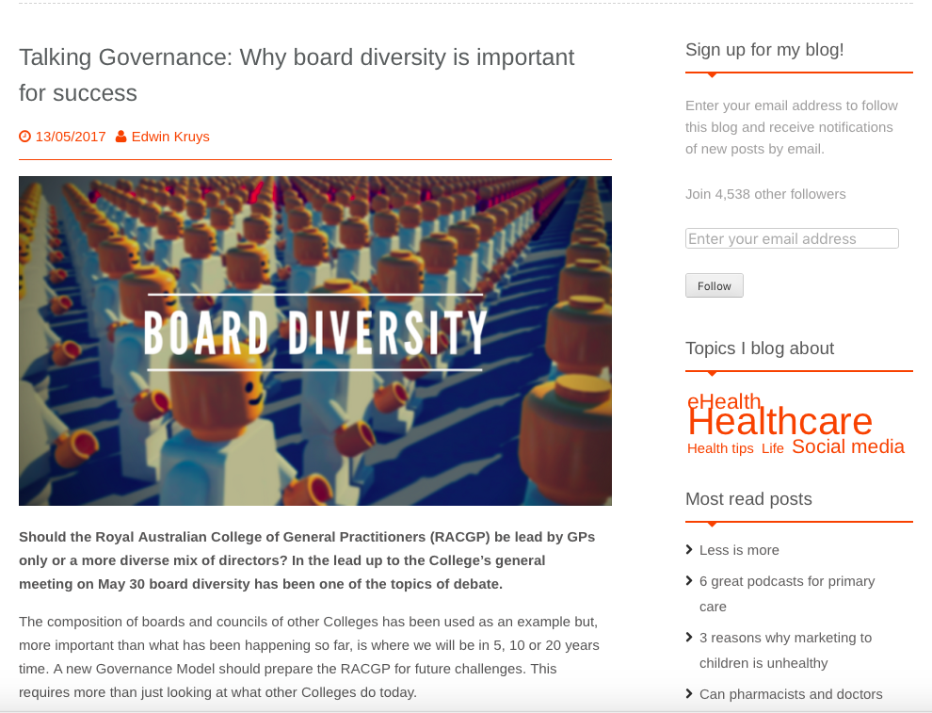
Notes:
GC
Board diversity has been well documented as improving governance! We and the RACGP came to question, how do we prepare for future challenges? Knowing that the primary care direction is heading towards communities, having a diversified board with members from our community would be strategic.

Slide 15
The Big Fundamental Questions!
How do we maintain the physician’s voice & influence?
How do we ensure community members are “not going sideways”?
How do we fully leverage the added value of community members?
How do we compensate community members on the Board?
Notes:
GC
As we landed in a preferred path (board diversification), 4 big fundamental questions surfaced!

Slide 16
Our Journey
2012
NPs and Specialists
2015
Non-member appointment
2016
BC Societies Act
2017
Community member elected
Equality
Sustainability
Conformity
Proficiency
Notes:
GC
Finally, our diversification process started at the 2017 AGM with the first appointment of a community member. Since then, we used a resign/appoint strategy to bring 2 more community members on board.

Slide 17
2017: Community Members Appointments
Notes:
BH
So, how did we choose them?

Slide 18
2017: Community Members Appointments
Community reputation
Community connections
Nonprofit governance
Financial expertise
Notes:
We identified 4 selection criteria to help us shortlist community members that we felt would meet most of them.

Slide 19
Our current Directors
Name: Janet Newbury, PhD
Profession: Associate Professor, University of Victoria
Skills/Experience:
First Nations engagement
Research & evaluation
Nonprofit governance
Social determinants of health
Notes:
GC

Slide 20
Our current Directors
Name: Lyn Adamson
Profession: Retired Nonprofit Executive, Realtor
Skills/Experience:
Government relations & advocacy
Nonprofit governance
Community advocacy
Social enterprise
Notes:
GC

Slide 21
Our current Directors
Name: Russell Brewer
Profession: City Councilor, Chief Forester
Skills/Experience:
Finance
Community engagement
Local government relations & advocacy
Social determinants of health
Notes:
BH

Slide 22
Our Journey
2012
NPs and Specialists
2015
Non-member appointment
2016
BC Societies Act
2017
Community member elected
Equality
Sustainability
Conformity
Proficiency
Notes:
GC

Slide 23
Powell River Division of Family Practice Board Composition & Succession Planning
August 16th, 2018
Notes:
Thank you!

Slide 24
South Okanagan Similkameen Division of Family Practice Board Composition & Succession Planning

Slide 25
Our Journey
Began before the changes to the Societies Act
Board has varied in size over the years
Involvement from communities in both Urban and Rural settings
Recognized that to reduce physician burnout, non-physician input was needed

Slide 26
BC Societies Act (Section 41)
One of the pilot Divisions to engage in conversations with the centrally provided Lawyer
Sat down with the Lawyers to understand the changes, and what it would mean for Divisions
Lead to a discussion around membership for the Division

Slide 27
Where we are today
Maintain a Board of 9, with varying voices and varying expertise
Two new members since 2017, a retired Physician Lead and a Nurse Practioner
For 2018, reached out to a community member with a financial background, the First Nation communities, and a member of the MSA for involvement
All Board members are compensated in the same way
Notes:
Challenge-toyed with whether the board should be 7 or 9– majority were non active when 7, however active physician voices are relied on. Board of 9 gives better representations.

Slide 28
New Board Members Orientation
Spend a few hours with them, whether they’re community members or Physicians
Provide them with an acronym list
Regular Physician Lead events, which includes all Board members

