Slide 1
What’s Going on in BC Now – The Public Health Perspective
Physician Leadership and the Social Determinants of Health (SDH)
June 16, 2016
BC Divisions of Family Practice
Arlene King, MD, MHSc, FRCPC, ICD.D
Executive Medical Director (Interim)
Population and Public Health

Slide 2
Overview
Public Health Perspective on the Determinants of Health (DH)
Role of Public Health in the SDH
Public Health Action in Influencing the SDH in Fraser Health

Slide 3
What is health?
“A state of complete physical, mental and social well-being and not merely the absence of disease or infirmity”
  Preamble to the Constitution of the World Health Organization 1948
“A state of moral, mental and physical well-being that enables a person to face any crisis in life with the utmost grace and facility”
  Pericles 495-429 BC

Slide 4
What affects our health?
Good health starts long before we visit doctors. It starts in childhood, in our homes, in our schools, our work places and our communities
The factors that influence health lie, for the most part, outside of the health sector
Public Health is Everyone’s Business – Ontario CMOH Annual Report 2009

Slide 5

What Affects Our Health?
Determinants of Health
Income and Social Status | Physical Environments
Social Support Networks | Personal Health Care Practices & Coping Skills
Education | Healthy Child Development
Employment/Working Conditions | Biological and Genetic Endowment
Social Environments | Health Services
Gender
PHAC, What Makes Canadians Healthy or Unhealthy, 2003
Notes:
Key Points:
Health is complex and no one determinant acts alone
There is an interaction between all of these determinants and together they influence health
Income and Social Status: Health status improves at each step up the income and social hierarchy, higher income determines living conditions and ability to purchase resources
Social Support Networks: Support from families, friends and the community are associated with better health
Education: Education is closely tied with socioeconomic status and health status improves with level of education
Employment/Working Conditions: Unemployment, underemployment, stressful or unsafe working conditions are associated with poorer health
Social Environments: The values and norms of a society influence the health and well-being of individuals or populations
Physical Environments: Contaminants in air, water, food or soil can cause a variety of adverse health effects and the built environment can play a role in physical and psychological well being
Personal Health Practices and Coping Skills: Individuals can take actions and make choices to prevent disease and promote self-care, however those actions and choices are influenced by the socioeconomic environment in which the exist
Healthy Child Development: Early experiences, brain development and school readiness are all critical in determining health in later life
Biological and Genetic Endowment: Services can maintain or promote health, prevent disease, or restore health
Health Services: Society-determined roles, personality traits, attitudes, behaviours, values, relative power and influence ascribed to the sexes on a differential basis
Gender: Socioeconomic environment is largely determined by dominant cultural values and can perpetuate conditions of marginalization, stigmatization, loss or devaluation of culture and language, and lack of access to culturally appropriate services

Slide 6
Relative Impacts of the Determinants of Health
Notes:
50% Social and Economic Environment
25% Health Care System
15% biology and genetics
10% physical environment
CIAR 2001

Slide 7
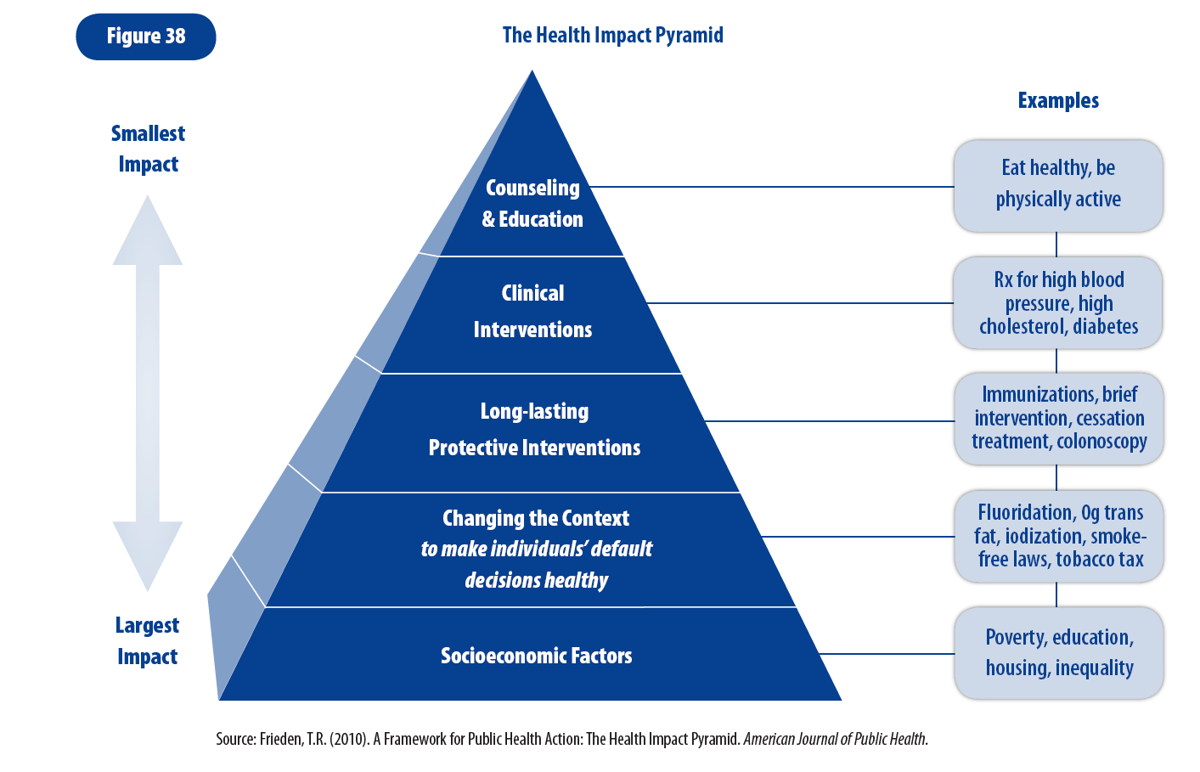
Health Impact Pyramid
From “Investing in prevention: Improving health and creating sustainability: The Provincial Health Officer’s special report” by P. Kendall, p. 41. BC. Office of the Provincial Health Officer. Adapted from “A framework for public health action: The health impact pyramid,” by T. R. Frieden, p. 591. American Journal of Public Health.
Notes:
This 5 tier pyramid best describes the relative impact of different interventions and provides a framework to improve health.
At the base of the pyramid, indicating the interventions with the greatest potential population impact, are efforts to address the socioeconomic determinants of health. In ascending order, are those that change the context to make individual’s default decisions healthy and clinical interventions which are within the domain of the health care system.
Interventions falling within the lower levels of the pyramid tend to be more effective because they reach broader segments of society and require less individual effort (more efficient).
Changing the context to create healthier default decisions includes clean water and air, improvements in road and vehicle design, designing communities to promote increased physical activity, enacting policies that encourage public transit, biking, walking, designing building and promoting stair use.

Slide 8
Public Health
Non-Health Sector Partners
Local government
Provincial ministries
Federal departments
Broader public sector
Private sector
Education sector, including Colleges and Universities
Health Sector Partners
Primary care
Community care
Acute care
Long-term care
Professional, and other, associations
Non-governmental organizations
Health Canada, Public Health Agency of Canada
Public
Health
Sector
Please note that the Venn diagram is not meant to list all partners/organizations.
Those included are identified as examples.
Determinants of health – social, economic, environmental
Source: Make No Little Plans: Ontario’s Public Health Sector Strategic Plan. 2013.
Notes:
Public Health is uniquely positioned to work with both Health Sector and Non-Health Sector partners, because public health programs and issues span many sectors, beyond the Health Sector. As such, the Public Health sector straddles both.
On the right, and as a critical component of the Health Sector, strong alignment and integration between public health and health care services are important to advancing health equity and improving individual and population health. However, it is recognized that good health comes from a variety of factors and influences, 75% of which are unrelated to health care services, and that health care delivery accounts for only 10% of preventable deaths.
On the left of the Venn Diagram, the Plan acknowledges that public health works closely with non-health sector partners (health creating public service sectors); at provincial and local levels, Public Health influences, supports and helps shape legislation, policies and programs that affect health, often providing evidence related to health risks and ways to reduce them.
Put another way, health creating public services which take a population health approach are required to prevent the escalating treatment costs from bankrupting the health of future generations (to quote a public health colleague from Saskatoon)

Slide 9
Roles of Public Health - Social Determinants of Health
Creating and using data to inform
  a collective understanding of the DH
  To highlight inequities
  To frame problems
Engaging in meaningful partnerships to seek policy change and improvements in service delivery
  Achieving collective impact
Notes:
I have a slide in the appendix on the approach to achieving collective impact from the Stanford Social Innovation Review, 2012.
It describes an approach that brings public health and other health creating sectors together to address issues using a common agenda, shared measurement, continuous communication and a strong commitment to create impact

Slide 10
Creating and Using Data: My Health My Community
Conducted from June 2013-July 2014
Vancouver Coastal and Fraser Health residents aged 18 and over
Offered in English, Chinese and Punjabi
Over 33,000 respondents
Data weighted to reflect the population
www.myhealthmycommunity.org
Notes:
The My Health My Community survey was conducted between June 2013 and July 2014.
People who responded to the survey were 18 years of age or older and lived within the Vancouver Coastal or Fraser Health regions.
Fraser Health n=15427, Vancouver Costal n=17648
The survey was available online, in both English and Chinese, and printed versions were also available in English, Chinese and Punjabi.
To ensure that we reached all segments of our population, our field outreach team also administered the survey in person in community settings (e.g. community events, seniors groups, homeless shelters).
After all of the surveys were completed, we used statistical “weighting” to balance the results so that they represent the population of the geographic region specified. Data were weighted by age, gender and education.
More information at myhealthmycommunity.org

Slide 11
Higher Income, Better Health
Notes:
Highest income group has better health behaviours, better access and utilization of primary health services, and this is reflected in better self reported health and lower chronic disease prevalence.
Health Behaviours
Smoking more than 3 times higher among lower income group (20% vs. 6%)
Consumption of 5+ servings lower among lower income group (20% vs. 32%)
Primary Care and Clinical Prevention
Sig. lower proportion of low income group had a family doctor (77% vs. 88%)
Sig. lower proportion of women in low income group had a pap test in past 12 months (39% vs. 48%)
Sig. lower proportion of low income group got a flu shot in past 12 months (37% vs. 50%)
Health Status
Sig. lower proportion in low income group reported excellent or v. good health (36% vs. 64%)
Diabetes was more than three times higher in low income group (12% vs. 4%)
Multiple chronic diseases were more than three times higher in low income group (13% vs. 4%)
Technical Notes:
All differences statistically significant
Pap test and flu shot were asked over the 12 month period. Which is not the time frame in which pap tests are recommended.
2+ Chronic diseases: Reported diagnosis of two or more of the following: Diabetes, heart disease, stroke, high blood pressure or chronic breathing conditions

Slide 12
Higher Education, Better Health
Notes:
Higher education is not only a key factor in having higher income, but also helps people better navigate health information and health system. Highest education group has better health behaviours, better access and utilization of primary health services, and this is reflected in better self reported health and lower chronic disease prevalence.
Health Behaviours
Smoking more than 5 times higher in less educated group (21% vs. 4%)
Consumption of 5+ servings lower (approximately half) in less educated group (16% vs. 31%)
Clinical Prevention (no differences for having a family doctor)
Sig. lower proportion of less educated women had a Pap test in past 12 months (34% vs. 46%)
Sig. lower proportion of less educated women had a mammogram in past 12 months (38% vs. 52%)
Health Status – poorer outcomes in less educated group
Sig. lower (about half) proportion reported excellent or v. good health (28% vs. 61%)
Sig. higher proportion reported being obese (28% vs. 17%)
Diabetes was almost four times higher in less educated group (18% vs. 5%)
Multiple chronic diseases were four times higher in less educated group (20% vs. 5%)
Technical Notes:
All differences statistically significant between highest and lower education levels
Pap test and mammogram were asked over the 12 month period
2+ Chronic diseases: Reported diagnosis of two or more of the following: Diabetes, heart disease, stroke, high blood pressure or chronic breathing conditions

Slide 13
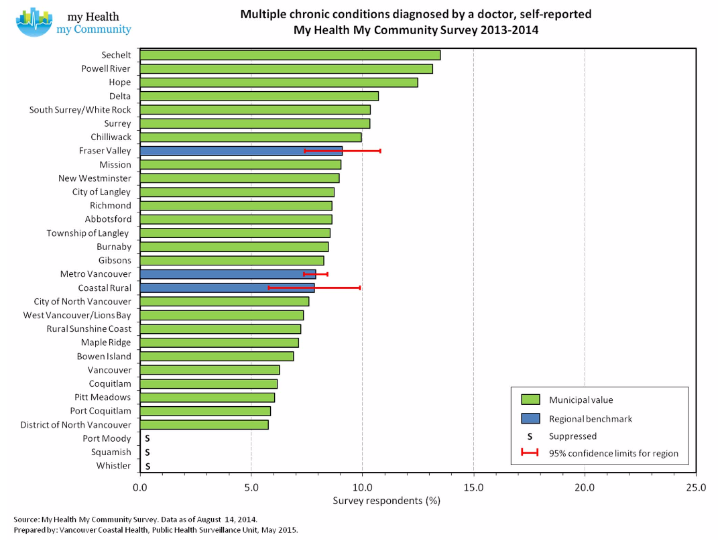
Income Inequity and Chronic Diseases
Notes:
Communities with lower income also have higher prevalence of multiple chronic diseases

Slide 14

Health Equity
Health Equity Assessment Tools
  Fraser Health
    long and short versions
    Implementation in PPH (long version)
  Community
    In development
Policy
  Needs assessment
  Health equity/diversity checklist for clinical policy development
Notes:
SPEAKING NOTES
Health Equity Assessment Toolkit
Both FH tools (long and short versions) have been piloted within PPH (long version) and with other FH programs and PHSA (short rapid tool)
Longer version is currently being implemented within Population and Public Health program, targeting managers and planners. Plans to integrate tool into planning cycles, integrate health equity into performance plans and workforce development (e.g., job descriptions, staff competencies, recruitment)
Community tool – work in progress to either identify an existing tool or develop a tool appropriate for FH Healthier Community Partnership tables to use to apply a health equity lens to their work
IMPACT: increasing -awareness of the tools; dialogue/conversations around health equity; requests to support/build capacity of teams to promote health equity
Policy
Since last year, increasing focus of work on policy
Needs assessment – conducted summer 2015 to assess how much health equity is integrated into existing organizational and clinical policies; recommendations made and moved forward with one of recommendations (develop health equity and diversity checklist for clinical policy development)
Health equity and diversity checklist for clinical policy – status: checklist developed. To be piloted in collaboration with FH’s Professional Practice & Integration group that oversees clinical policy development process
Reviewed FH Diversity Services organizational policy on “Respecting Diversity in Daily Interactions, Care Planning and System Design”
Revised version integrated health equity principles in language and actions that staff, teams and the organization can take
Waiting to Executive approval
Once approved, health equity working group has developed resources/tools that can help to support implementation of the policy (e.g., health equity certification framework that builds on the different training developed by the individual health equity working group members (e.g., trauma informed practice, working with diverse populations, etc)
IMPACT: early stages, difficult to assess at present. However, recognition of need to include a health equity lens in policy by some FH groups and within PPH

Slide 15
Housing and High Health Risk Populations
  Mental health and substance use, youth, Aboriginal, women fleeing abuse, seniors, disabilities, homeless
  Frequent ED users: mental health and addiction issues and complex medical needs and housing issues (homeless)
    Longer hospital LOS and delays in discharge
  Shortage of appropriate housing
Notes:
Frequent ED users: Highest avg # of visits (19-56 per year)

Slide 16
Housing - Current work
Absolute
Homelessness
At-Risk of
Homelessness
Subsidized
Housing
Affordable
Rental
Housing
SRO
Apts
Single
Family
Housing
Streets
Cold Wet
Weather
Emergency
Shelters
Shelters
Couch
Surfing
Supported
Housing;
Transition
House;
Youth Safe
Houses
Independent
Living
  Partnership & collaboration with BC Housing, housing providers, municipalities and non-profit agencies
  Reorienting health services
  Asset mapping
Notes:
SPEAKING NOTES
Due to complex needs of existing clients, majority of needs focussed on the earlier part of the housing continuum (darker green areas)
Shelters
Transition housing
Supportive housing
Independent living, subsidized housing, affordable housing considered only when clients are ready. However, majority of clients are not yet ready.
CURRENT WORK
Partnership & collaboration with BC Housing, housing providers, municipalities and non-profit agencies
- Identify and develop housing opportunities to meet housing and health service needs of high health risk populations (e.g., securing dedicated beds for FH clients at hospital waiting for appropriate housing option – FH would provide required health services to accompany client; early FH engagement and participation in planning and development of new housing sites)
- Build community capacity on Housing First Approach (e.g., education, support in establishing homelessness committees)
Reorienting health services (e.g., increasing NP visits to housing sites to assess/treat/refer vulnerable populations)
Asset mapping: strengths, gaps, opportunities
To assist FH Housing Leadership on prioritizing work in housing
IMPACT: strengthened partnerships with housing providers and BC Housing; dedicated units/rooms secured for FH high health risk populations for safe discharge from hospital with wrap around health services; strengthened alignment and coordination within FH hospital sites and housing providers

Slide 17
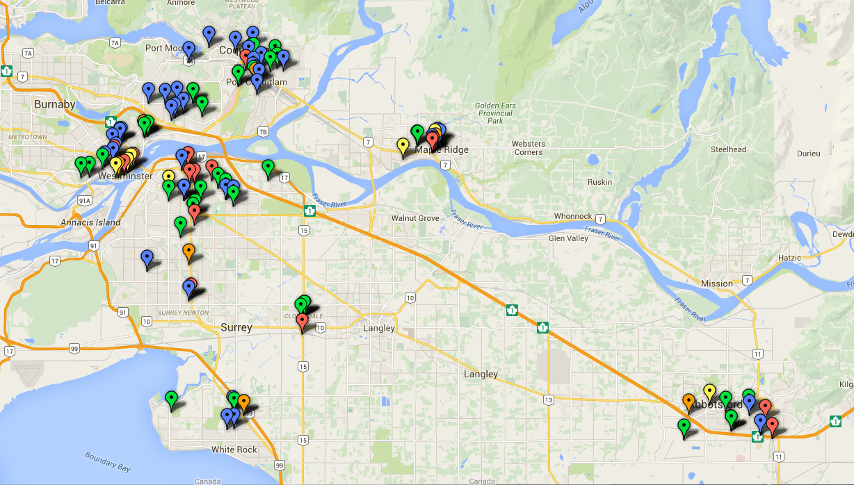
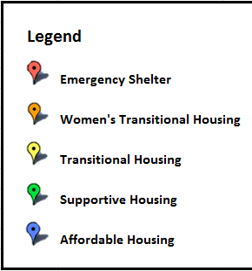

Housing Resources: High Health Risk Populations in Priority Communities: Abbotsford, Maple Ridge, New Westminster, Surrey, Tri-Cities
Notes:
SPEAKING NOTES
Asset mapping currently being done for 5 geographical priorities
Surrey, Abbotsford, New Westminster (regional hospitals located here)
Tri-Cities and Maple Ridge – due to emerging issues/opportunities
Asset map includes current housing resources that would be appropriate for high health risk populations
Shelters, transitional housing, supportive housing
Select affordable housing included for when clients are ready for this type of housing
To assist with identifying gaps, strengths and opportunities within a community
To inform planning and prioritization of work
Major gap: shortage of appropriate housing options in Fraser Health region
FYI:
Definitions
Emergency shelter: Provides temporary shelter, food, and a variety of support services for people who are homeless or at-risk of homelessness (BC Housing, 2016)
Transitional housing: Supportive yet temporary housing that is meant to bridge the gap from homelessness to permanent housing by offering structure, supervision, supports, life skills, education and training (The Homeless Hub, 2016)
Supportive housing: Combines housing with individualized flexible and voluntary support services for homeless individuals and those at-risk of homelessness (The Homeless Hub, 2016)
Affordable housing: Permanent housing provided at a rate of 30% of individuals’ gross monthly income delivered by the private, public, or not-for-profit sector (The Homeless Hub, 2016)
The affordable housing resources indicated on the maps are facilities that contain bachelor or one-bedroom units that may be appropriate for the homeless population. Co-operative housing was not included as applicants must purchase a share in order to apply for units in these developments. The share purchase makes this financially unattainable for the homeless population.

Slide 18
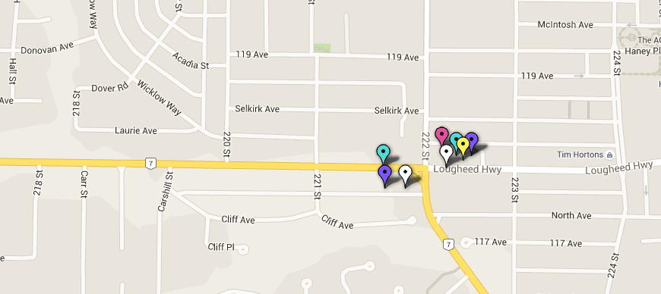
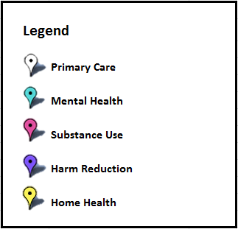
Health Services at Maple Ridge Homeless Shelters
Winter Shelter
- Closing Jun 2016
Caring Place
(year-round emergency shelter)
Working together with BC Housing, Maple Ridge Council and other community partners to identify solutions
Notes:
SPEAKING NOTES
To inform planning around FH health services at housing sites, mapping done to see which services currently are provided at a particular location.
With the example here, Caring Place (run by Salvation Army) – traditionally has used an abstinence-based approach, which would be a housing access barrier for clients who still use substances
With the recent emergent OD issues, Salvation Army will be transitioning to low barrier services at all their facilities across the Province and distribution of harm reduction supplies
FYI
Shelter Resources
The Caring Place (emergency shelter)
Operated by the Salvation Army’s B.C. Division
Year-round emergency shelter and cold, wet-weather beds during winter months
Recently accepting individuals actively engaged in addiction
The Salvation Army will be transitioning to low barrier services at all their facilities across the Province and distribution of harm reduction supplies
One nurse practitioner (NP)
Mental health and substance use services available on-site and referral system
The ACT Team from the Tri-Cities does make visits to the shelter on request
Maple Ridge Winter Shelter (emergency shelter)
40 beds for men and women
Operated 24/7 by RainCity Housing and Support Society
Harm reduction model
Peer Support Program (Fraser Health funded)
Initially slated to close on March 31, 2016
Additional provincial funding granted; will remain open until the end of June 2016
One NP from the Caring Place
Fraser Health MHSU services on-site
Riverstone Mobile Detox

Slide 19
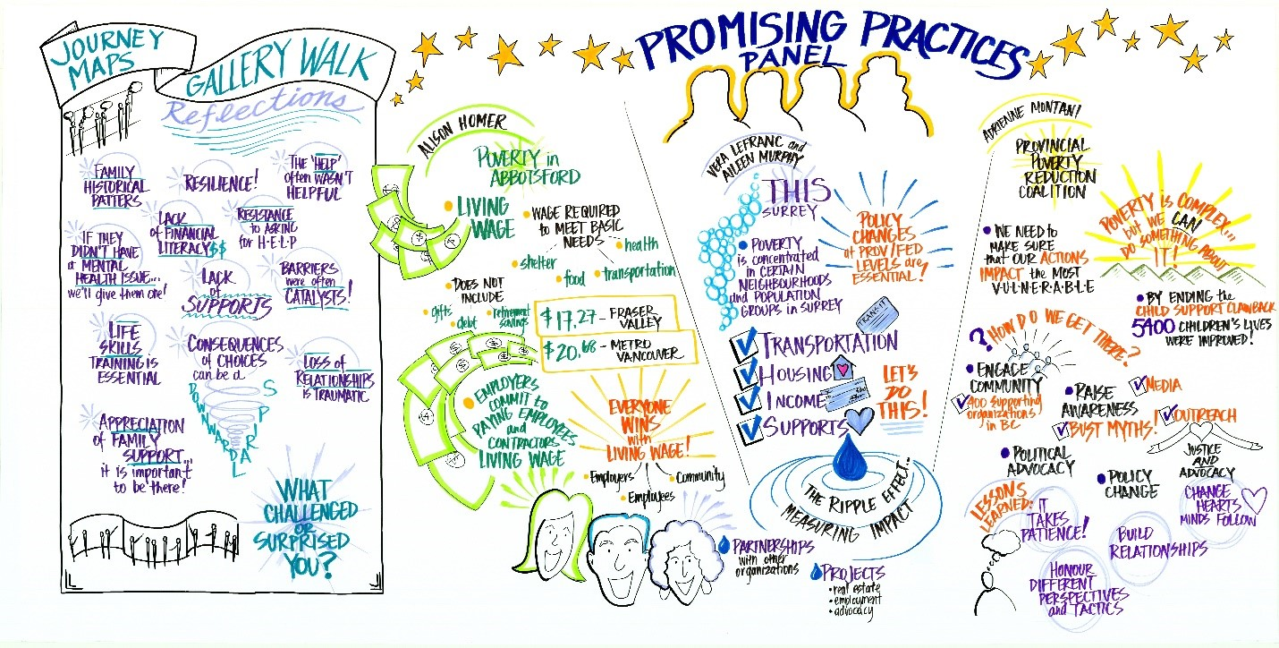
Notes:
This is an example of public health engaging in meaningful partnerships to see policy change … I like to highlight the healthy community partnership work in Langley. Poverty to prosperity came out of this HCP work. The Langley Division of Family Practice supported patient journey map development for youth, senior and a single mom. The division led a community wide workshop reviewing myths and facts (Dr Lee), creating a collaborative vision, hosting a gallery walk on the patient journey maps, identifying and prioritizing the barriers, looking at best practice in our RHA and provincially) and then created Langley community strategies action plan to overcome our barriers. These are the gallery walk and promising practices images that were created. Ellen Peterson (ED Langley Division) and Leo Wong (Board Chair) are present and have copies of the report created for those who may be interested in how they approached this challenge.

Slide 20
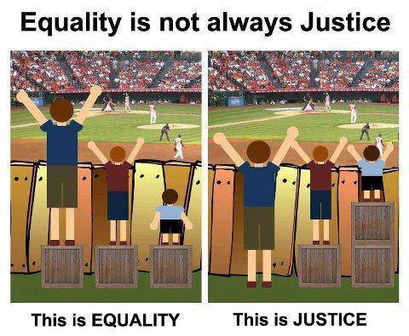
https://fbcdn-sphotos-f-a.akamaihd.net/hphotos-ak-frc3/1395296_10151771684061275_2130663111_n.jpg
Notes:
Equity is about justice, and that doesn’t always mean equality, as this very simple illustration shows that.
You can think of the fence as the minimum acceptable level of health
In the first picture, we are treating everyone equally, but with very different outcomes
In the second picture, we are meeting people where they are at, and that results in all of the individuals reaching that acceptable level of health

Slide 21
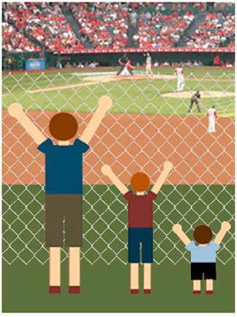
Systems Level Interventions – Thank You!
Notes:
The third image on the right – with systems level interventions (e.g., policy) – remove systems barrier

Slide 22
Acknowledgements
Dr. Victoria Lee, CMHO and VP, Population and Public Health
Samantha Tong, Team Lead, Health Equity and Population Health
Corey Green, Manager, Population Health Observatory
Ellen Peterson, Langley Division of Family Practice

Slide 23
Appendix: Achieving Collective Impact
Common Agenda: Participants have a shared vision for change, a common understanding of the problem, and a joint approach to solving it through agreed upon actions
Shared Measurement: Collecting the data and measuring results consistently across all participants ensures efforts remain aligned and participants hold each other accountable
Mutually Reinforcing Activities: Participant activities must be differentiated while still being coordinated through a mutually reinforcing plan of action
Continuous Communication: Consistent and open communication is needed across the many players to build trust, assure mutual objectives, and create common motivation
Backbone Organization: A separate organization to serve as the backbone for the entire initiative and coordinate participating players
            Source: Hanleybrown et al. Channeling Change: Making Collective Impact Work. Stanford Social Innovation Review, 2012.

Slide 24
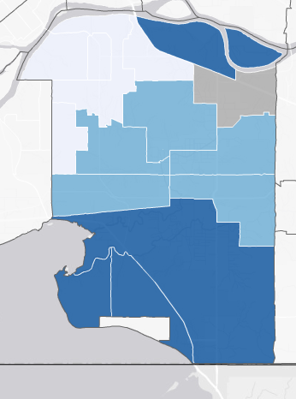
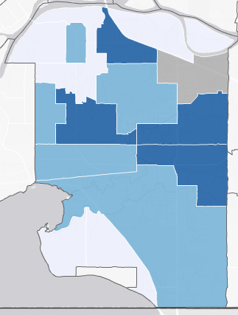
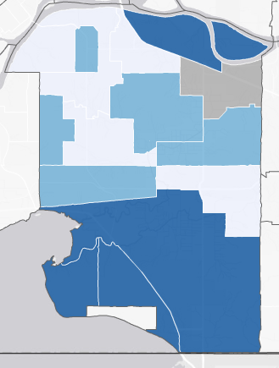
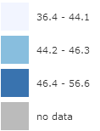
Inequities intersect – Obesity
Body mass index ≥ 30
Surrey
Education – Bachelor's or more
Household Income -$100,000+
Surrey
Surrey
Q1
Q2
Q3
No Data
Notes:
The maps show tertiles of income education and obesity

Slide 25
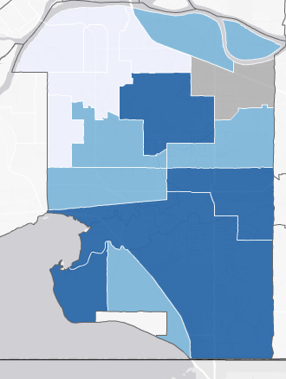
Inequities intersect – Self-reported health
Excellent or very good health
Surrey
Education – Bachelor's or more
Surrey
Household Income -$100,000+
Surrey
Q1
Q2
Q3
No Data
Notes:
The maps show tertiles of income education and obesity

Slide 26
Deprivation Map (2006)
Health Equity Deprivation Index
From “Fraser Health Population Health Analysis” by M. Hayes & O. Amram, p. 8.
Notes:
SPEAKING NOTES
Health equity deprivation index being developed by Population Health Observatory
- Once complete, data can be shared with communities and partners to promote upstream prevention and address social determinants of health and health inequities
The map shows the socio-economic status of the Fraser region from most deprived to least deprived (social and material deprivation).

